Slide 1
Escaping from the iron cage of embedded neoliberal statutes
Geoff Bertram
2 April 2025
We shouldn’t put people in charge of government who don’t believe in government. They fail us every time.

Slide 2
The problem
The body of ideas known as neoliberalism has dominated New Zealand policymaking for two decades following the 1984 election of the Fourth Labour Government.
During those years, several major pieces of legislation, passed by our Parliament, have entrenched neoliberal policy prescriptions on the statute book.
The legacy of neoliberal law continues to put what I call an ‘iron cage’ around policy by tying the hands of Government and the courts.
Breaking out of that cage is extraordinarily difficult so long as much of the public service remains wedded to it and Parliament lacks any clear programme of proposals for post-neoliberal legislation.

Slide 3
A whole generation of New Zealanders have never known what it is like to live in a country where
a Ministry of Works did the heavy lifting in infrastructure
blue-skies scientific work thrived in a not-for-profit Department of Scientific and Industrial Research
state-owned businesses were directed to pursue social wellbeing rather than profit
universities were motivated by scholarship and knowledge rather than profit and property development
there were local democratic elections to, and participation on, Harbour Boards, Education Boards. Hospital Boards, Electricity Supply Authorities and similar agencies
the public service was headed by senior officials who knew first-hand the business of their departments;
monopoly profits were illegal;
and so on.

Slide 4
The essential neoliberal tactic is to embed into statute a series of measures that either directly restrain government from acting, or put it in the position of having to defend itself against charges of “irresponsibility”.
Sometimes just single sections within an Act:
Public Finance Act s26G
State Owned Enterprises Act s.4.
Overseas Investment Act s.17.
Climate Change Response Act definition of net emissions
‘Takings clause’ planned for the Regulatory Responsibility Bill
Other times, entire pieces of legislation:
Commerce Act 1986 eliminates lots of powers and penalties and removed explicit naming of offences, plus allowed monopoly profits and adopted Bork’s version of consumer interests
Public Sector Act 1989 pushed aside professionals and installed managers
Electricity Industry Reform Act 1998
Reserve Bank Act 1989 => monomaniacal focus on inflation and independence from other policy

Slide 5
Three duties of the sovereign
“According to the system of natural liberty, the sovereign has only three duties to attend to; three duties of great importance, indeed, but plain and intelligible to common understandings: first, the duty of protecting the society from violence and invasion of other independent societies; secondly, the duty of protecting, as far as possible, every member of the society from the injustice or oppression of every other member of it, or the duty of establishing an exact administration of justice; and, thirdly, the duty of erecting and maintaining certain public works and certain public institutions which it can never be for the interest of any individual, or small number of individuals, to erect and maintain; because the profit could never repay the expense to any individual or small number of individuals, though it may frequently do much more than repay it to a great society.”
Adam Smith, Wealth of Nations Book IV Chapter ix

Slide 6
The twentieth-century welfare state and mixed economy were an expansive and fruitful reading of Smith
Defence of the realm where necessary
Pursuit of justice for all (and especially for the weak) via redistributive taxes and transfers and effective regulation of monopoly (including restrictions on private property rights)
Public works and public goods, insulated from the profit motive because optimal levels of provision were not profitable and the market would therefore fail to give the best outcomes

Slide 7
The neoliberal view
regards the state as unproductive =>
  only legitimate role is to underwrite property rights and rule of law
  state activities that put a claim on scarce resources reduce social welfare => abolish Ministry of Works, DSIR, Forest Service, etc
  all actual resource-using activity should be private => funder-provider split
  taxes are a coercive taking of private wealth, rather than the price paid to live in a civilised society
acknowledges no motivation for human action beyond self-interest =>
  professional people providing service are just rent-seekers => funder-provider split
  “there is no such thing as society”

Slide 8
Constitutional Political Economy: A project seeking to encode into law or constitutional principles a nexus of restraints on the scope and power of state action
Typical examples:
Budget-balancing rules and limits on public debt
    Public Finance Act s.26
Tight limits on the powers and actions of regulators
    Commerce Act 1986 and the 2008 Amendment
Force productive activities of the government out into the private market
    Privatisation, asset sales, State Owned Enterprises Act 1986
Narrowly restrict monetary policy to inflation-fighting and put it in the hands of an institution separate from government itself
    Reserve Bank Act 1989
Absolutist defence of “property rights” against government “takings”
    Regulatory Standards Bill; Bishop’s RMA reforms
Outsource to the private sector the delivery of public services and then cut them back
    Funder-provider split, long-run goal of privatisation of health and education
Treat government as a business to be operated by managerial elites
    Public Service Act 1989, New Public Management model

Slide 9
Geoffrey Brennan and James M Buchanan The Power to Tax: analytical foundations of a fiscal constitution
“Constraints become much less effective, and may well be evaded, if the motive force behind governmental action is ‘do-goodism’”

Slide 10
Neoliberalism’s statutory legacy: examples
Permanent fiscal austerity and submission to top-down rules: s.26G of the Public Finance Act 1989
Monopoly profiteering is legal and anti-competitive conduct gets a free pass: Commerce Act 1986
Proper cost-benefit assessment of overseas investment in sensitive land is illegal: Overseas Investment Act 2006 ss.16 and 17.
Socially responsible behaviour by SOEs is trumped by the profit requirement: State Owned Enterprises Act 1986 s.4.
Government’s in-house operational capabilities stripped back: Ministry of Works and Development Abolition Act 1988; Crown Research Institutes Act 1992 s.48 (repeal of Scientific and Industrial Research Act 1974).
Public-sector dysfunction flowing from “New Public Management” and “funder-provider split” under the State Services Act 1988

Slide 11
Section 26G of the Public Finance Act 1989
Lays out so-called “principles of fiscal responsibility”
Treats Government as simply a firm or household subject to an externally-imposed budget constraint
Requires debt to be reduced to and held at “prudent Levels” (currently treated as 20-25% of GDP)
Requires the operating budget to be continuously balanced over the medium term
Focuses on Government “net worth” even though Government is inherently a non-market set of activities and the “umbrella for a rainy day” image is pure fiction with no economic substance
Allows only temporary departures from the “principles” and imposes a potentially high political cost

Slide 12
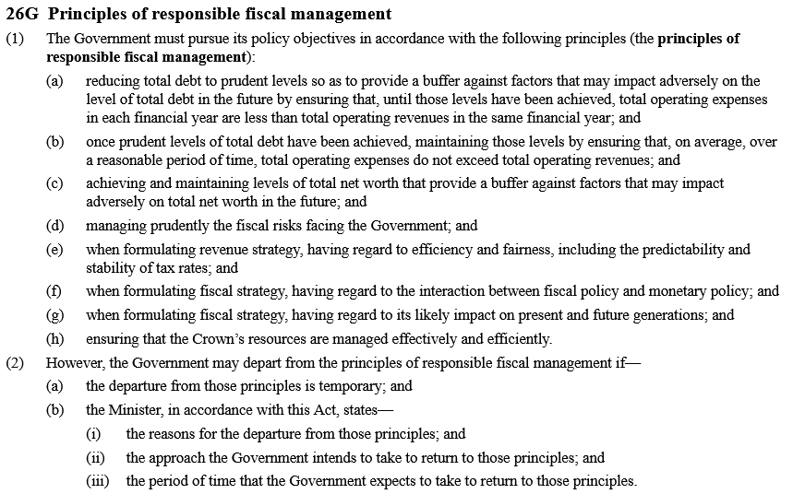

Slide 13

Overseas Investment Act ss.16, 16A and 17
Overseas investors wishing to buy sensitive land are subject to a so-called “benefit to New Zealand test” which is in fact nothing of the sort, but wastes a lot of time and resources.
Section 17 of the Act is carefully worded to prohibit Government Ministers from weighing the costs of a foreign purchase against the benefits. They can consider only the benefits or net benefits.
=> Government in 2018 could not prevent Nongfu Spring from buying-up an artesian water source for a mass bottling plant in 2018, nor in 2020 could it even contemplate preventing Oceana Gold buying a dairy farm at Waihi for conversion to a toxic waste dump
Official advice to Ministers from LINZ in the Whakatane water-bottling case:

Slide 14
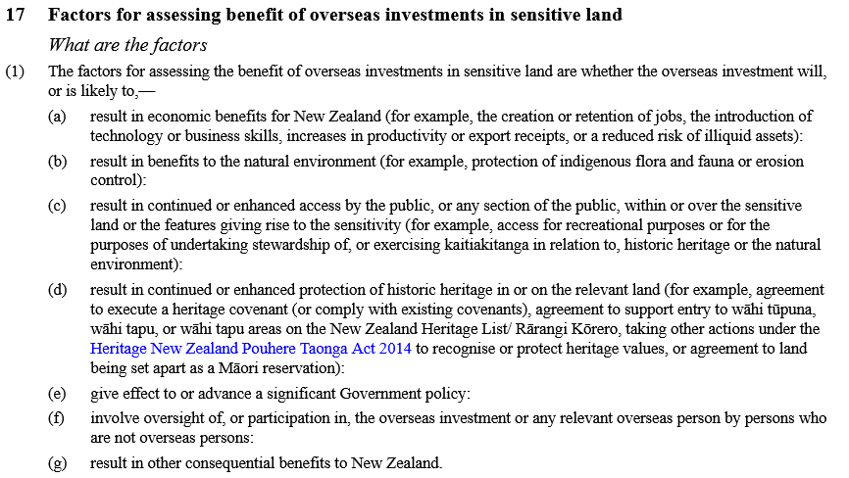
Overseas Investment Act 2006 s.17 as of now

Slide 15
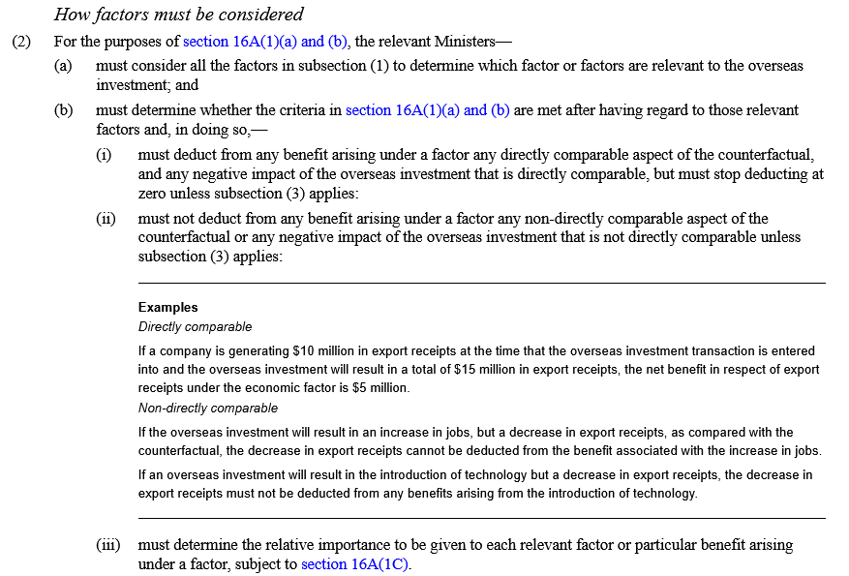
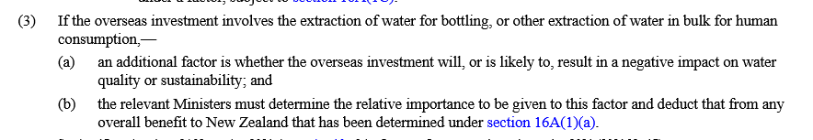

Slide 16
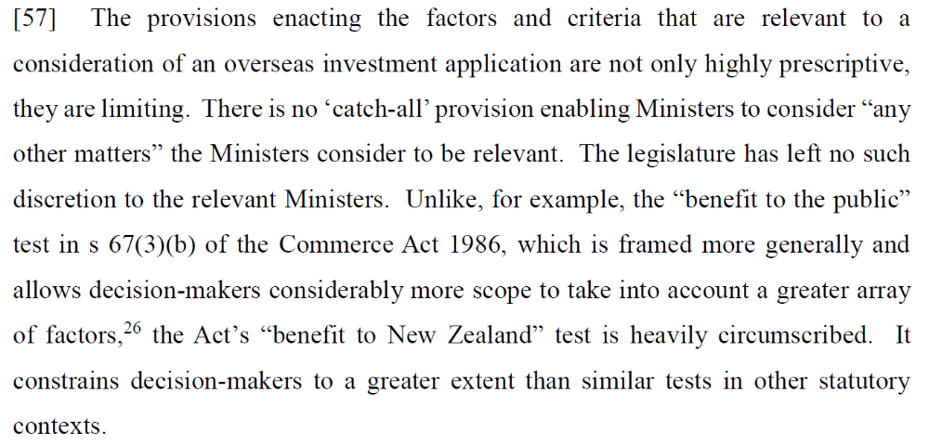
Overseas Investment Act ss.16A & 17 continued…
Coromandel Watchdog v Minister of Finance and Associate Minister of Finance and Oceana Gold, [2020] NZHC 2345 at paragraph 57:

Slide 17
Commerce Act 1986
In its original form
  stripped away old common law protections against monopolies, eliminating the former role of courts and tribunals in regulating prices
  facilitated the consolidation of corporate empires via mergers and takeovers (e.g. the “public benefit test”)
  allowed anti-competitive conduct by large corporations unless they openly revealed that their purpose was to destroy competition
As amended in 2000 and 2008
  Declared the taking of excessive profits even under regulation to be legal – by requiring only that “suppliers of regulated goods or services … are limited in their ability to extract excessive profits” (s.52A(1))[emphasis added]
  Stated that its purpose was to “promote competition in markets for the long-term benefit of consumers within New Zealand” (s.1(A)) – not to provide consumers and small enterprises with immediate protection against monopolistic predation. No definition of “long term benefit” was provided.

Slide 18
Some suggested changes
Put teeth back into anti-trust policy
Resurrect some of the Commerce Act 1975’s blunt prohibition of profiteering, its quick-response provisions for inquiring into possible cases of abuse of market power, and its specific criminal penalties
Put the interests of New Zealand consumers explicitly at the centre of the law as the overriding goal to which other goals are subsidiary. A new “purpose statement” is needed without weasel words.
Make the taking of excess profits illegal, except where clear evidence can be presented to justify a greater return. That would put the burden of proof where it belongs – on the profit-taker.
Specify forms of anticompetitive conduct that are proscribed (as in Part II of the 1975 Act).

Slide 19
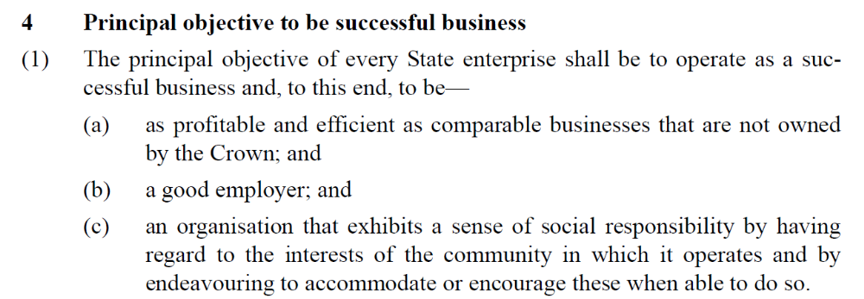
State Owned Enterprises Act 1986 s.4:
Social responsibility is allowed only when it contributes to profit. That’s the significance of the words “to that end”.
Wellington Regional Council v Post Office Bank Ltd, High Court, Wellington, 22 December 1987, CP 720/87, Greig J.
“The formal separation of commercial and social objectives envisaged in the SOE Act has resulted, in practice, in the negation of social objectives. This … was an important step on the way to privatisation.”
Taggart, M., Corporatisation, privatisation and public law Auckland: NZ Legal Research Foundation Occasional Paper 31, 1990, http://www.nzlii.org/nz/journals/NZLRFOP/1990/31.html p.2.)

Slide 20
SOE Act continued
The common-law duties of a monopoly supplier were extinguished by the Act: “It is not a case where Parliament would have intended the powers of this new commercial entity would be limited by ancient doctrine ...The modern controls are commercial and political. Any former common law disability - if such ever existed - no longer applies”
(McGechan J in Federated Farmers of New Zealand (Inc) v New Zealand Post Ltd, High Court, Wellington, 1 December 1992 CP 661/92, p.20. See S. Mataga “Case Notes” Auckland University Law Review 7(2): 430-434.)
So when KiwiRail refuses to preserve and complete the electrification of the Main Trunk line, and NZ Post closes down branches and removes mail boxes from suburbs, and Airways NZ withdraws control-tower services from airports, they are just obeying their statute.
Creation of new Crown entities such as Kainga Ora has been an ad-hoc response that leaves the original statute standing.

Slide 21
SOE Act continued…
What to do?
Either dump it
or rewrite it with a wellbeing objective instead of profit.
State ownership with no social purpose does not make sense.

Slide 22
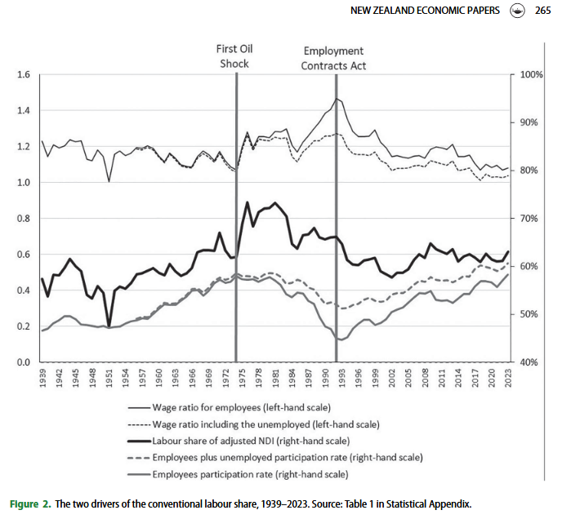
… then there’s the long shadow of the Employment Contracts Act 1992…….
Geoff Bertram and Bill Rosenberg, The Employment Contracts Act 1991 and the labour share of income in New Zealand: an analysis of labour market trends 1939–2023, New Zealand Economic Papers Vol. 58, No. 3, pp.261–287, 2024.

Slide 23
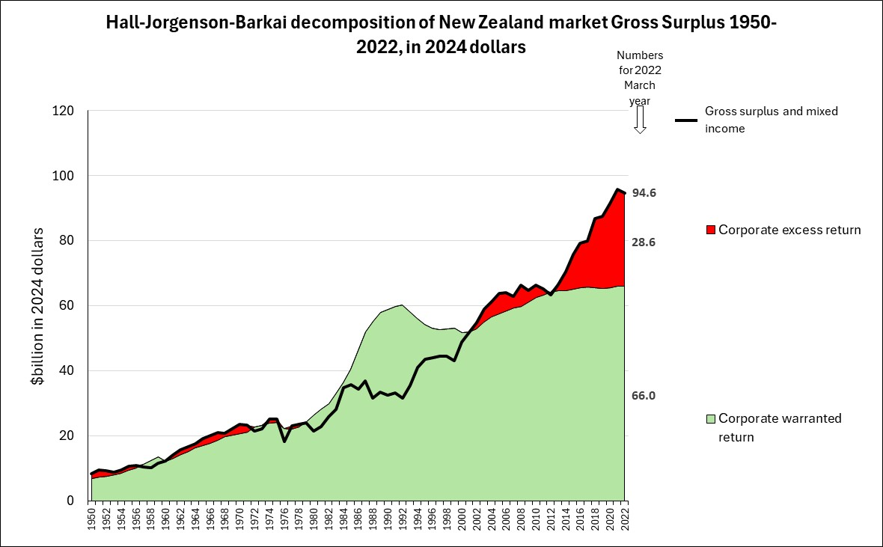
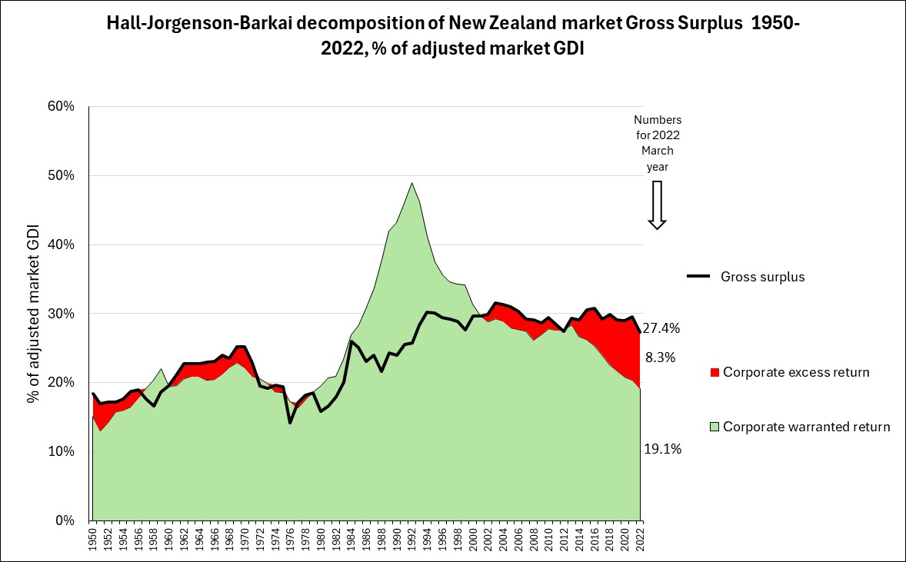
… and the distributional consequences of weak regulation of monopoly
Geoff Bertram and Bill Rosenberg, Distribution of the total product in New Zealand since 1939, forthcoming

Slide 24
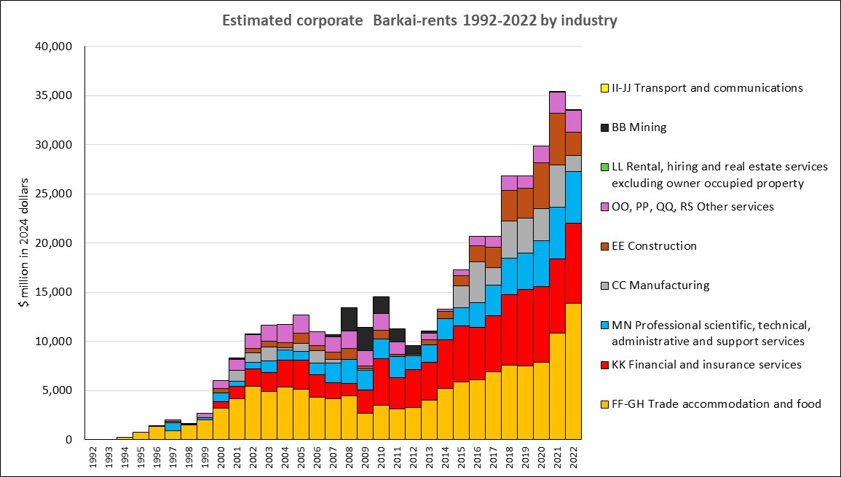

Slide 25
Polarisation between the self-employed and wage and salary workers
Real average annual incomes in March 2024 dollars
Onset of mass unemployment

Slide 26
Where to from here?
Creating avenues of escape from the iron cage involves a careful, strategic process of weeding out the poison pills that have been built into our laws and our policy processes
A slow, steady process of picking up the pieces while holding onto the genuine gains of the past three decades
Get rid of specific provisions and structures that
  block Government from moving in a progressive direction,
  block our courts from applying time-tested common law principles,
  load our public sector with too many well-paid but unproductive and self-serving career managers,
  cripple the provision of many collectively-funded services by imposing a model of arms-length contracting when integrated supply chains would perform better

