Slide 1
Competition for the electricity market
Geoff Bertram
Talk to Engineers for Social Responsibility
15 July 2026

Slide 2
Rhetoric versus reality
Endless talk about “competition” and “efficiency”
Reality: minimal competition and no obvious efficiency gains (dry years as bad as ever, for example)
Reasons:
  Gentailers simply match their retail sales volumes to their generation capacities, so no incentive to change market shares
  Fringe retailing is constrained to 10% or less of the market by standard anti-competitive tactics
  Regulators work within impoverished intellectual frameworks that protect monopoly profits and asset values
  Politicians captured/indoctrinated by industry lobbyists and associated “consultants”

Slide 3
My 2020 ESR presentation did the critique
That’s at https://youtu.be/bX0j1RvsBYk
An updated version from a presentation a couple of weeks back is at https://www.youtube.com/watch?v=VS_Bl2_OmGk and https://geoffbertram.com/wp-content/uploads/2026/06/waikato-wellbeing-june-2026.pdf .
Today is new stuff: basic economics of competition for a market, and design of institutions to match the new technological frontier
Start with the “bucket diagram” as a key analytical tool

Slide 4
Bucket diagram example: allocating scarce hydro water between two periods: competitive with zero discount rate
Price in period 1
Price in period 2
Demand curve in period 2
Demand curve in period 1
For the model setup and equations see Finn R. Førsund, Hydropower Economics, New York: Springer International Series in Operations Research and Management Science, 2007, Chapter 2.
p₁
p₂
Generation in period 1
Generation in period 2
q_{s}
Total available water

Slide 5
Market power and market failure: Monopolist with no reservoir constraint (Førsund 2007 Chapter 8)
Price in period 1
Price in period 2
p_{1m}
Demand curve in period 1
Marginal revenue 1
Increased revenue
Demand curve in period 2
Water use is shifted away from the period with lower demand elasticity, to increase profit
Marginal revenue 2
p₁
p₂
Lower revenue
p_{2m}
Generation in period 1
Generation in period 2
q_{m}
q_{s}
Total available water

Slide 6
Modelling competition for the market: two close-substitute upward-sloped supply curves
Price
Optimum and equilibrium when supplier 1 supplies OA and supplier 2 supplies O’A
Price
Supplier 1 (origin O)
Supplier 2 (origin O’)
p
O
A
O’
Total quantity demanded is OO’
Geoff Bertram Institute for Governance and Policy Studies
6

Slide 7
Turn now to natural monopoly (e.g. electricity transmission and distribution networks) with economies of scale: two identical firms enter and compete for market dominance
Firm 1’s supply cost
Firm 2’s supply cost
Not an equilibrium where the curves cross!
Firm 1’s Average Cost curve
Firm 2’s Average Cost curve
p₂ if Firm 2 wins
p₁ if Firm 1 wins
Winner takes all!
If no entry barriers, contestability (permanent threat of entry by the other firm) holds price down to p₁=p₂
Firm 1’s quantity supplied
Firm 2’s quantity supplied
Total market demand (assumed fixed and given)

Slide 8
Apply that model to the 1992 Energy Companies Act’s corporatisation of Electricity Supply Authorities, and revaluation of assets to “Optimised Deprival Value” (ODV)

Slide 9
Suppose Firm 1 is an existing supplier whose asset base is fully written-down so only current operating costs have to be recovered
Firm 1’s supply cost
Firm 2 is a hypothetical new entrant setting up from scratch
Firm 2’s supply cost
Firm 2’s Average Cost curve
Firm 1 revalues its assets up to match the amount Firm 2 would have had to install, and raises price to p₂ to get “fair return” on “fair value”
p₂ is the “contestability” limit on Firm 1’s price and profit
p₂
Firm 1’s Average Cost curve
p₁ is just opex
Firm 1’s quantity supplied
Firm 2’s quantity supplied
Total market demand (assumed fixed and given)

Slide 10
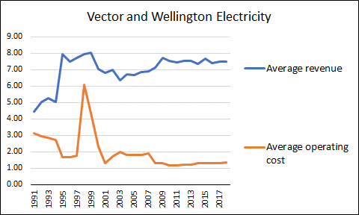
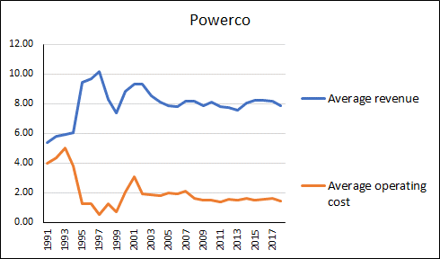
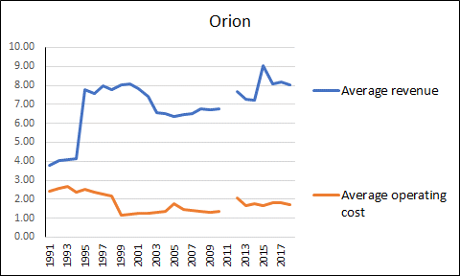
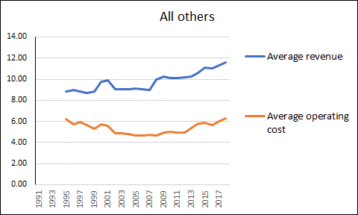
Lines networks, increased markups 1991-2018, in 2018 cents per kWh
Key message: lowering aggregate lines charges will hinge on reducing asset valuations
The economic value of the assets is their scrap value (byegones are byegones for highly-specific fixed assets )

Slide 11
Specific assets are specialized resources, investments, or skills that hold significantly higher value in a particular transaction or relationship than they would if redeployed for any other purpose.

Slide 12
For established natural monopoly firms, “competition for the market” can’t force their asset values and prices below the contestability entry price
(Bundling the assets into a firm that faces competition can change the game because of scope for internal cross-subsidisation – to come, later on)
But regulation can force asset values and price down to reflect true opportunity costs
Turn now to generation, which has upward-sloping supply curves, as a new technology enters with its costs steadily dropping over time

Slide 13
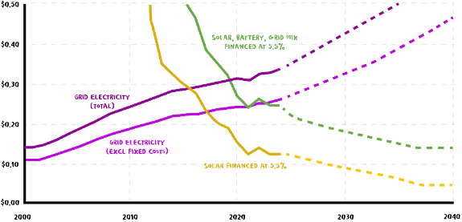
Solar versus grid electricity cost trends over time
Source: Mike Casey of Rewiring NZ, Newsroom 4 February 2026

Slide 14

Competition for a “normal” market as a competing supplier’s costs come down
Total demand
New industry is not competitive at this level of long-run marginal cost
Existing industry cost cents/kWh
Incumbent supply curve
New industry cost cents/kWh
$$O_{ }^{x}$$
O
Output of the existing industry measured in this direction
Output of the new industry measured in this direction

Slide 15
Competition for a “normal” market as a competing supplier’s costs come down
Total demand
New supplier supply curve
New industry is competitive
at this level of cost
Existing industry cost cents/kWh
Incumbent supply curve
New entrant market share grows …
New industry cost cents/kWh
$$O_{ }^{x}$$
O
Output of the existing industry measured in this direction
Output of the new industry measured in this direction

Slide 16
Competition for a “normal” market as a competing supplier’s costs come down
Total demand
New supplier supply curve
Existing industry cost cents/kWh
Incumbent supply curve
New industry cost cents/kWh
… and grows
$$O_{ }^{x}$$
O
Output of the existing industry measured in this direction
Output of the new industry measured in this direction

Slide 17
Competition for a “normal” market as a competing supplier’s costs come down
Total demand
Existing industry cost cents/kWh
Incumbent supply curve
New industry cost cents/kWh
New supplier supply curve
… and grows
$$O_{ }^{x}$$
O
Output of the existing industry measured in this direction
Output of the new industry measured in this direction

Slide 18

Competition for a “normal” market as a competing supplier’s costs come down
Total demand
P_{h}
Incumbent assets stranded => value written down
Crucial point here: the price comes down because the new entrant is outside the incumbents’ supply curve and capturing market share from them
Of course, if demand expands as fast as new supply enters, then the game changes (next slide)
Existing industry cost cents/kWh
Incumbent supply curve
New industry cost cents/kWh
New supplier supply curve
… and grows
$$O_{ }^{x}$$
O
Output of the existing industry measured in this direction
Output of the new industry measured in this direction

Slide 19






If demand expands as fast as the new outside supply then the incumbent firms can preserve their shareholder value while losing market share – but this requires either segmenting the market or taking control of the outside supply to bring it in-house
Here’s the segmented market model, where a lot of prosumers go off-grid and get power at P_{x} while existing grid-connected customers continue to pay P_{I} (or contract discounts off P_{I})
Existing industry cost cents/kWh
P_{I}
P_{x}
O
$O_{1}^{x}$
$$O_{2 }^{x}$$
$$O_{3 }^{x}$$
$$O_{4 }^{x}$$
$$O_{5 }^{x}$$
$$O_{6 }^{x}$$
GWh

Slide 20
If demand expands as fast as the new outside supply then the incumbent firms can preserve their shareholder value while losing market share – but this requires either segmenting the market or taking control of the outside supply to bring it in-house
D1
D2
D3
D4
D5
D6
Here the incumbents install the renewables themselves and keep the price up and take big rents on the new tech
This is no longer competition for the market, and the outcome is quite different!
Existing industry cost cents/kWh
P_{I}
O
GWh

Slide 21
Using the bucket-diagram model for competing supply technologies 1: Central supply dominant as now
Supply price of grid-connected generation
Supply price of distributed technology
Rectangular hyperbola (Transpower’s regulated allowed average revenue as quantity changes)
p_{d}
Cost of wind and solar c1990
p_{g=}p_{w+}p_{t}
p_{t}
Transpower’s recoverable grid revenue (set by Commerce Commission)
Gentailers’ wholesale revenue (price x quantity)
Total price of grid supply
p_{w}
Total market demand for electricity per period assumed fixed (inelastic)

Slide 22
Using the bucket-diagram model for competing supply technologies 2: Distributed supply becomes competitive
Supply price of grid technology
Supply price of distributed technology
Cost of wind and solar c1990
p_{g=}p_{w+}p_{t}
p’_{d}
p_{t}
Transpower’s recoverable grid revenue (set by Commerce Commission)
Cost of wind and solar c2022
Gentailers’ wholesale revenue (price x quantity)
p_{w}
Total market demand for electricity per period assumed fixed (inelastic)

Slide 23
Now the market design comes to the fore
Initially suppose that grid charges continue to be passed through to consumers’ daily connection charges as at present, and that rooftop solar etc stay connected to networks

Slide 24
Using the bucket-diagram model for competing supply technologies 3: Distributed supply becomes competitive [abstracting from local network costs] and prosumers stay connected
Supply price of grid technology
Supply price of distributed technology
The connected prosumer pays
p”_{d} + p_{t} < p_{g} which is effectively a cross-subsidy to their competitor
Market price stays the same while gentailers’ asset values fall
p_{g=}p_{w+}p_{t}
p_{t}
Transpower’s recoverable grid revenue (set by Commerce Commission)
Gentailers’ wholesale revenue (price x quantity)
Saving
Cost of wind and solar
p”_{d}
p_{w}
Prosumer supply cost
Total market demand for electricity per period assumed fixed (inelastic)

Slide 25
Using the bucket-diagram model for competing supply technologies 4: Distributed supply gains market share and prosumers go off-grid (or don’t pay grid charge)
Supply price of grid technology
Supply price of distributed technology
Price to other consumers goes up to p’_{g}>p_{g}
Distributed market share = installed capacity
Adding grid charges would prevent price increase but make connected prosumers uncompetitive
p’_{g=}p_{w+}p’_{t}
p’_{t}
Transpower’s recoverable grid revenue (set by Commerce Commission)
Cost of wind and solar +battery
p”_{d}
Gentailers’ wholesale revenue (price x quantity)
p_{w}
Total market demand for electricity per period assumed fixed (inelastic)

Slide 26
Using the bucket-diagram model for competing supply technologies 5: Getting serious
Supply price of grid technology
Supply price of distributed technology
Distributed market share ≤ installed capacity
p’”_{d} could be the price of stand-alone supply (rooftop solar + battery), or rooftop etc generation cost + local lines charges in an energy community.
p”_{g=}p_{w+}p”_{t}
p’”_{d}+p”_{t}
Even with grid charges added, grid assets would be stranded
Transpower’s recoverable grid revenue (set by Commerce Commission)
p”_{t}
Gentailers’ wholesale revenue (price x quantity)
p’”_{d}
Cost of wind and solar c2035, say
p_{w}
Total market demand for electricity per period assumed fixed (inelastic)

Slide 27
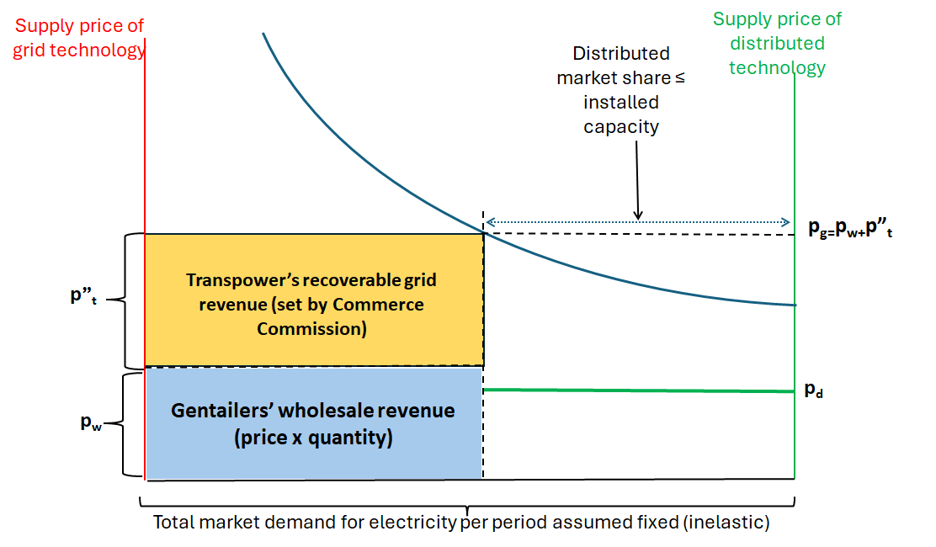
A different price formation process: commercial distributed supply matches the price of grid supply but doesn’t pick up grid charge
Gentailers’ reduced market share
Profits to commercial solar, wind and batteries
Market price has gone up, not down, with entry of low-cost renewables
p_{g=}p_{w+}p_{t}
The reason is that Transpower’s total grid charges have stayed the same while average grid charge has increased

Slide 28
Market architecture

Slide 29
The crucial market interface is shifting
Currently the system is coordinated and priced at the top
  wholesale spot market to price grid-connected generation at the margin
  Transpower system operator to coordinate dispatch and calculate nodal prices of delivered wholesale power
The future challenge is optimal coordination of grid-connected (remote) generation and transmission with distributed generation which does not require transmission
Present operating and pricing policies are designed to perpetuate dominance of remote generation and the grid

Slide 30
The new competitive threat
With no effective competition in the market, the incumbent firms have been secure in their excess profits and inflated asset values – but only so long as they face no competition for the market
The technology frontier has shifted in favour of (i) smaller scale generating units and (ii) dispersed generation rather than huge centralised/remote plant
For the incumbent cartel the big threat lies in an outside challenge from new entrants that can undercut monopoly prices
The strategic goal for both industry dominant firms and their captive regulators is to block or at least restrict the inroads of distributed generation into their market.

Slide 31
Function of a “pool” and pool operator
A pool exists to aggregate wide-ranging independent sources of electricity supply on the basis of merit order, into an optimal supply bundle that is then priced to recover all supply costs not otherwise covered.
In traditional top-down supply chains the pool is located at the point of entry into the grid. A fleet of remote generators are dispatched in merit order to inject power into the grid which then delivers that power to direct-supply customers and distributors.
Pricing flows down the chain: wholesale spot price for remote generation, marked up for grid charges, then marked up again for distribution and retail before delivery to final consumers.
That pricing set-up can become dysfunctional in the presence of a rising amount of distributed generation – especially if (as in NZ) the price structures for remote generation and transmission are designed to protect incumbent monopolists on the “upstream” side of the market.

Slide 32
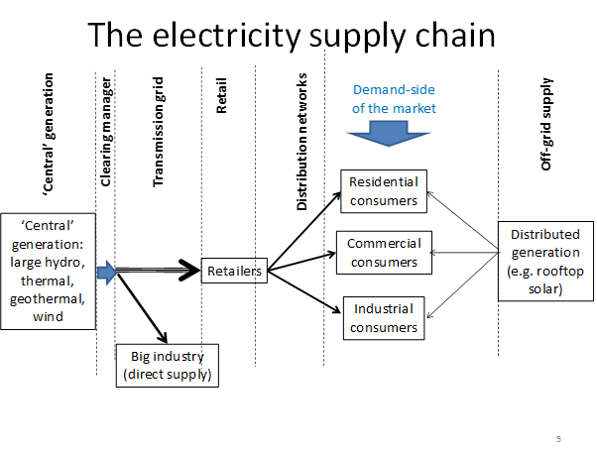
Antitrust problems at every step
Ricardian rents, carbon rents, market manipulation rents
Natural
monopoly
(revaluation)
rents
Ramsey pricing shifts the burden onto residential consumers
Predatory pricing and captured regulators combine to obstruct rooftop solar etc
Natural
monopoly
rents
Vertical integration rents

Slide 33
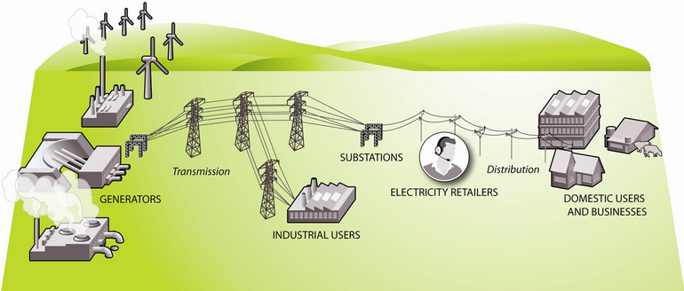
Here’s the official MBIE picture of the industry with no distributed supply whatever
Top-down one-way story with market power exercised upstream
The system operator is here
https://www.mbie.govt.nz/building-and-energy/energy-and-natural-resources/energy-generation-and-markets/electricity-market/electricity-industry/ copied 4 May 2023.

Slide 34
Here’s an alternative vision

Slide 35
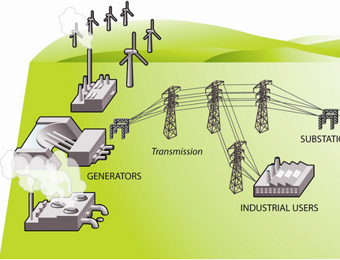
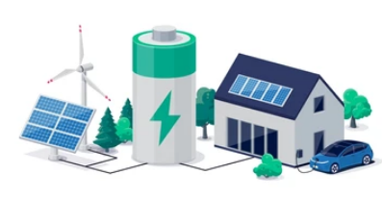



Central/remote generation and transmission
Energy community
Distributed generation
Local distribution network and independent retailers
DOMESTIC USERS AND BUSINESSES WITH NET METERS
Retailers purchase wholesale supply here here
Homes
Local aggregator/pool with battery to smooth load fluctuations
Industry
System operator/single buyer of remote power operates here
Farms

Slide 36
“Single buyer” at the GXP could act as wholesaler to the local network market?
Could be the role of re-shaped supply authorities with a non-profit mandate
Retailers on each network would then combine grid wholesale supply with distributed local supply and average-out the costs in their retail pricing; competition then would tend to make full use of lower-cost distributed renewables and call on the grid for residual supply => gentailers would face “residual demand”
That would possibly give a signal for hydro rescheduling to operate as backstop [but market design here would be crucial, assuming re-nationalising heritage hydro is ruled out]

Slide 37
With wholesale market action at the grid exit point
Distribution lines network as an open-access platform => DG would compete head-to-head with remote generation delivered off the grid
Two possible changes to the current set-up:
  Break the vertical integration of generation and retail to open the way for independent retailers to source electricity from the lowest-cost source;
  Bundle transmission charges with the spot market wholesale price – not with distribution network fixed charges (perhaps with a smaller charge on local connections to reflect actual benefits of connection???). I.e.go back to BST.
Transpower would be threatened if demand fails to grow and small-scale wind and solar economics continue to improve
  Some stranding => write-downs is desirable (how much?)

Slide 38
Wrinkles
Implies decentralised local system operation and coordination, weighing-up the competing sources of supply into each local network maintaining some sort of merit order.
The relative supply costs of grid versus distributed supply will differ by locality which implies the optimal supply mix will be unique to each distribution network
Assume that distributed supply is absorbed into the local network up to that network’s physical constraints; the call on grid supply at Grid Exit Points would then be the residual demand after cost-competitive distributed supply has been utilised
Assuming that competing independent retailers are (a) taking distributed supply via their contracted prosumer meters, while (b) drawing on wholesale grid supply to make up their total demand volumes, then some agent would have to be active downstream of (or at) the Grid Exit Point to coordinate the aggregate residual demand on the grid
At the grid centre, the high-level system operator would have a complex coordination problem, with heritage hydro assets being managed (within their physical constraints) to counter the intermittency of demand at Grid Exit Points
Handling this through the current market mechanism would require financial compensation for the new role assigned to heritage hydro unless the heritage hydro assets are transferred back to public ownership and placed under the system operator’s direct control (but that is politically tough, albeit probably the best long-run solution)

Slide 39
In the current reality, the two components of delivered wholesale price are not bundled but instead arrive through separate billing arrangements
Transpower charges are picked up, and passed through to final consumer bills, by distribution lines companies
  So rising DG market share does not reduce grid charges – it is apt to push up price to final consumers unless demand is growing fast enough
Energy price is borne and passed through by retailers
  DG operators therefore compete only against the wholesale spot price and get no reward for avoided grid charges
Retailers are vertically integrated with generators and have incentive to pay minimal amounts for purchased DG power
Result is a set of incentives that deter DG expansion

Slide 40
In that set-up, if DG were to instal enough capacity to take the community off-grid, the grid charge would disappear [from the local point of view] and delivered price in the local market would fall (under competitive conditions)
But would it fall enough to compensate for the loss of grid backup and security?
Write-down of the grid’s asset valuation would bring more DG into the picture while keeping the benefits of grid connection
Problem: current protection of grid asset value by imposition of fixed charges brings closer the trigger point where going off-grid is the better option
Maybe stranding Transpower may be the sensible consumer-focused strategy to break its market power and could even (in a second-best or third-best world) be socially optimal?
But better by far would be for Government and regulators to drop their protection of monopolistic pricing, gold-plated asset valuations, and anticompetitive market conduct

Slide 41
New Zealand wholesale market price is set at the margin by Huntly-equivalents
Price
Huntly sets the price at the margin of the market
P_{mc}
Supply
P_{L}
Demand
Q_{E}
Volume

Slide 42
Curtailment: suppose entry of distributed renewables is confined within the existing market model
Demand
This excess supply has to be curtailed to balance the market
Price
The diagram is effectively averaging over periods of scarcity and abundance, with excess “faceplate” capacity in wind and solar that is fully utilised only part of the time
P_{mc}
Supply
P_{L}
Q₁
Q₂
Volume

Slide 43
The rules for who gets curtailed clearly depend on the market structure after entry of distributed renewables
Transpower and gentailer incumbents assume they get scheduled as usual while the distributed solar and wind get curtailed by the local network operator, under the general heading of “demand management”, directed from the centre by the wholesale system operator and implemented at local level by distribution companies.
But the heritage hydro assets are the prime potential source of battery-type firming for intermittent distributed renewables => there’s a case for systematically curtailing hydro output when there’s an abundance of sun and wind and giving those renewables first place in the dispatch queue
We’ve done some modelling of this, looking at physical stocks and flows.

Slide 44
Other elements of pricing
Network service could possibly be priced for cost recovery under some political or regulatory constraint (such as the old elected EPB boards)
Retail services would have a competitive market price
Distributed supply could well have to face some sort of administered price, given that it is a mix of commercial enterprises and lifestyle household installations with an implicit reservation price of zero for surplus power.
How the feed-in tariff rate gets set is thus an interesting design issue;
  One possibility: individual retailers bid for household supply, establishing a sort of competitive market price
  Another possibility: a regulator either sets the price at which all retailers purchase from households and other distributed producers, or sets the bounds within which power purchase price has to fall
  Or a development from the status quo: a price is set for grid supply, and distributed supply is priced to parity, with appropriate discounts and/or top-ups. That would leave price-making power with the gentailers and Transpower => the benefits from lower LRMC of distributed renewables might be suppressed
  The commercial (as distinct from lifestyle) viability of small-scale distributed generation such as rooftop solar and small windfarms is quite sensitive to the price structure facing households: for example, the Labour Government’s decision removing low-fixed-charge regulation was a quick way to make rooftop solar less economic.

Slide 45
Summary: the new technologies open up a wide range of new options for consumers both individually and as local collectives
Essentially, in the long run each consumer can choose between living off-grid or with grid connection
To keep grid connection the preferred choice, grid electricity has to be priced competitively and offer added value compared with stand-alone individual or community prosumers
That cannot be achieved with the present asset valuations of gentailers and Transpower => some mechanism for write-offs is required
The market will eventually do this – by simply stranding un- or under-utilised assets
Incumbent industry players will obviously want taxpayers to pick up the cost (the usual socialise-the-losses model after decades of profiteering)
The politics are not easy!

