Slide 1
How NZ's electricity market could be improved to give us better prices
Geoff Bertram
23 April 2026

Slide 2
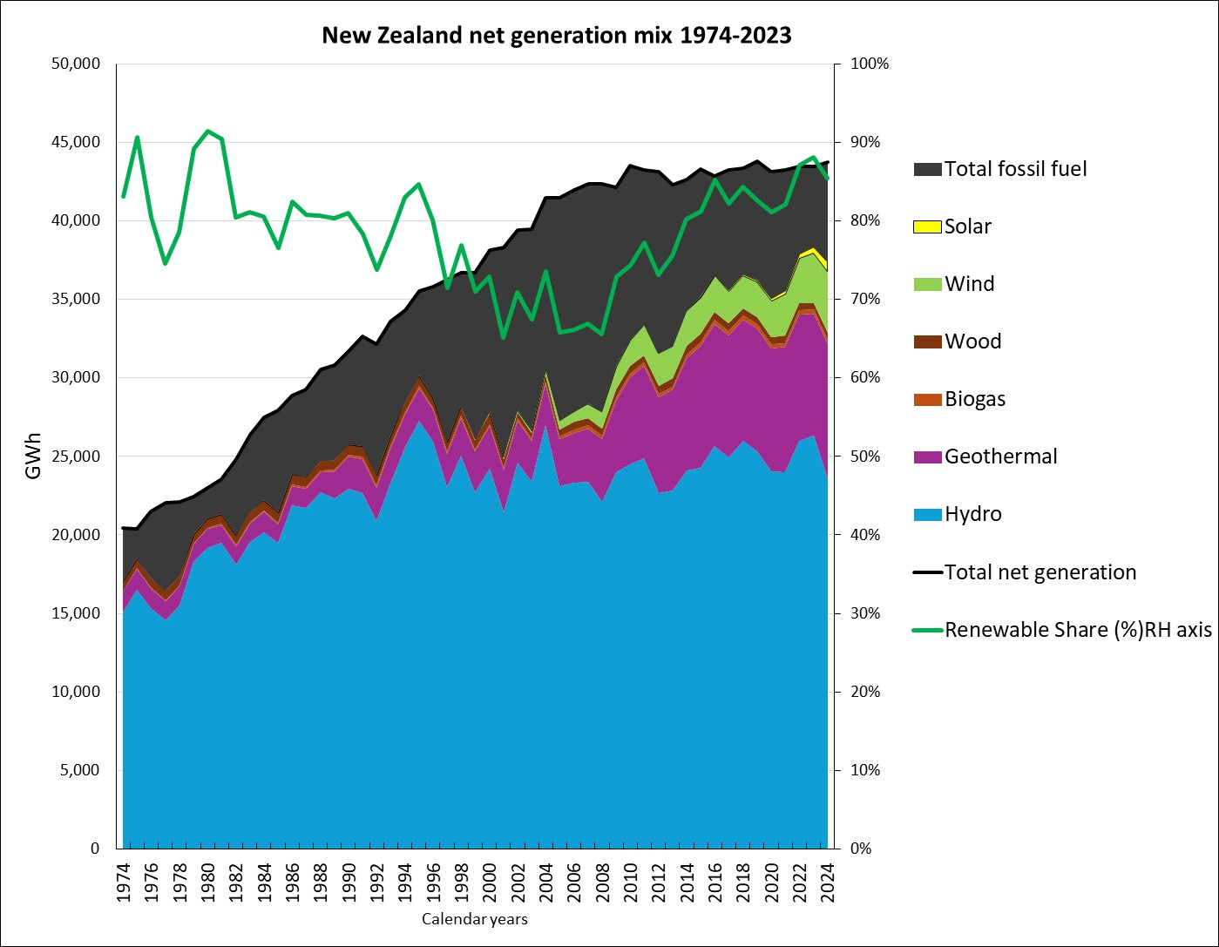
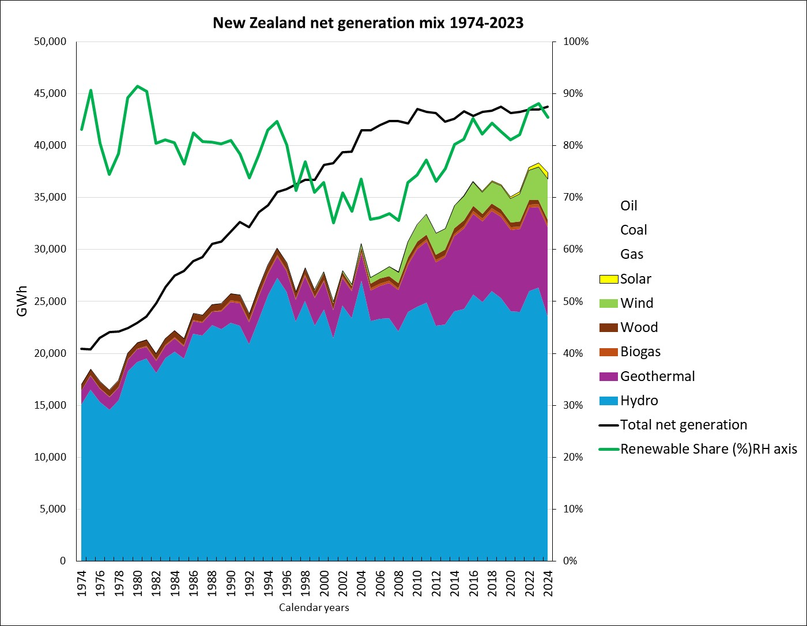
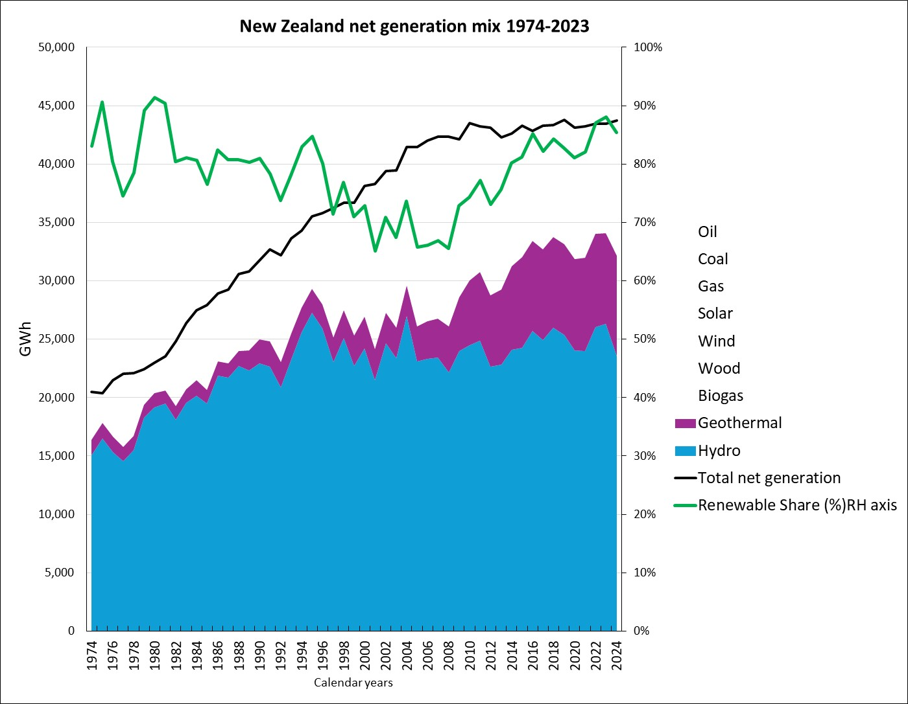
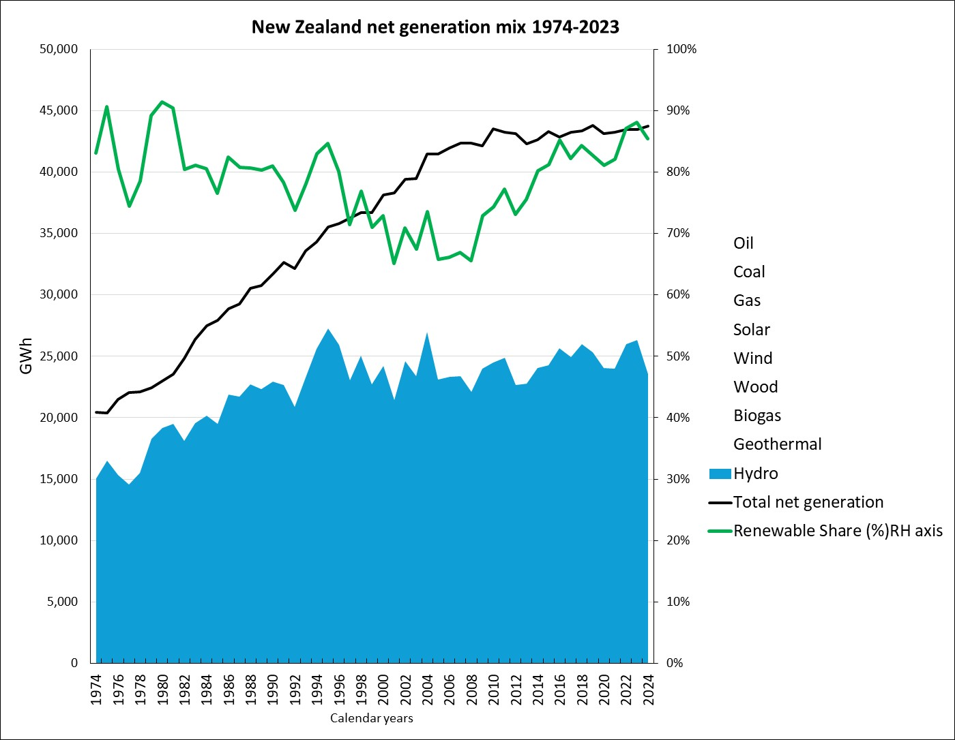
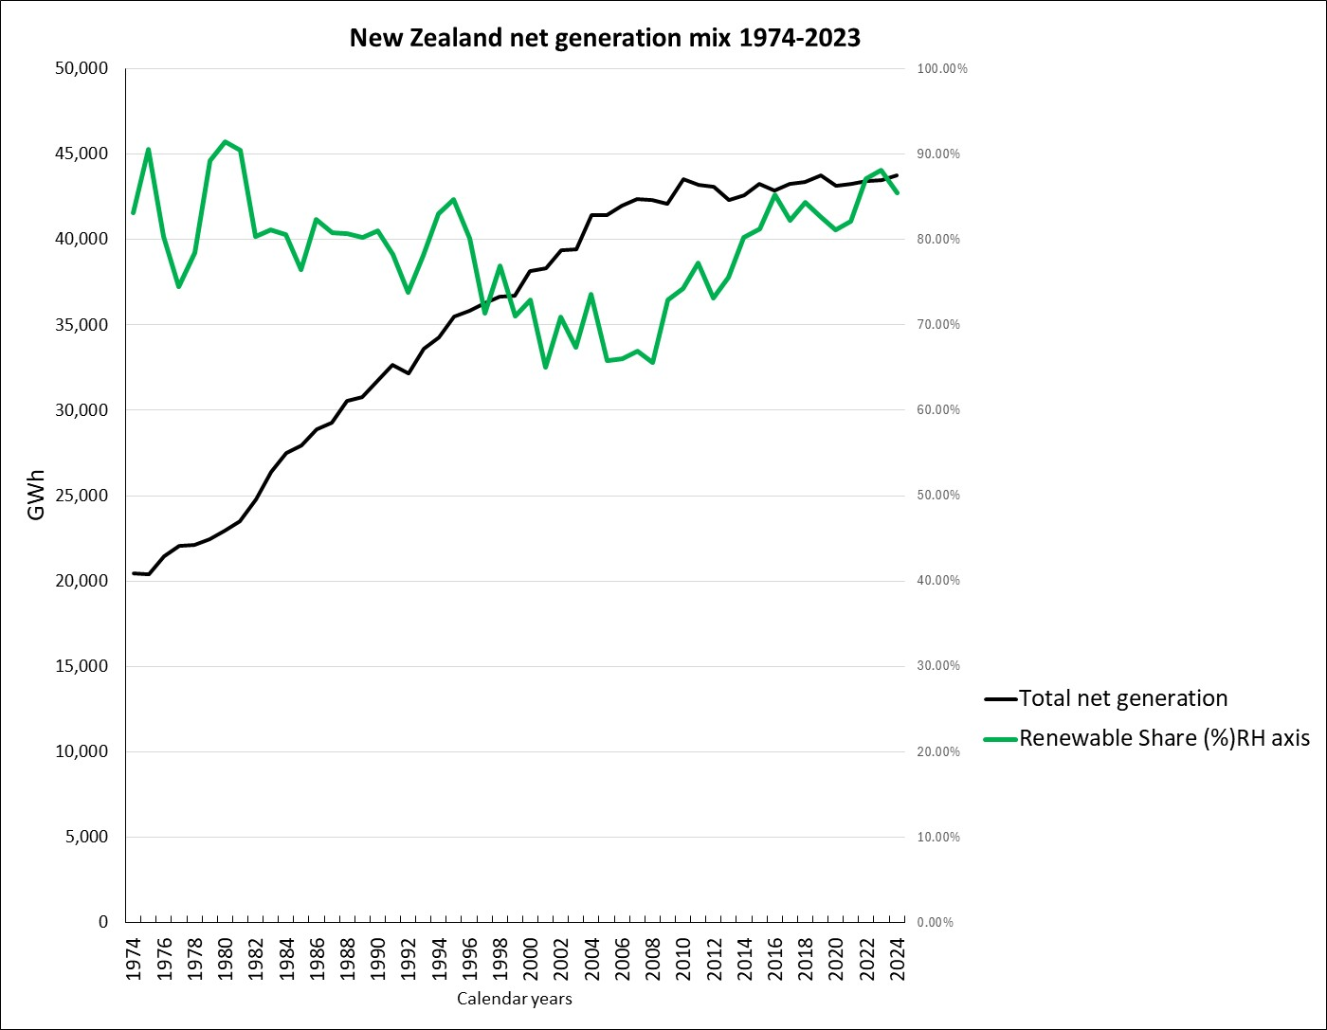
Total generation (black line) is nearly flat since 2012.
Renewables share in 2024 was the same as fifty years ago – just below 90% (green line)
Coal, gas and oil stay stubbornly parked on the margin of supply
Wind is growing but solar has lagged and biomass is minimal
Geothermal has been a big mover since 2000
Hydro development was complete by 1990 => this is now a legacy asset

Slide 3
Neoliberal transformation of the Aotearoa electricity industry
Before 1986
Since 1986
An “essential service” collectively provided
Priced as cheaply as possible to households: wellbeing the goal
Run by civil engineers committed to optimal planned outcomes
Integrated monopoly with non-profit objectives
A commodity allegedly like any other supplied by corporates
Priced to recover the full cost of the marginal generator plus the monopoly price for each lines-network operator plus a fat margin for dominant retailers
Run by corporate managers and financial engineers maximising profit and “shareholder value”
Multiple players in a complicated institutional landscape of
  some [allegedly but actually not] “competitive” and
  some [allegedly but actually not] “regulated” markets

Slide 4
Outline
Where did the high prices come from?
The new competitive threat that should bring prices down
The politics of breaking the gentailer cartel’s market power

Slide 5
Where did the high prices come from?

Slide 6
Seven key elements of the restructuring that were designed to push up the price to final consumers
Competitive markets were eagerly harnessed to drive up the wholesale price of generated electricity
Making ECNZ and Transpower into SOEs added profit margins onto prices
Separation of the old NZED between “competitive” generation (ECNZ) and “regulated” grid (Transpower) ensured higher total price than under the old Bulk Supply Tariff model
Compulsory pass-through of grid charges to retailers insulated Transpower’s asset value and profits from competitive threats
Adoption of accrual accounting and ODV drove up asset values of lines businesses and hence underwrote increased “regulated” allowed revenue
The NZETS put a carbon tax onto renewable wholesale generation
Retail pricing was not regulated => residential prices rose faster than prices to business

Slide 7
1. Competitive markets eagerly harnessed to drive up the wholesale price of generated electricity
$ per kWh
Supply
A non-profit monopolist like NZED can get by with price =c*
p* is the “competitive price”
P*
Having separate corporate producers requires price =p* to satisfy market demand
Surplus
c* is the average cost
c*
The low-cost producers get the yellow rent (unearned profit)
Total cost
Demand
q*
q’
kWh
q* is the “competitive quantity”
q’ is the amount sold at an average-cost price

Slide 8
Generation rents in the New Zealand wholesale electricity market:
Low-cost hydro operators collect big profits (actually rents)
High-cost fossil-fuel plants set the marginal cost and hence the price
Price
Supply
Tiwai Point smelter owners head off to the bank with a slice of the rents
P_{E}
Tiwai
Point
Gentailer profits
Cost of supply
Demand
Q_{E}
Volume

Slide 9
1. Suppose Tiwai Point closes…
Price
Smelter’s power use
}
Supply
curve
p₁
Gentailer profits
Tiwai
Point
Cost of supply
Demand₁
Q_{E}
Volume

Slide 10

1. Suppose Tiwai Point closes…
How to stop this: sign up another big user with a cheap power contract asap:
“green hydrogen”
big data centres
anything…..
Smelter’s power use vanishes
}
Price
Supply
curve
p₁
Price falls to p₂
Gentailer profits
gone!
p₂
Cost of supply
Demand₂
Demand₁
Q_{E}
Volume

Slide 11
2. Suppose heaps of households install rooftop solar..
Price
Supply
P_{E}
Tiwai
Point
Gentailer profits
Cost of supply
Demand
Q_{E}
Volume

Slide 12
2. Suppose heaps of households install rooftop solar..
Price
p₁
New supply
curve
Price falls to p₂
Tiwai
Point
Gentailer profits
additional supply
gone!
High-cost generation assets “stranded”
p₂
Cost of supply
Demand₁
q_{E}
Volume

Slide 13

2. Suppose heaps of households install rooftop solar..
And once again:
Sign up hydrogen plants, cloud data centres, anything power-hungry
Price
p₁
New supply
curve
Price back up to to p₁
Cloud data centre
Gentailer profits
back!
Tiwai
Point
“Green
Hydrogen”
p₂
Cost of supply
Q_{E}
Volume

Slide 14
3. Separation of the old NZED between “competitive” generation (ECNZ) and “regulated” grid (Transpower) ensured higher total price than under the old Bulk Supply Tariff model
$ per kWh
Increasing-cost activity (generation)
Combined and averaged
$ per kWh
kWh
Bulk Supply Tariff
$ per kWh
Decreasing-cost activity (transmission)
kWh
kWh

Slide 15
4. Compulsory pass-through of grid charges to retailers insulated Transpower’s asset value and profits from competitive threats
Transpower’s interconnection charges currently passed through are around $700 million (another $120 million is charged to directly-grid-connected consumers)
Households that export surplus solar to their local networks have to pay the full grid charge – subsidising their dominant competitor even though their supply reduces long-run grid costs

Slide 16
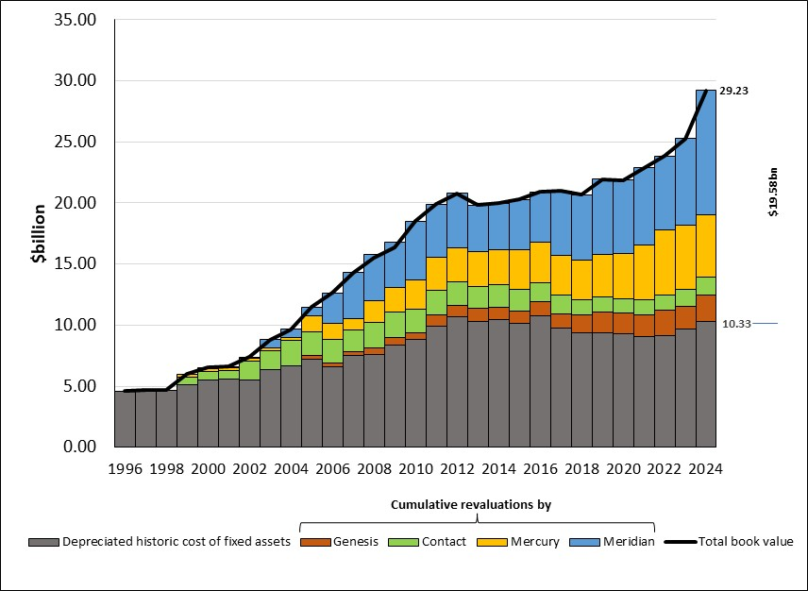
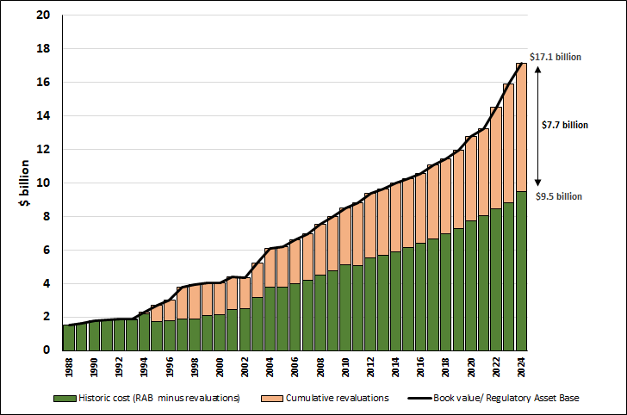
5. Adoption of accrual accounting and ODV drove up asset values of lines businesses and hence underwrote increased “regulated” allowed revenue
Gentailer asset book values
Distribution networks’ asset book values

Slide 17
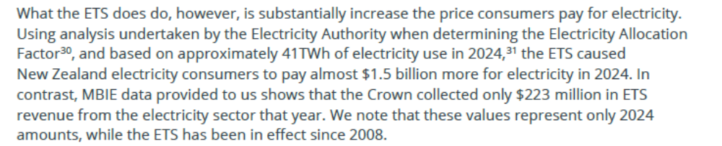
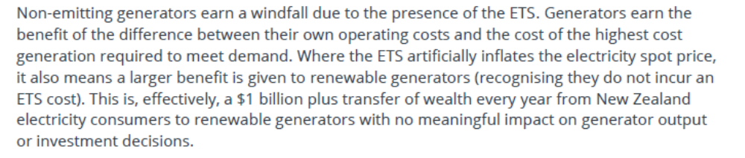
6. The NZETS adds a carbon tax onto what consumers pay for renewable wholesale generation
Frontier Economics report 2025 p.36 https://www.mbie.govt.nz/dmsdocument/31228-review-of-electricity-market-performance-by-frontier-economics
Total electricity sales revenue is around $10 billion p.a
Frontier report p.37

Slide 18
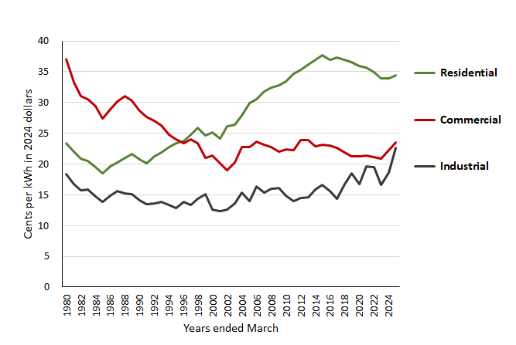
7. Retail pricing was not regulated => residential prices rose faster than prices to business
Monopoly pricing hits the demand curve
Gentailer price-gouging shifts to industry from 2018, accelerates 2023

Slide 19
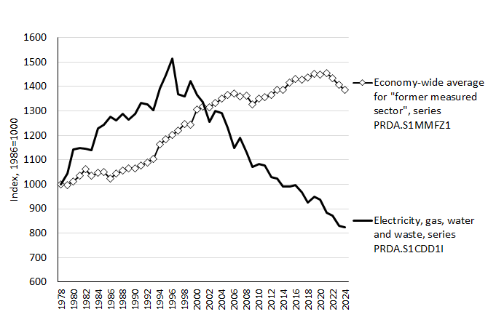
The big promise: despite all the above, corporatisation and privatisation would increase efficiency and hence productivity and so would lower the price
Multifactor productivity: two trends
Source: Statistics NZ Infoshare Table PRD014AA
In 2024:
18% below 1978
35% below 1986
46% below 1996

Slide 20
The new competitive threat that should bring prices down

Slide 21
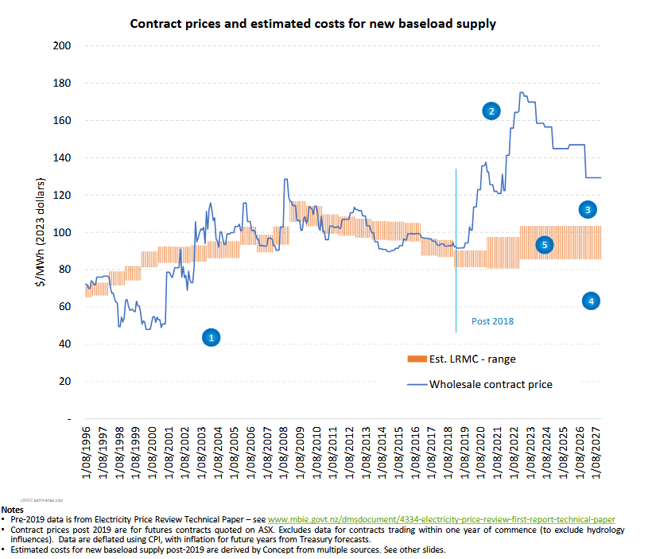
If Long Run Marginal Cost is increasing, then increased demand means higher price over time, so low-cost suppliers’ high profits are secure
y
If Long Run Marginal Cost is below the prevailing price then the profits of incumbent producers are threatened
Concept Consulting chart at 2023 from https://www.ea.govt.nz/documents/4414/Generation_Investment_Survey_-_2023_update.pdf

Slide 22
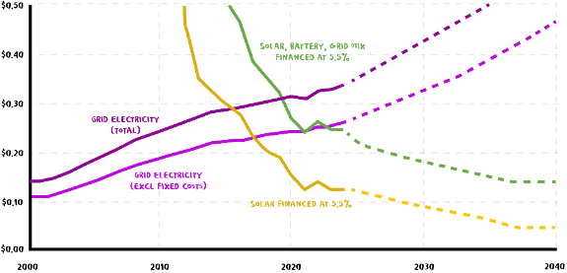
There is now “competition for the market” by a new source of supply from outside the grid-gentailer complex
$ per kWh
Source: Mike Casey of Rewiring NZ, Newsroom 4 February 2026

Slide 23
Technology shift towards small-scale renewables means a new era of “competition for the market”
From this
Remote generation
Retail market
Distributed generation
Transmission
to this
Remote generation and transmission
Retail market
Distributed generation

Slide 24
From my 2023 submission in response to the MBIE discussion document Measures for Transition to an Expanded and Highly Renewable Electricity System, p.12:
For a small country with limited fiscal resources but ample renewable energy resources spread across our geographic space, the option of decentralised utilisation of those renewable resources by small and medium-scale operators, taking responsibility for their own resource mobilisation, stands out as the logical starting point for prioritisation, unless one is committed above all else to preserving the privileged position of the long-established vested interests in central generation and transmission.
https://geoffbertram.files.wordpress.com/2023/10/bertram-submission.pdf

Slide 25
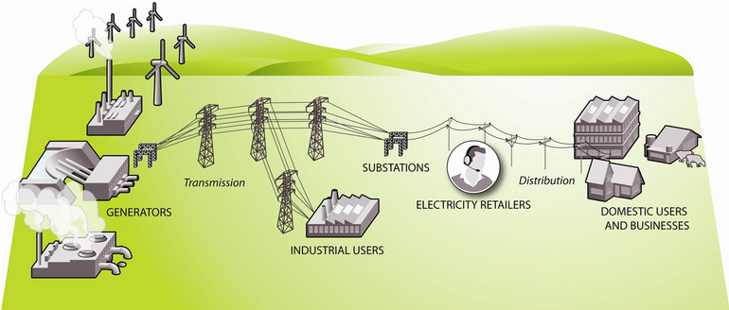
Here’s the official MBIE 2023 picture of the industry - no distributed supply whatever acknowledged
The system operator is here
https://www.mbie.govt.nz/building-and-energy/energy-and-natural-resources/energy-generation-and-markets/electricity-market/electricity-industry/ copied 4 May 2023.

Slide 26
Here’s an alternative vision

Slide 27
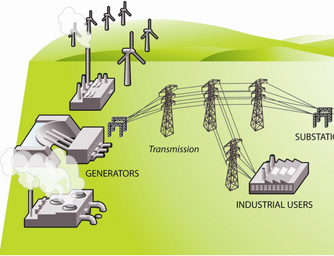
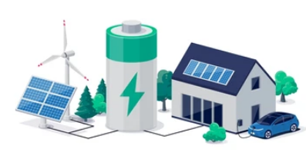



Central/remote generation and transmission
Energy community
Distributed generation
Local distribution network and independent retailers
DOMESTIC USERS AND BUSINESSES WITH NET METERS
Homes
Local aggregator/pool with battery to smooth load fluctuations
Industry
Buyers of grid power operate here and pay a bundled wholesale price
Farms

Slide 28
Implication: The wholesale market competitive action needs to shift from grid entry to grid exit
With the distribution lines network as an open-access platform, DG would compete head-to-head with remote generation delivered off the grid
This would require two changes to the current set-up:
  Break the vertical integration of generation and retail to open the way for independent retailers using local networks to deliver electricity from the lowest-cost source;
  Bundle grid-transmission charges with the spot market wholesale price, not with distribution network fixed charges.
Ideally, kill the lines/energy split and revive the old Electricity Supply Authority model

Slide 29
The politics of breaking the gentailer cartel’s market power

Slide 30
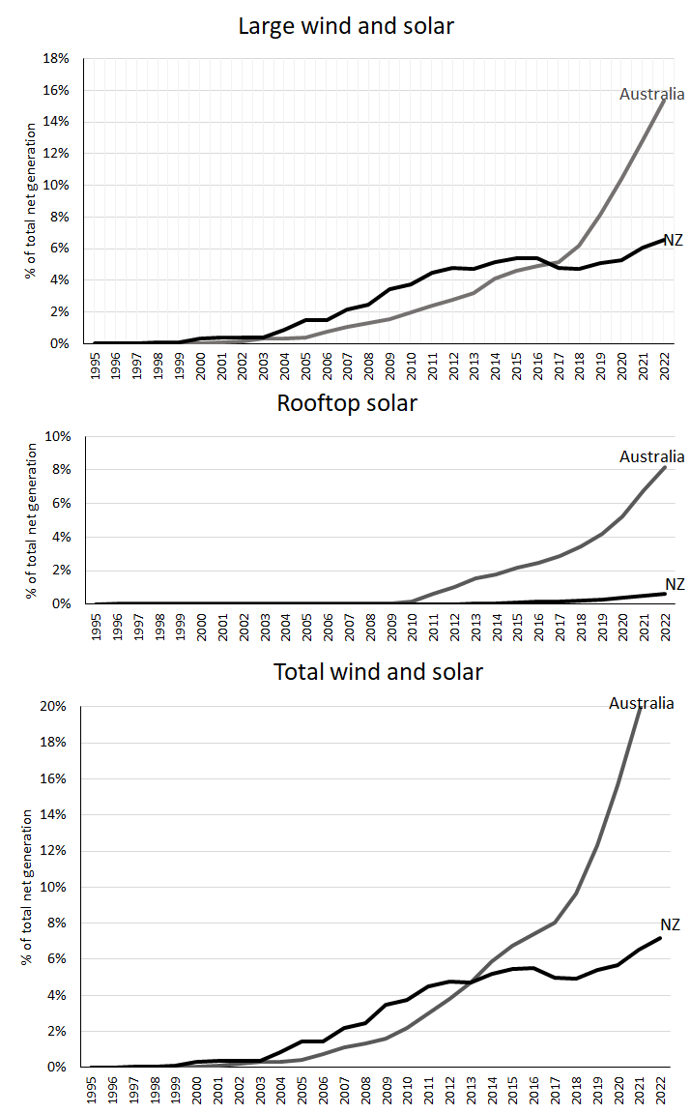
Share of new renewables (wind and solar) in total net generation 1995-2022: Australia and New Zealand compared
Key point: the cross-over coincided with the National Government’s part-privatisation of the SOE gentailers

Slide 31
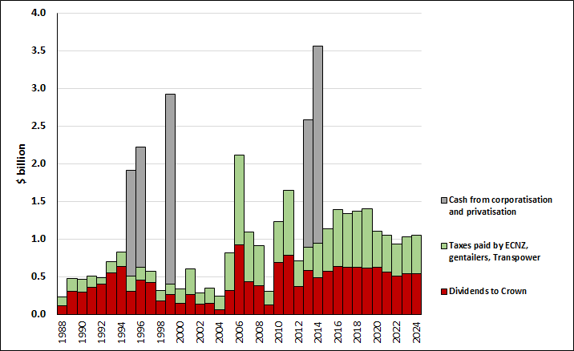
Crown cash receipts from gentailers and Transpower

Slide 32
Compulsory pass-through of grid charges
The issue: what is a fair charge (if any)for distributed generation and batteries to pay for gird backup?
Currently DG pays for grid as well as local network even when only using the latter
That’s a cross-subsidy to gentailers
Solution: make gentailers pay for transmission to the GXP

Slide 33
Lines/energy split
An ideological construction
Blocks local integration of network management with distributed generation and batteries
“Energy communities” need a coordinator
Retailers on a neutral network platform would combine local and grid supply to minimise cost to consumers
=> Revive the old ESA model?

Slide 34
Public-private partnerships
To date these have been largely-confidential arrangements between Government and big corporates
The future lies with partnership between Government and households, small businesses, and mid-level utility developers of solar, wind and batteries
The whole atmosphere changes when ownership, agency and resourcing are decentralised to ordinary New Zealanders rather than to big predatory transnationals

