Slide 1
Identifying and estimating excess profits in the New Zealand electricity industry
Geoff Bertram
Institute for Governance and Policy Studies
Victoria University of Wellington
July 4 2019

Slide 2
Lest we forget, the period 1984-94 has left a permanent mark

Slide 3
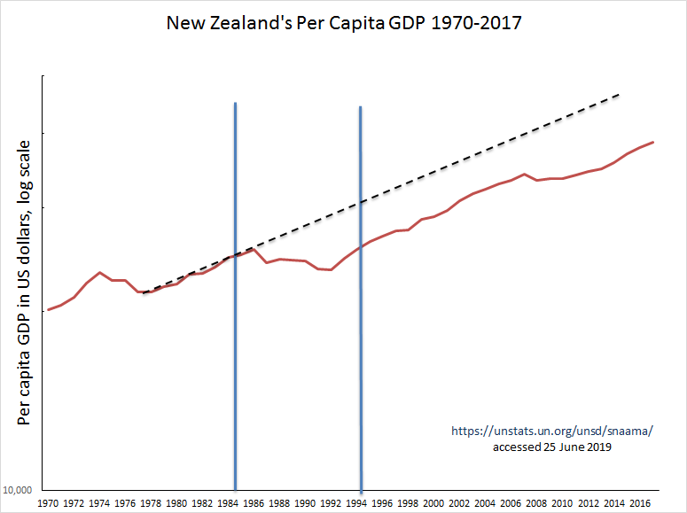
Peak
neoliberalism
Douglas &
Richardson

Slide 4
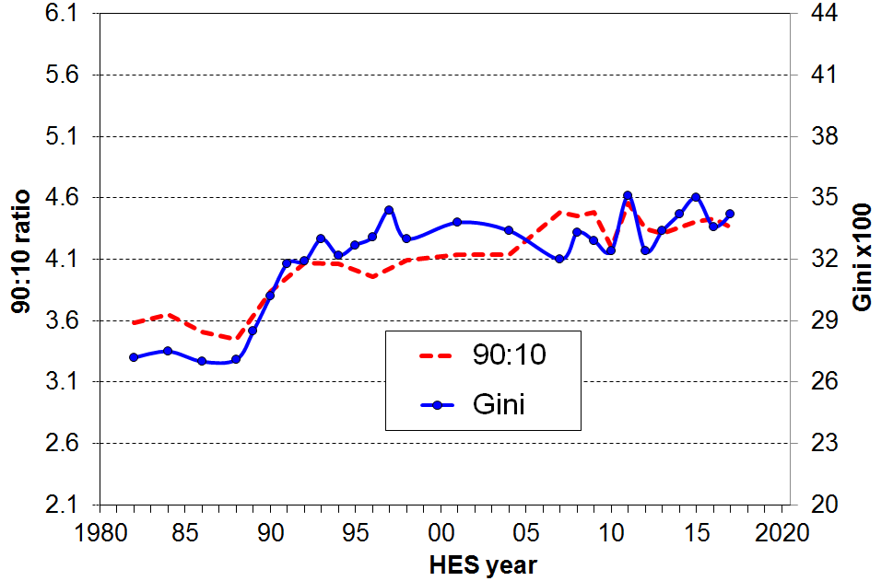
New Zealand inequality indicators
Douglas-
Richardson
Brian Perry, Household incomes in New Zealand: Trends in indicators of inequality and hardship, 1982 to 2017, Wellington: MSD, October 2018, p.90.

Slide 5
Post-GFC reappraisal of neoliberalism
Growing concern about the damaging effects of market power and rent-seeking behaviour on the rate of productivity growth and the distribution of income and wealth in advanced western economies
An important strand in this new literature is a focus on rising markups which suggest the taking of profits that are excessive relative to the benchmark of the quantum of profit that is socially necessary to sustain productive endeavour in a capitalist economy.

Slide 6
In New Zealand, electricity experienced the biggest sectoral restructuring
Outline
  Some macro numbers: prices, productivity and profits
  Updating excess profit estimates for distribution networks
  Some comments on profits in generation and retail

Slide 7
Two sides to the neoliberal coin
Market fundamentalism: markets are best, competition the sufficient condition for promoting consumer benefit, regulation a drag on efficiency (Stigler, Posner, Bork, Easterly…) => corporatise, privatise, deregulate: promise lower prices in long run
Small-government agenda driven by desire to reduce taxes on the wealthy and reverse the mid-twentieth century egalitarian consensus (Buchanan) => cut back government provision of “essential services”, move to user-pays, reduce welfare benefits, privatise state assets, substitute non-tax revenues and regressive taxes for progressive taxes: implies higher prices in long run

Slide 8
So how did the great experiment work out in electricity?
First, prices…….

Slide 9
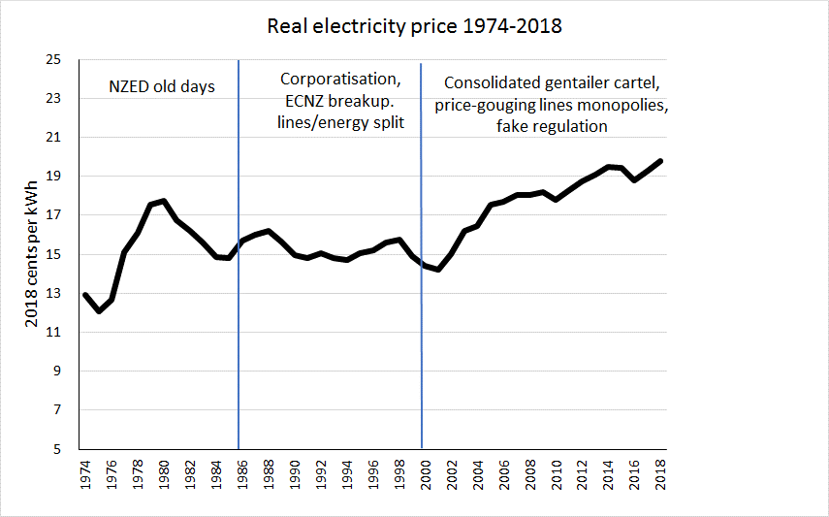
Calculated from MBIE ‘Data tables for electricity” and “energy price tables” at https://www.mbie.govt.nz/building-and-energy/energy-and-natural-resources/energy-statistics-and-modelling/energy-statistics/electricity-statistics/ and https://www.mbie.govt.nz/assets/Data-Files/Energy/energy-quarterly-statistics/q1-march-2019/f0208a8a33/Prices.xlsx accessed June 2019.

Slide 10
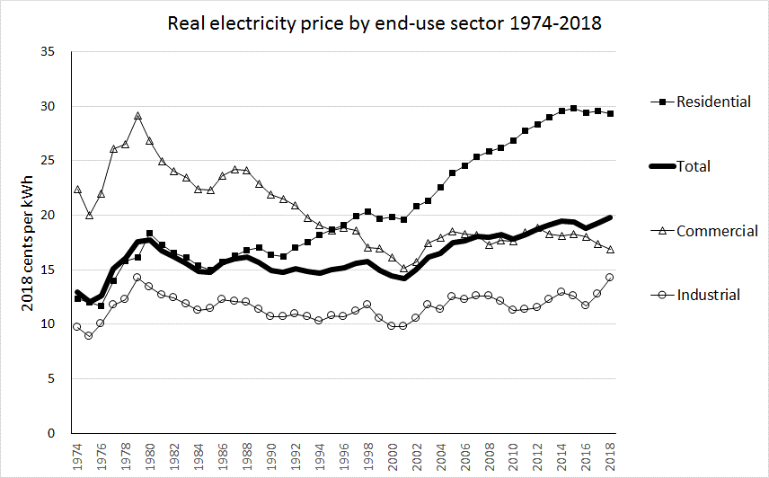
Restructuring
begins
Source: MBIE data from https://www.mbie.govt.nz/assets/Data-Files/Energy/energy-quarterly-statistics/a0285022ed/prices-statistics.xlsx downloaded 20 May 2019, deflated to 2018 values using CPI for residential and PPI Inputs for commercial and industrial.

Slide 11
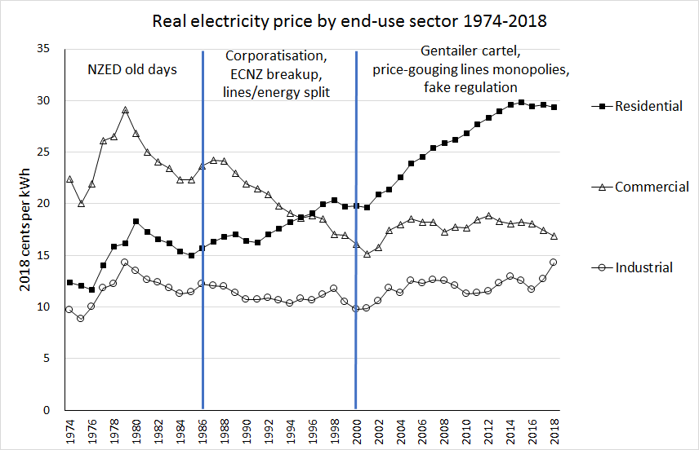

Slide 12
and comparing with other OECD countries

Slide 13
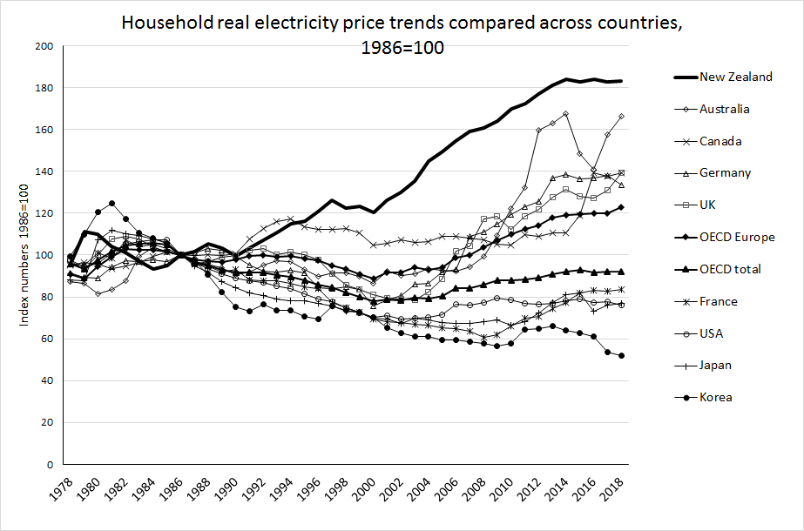
Source: International Energy Agency (2019), "End-use prices: Indices of energy prices by sector", IEA Energy Prices and Taxes Statistics (database), https://doi.org/10.1787/data-00444-en (accessed on 20 May 2019). Series rebased by author to 1986=100.

Slide 14
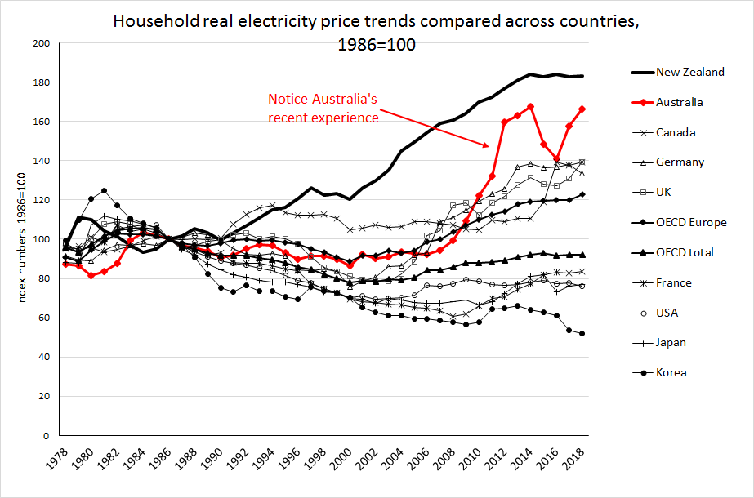

Slide 15
How about productivity?
Electricity is the dominant component of “electricity gas, water and waste services” in the national accounts

Slide 16
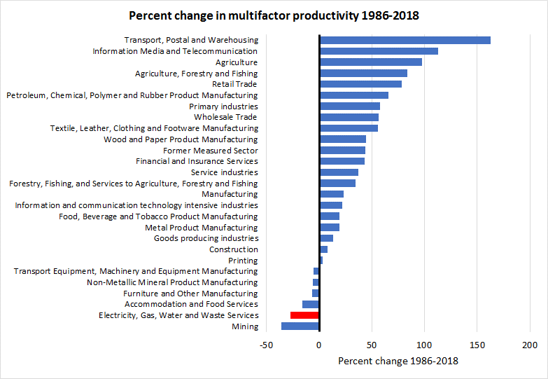
Source: Statistics New Zealand Infoshare table PRD014AA updated February 2019

Slide 17
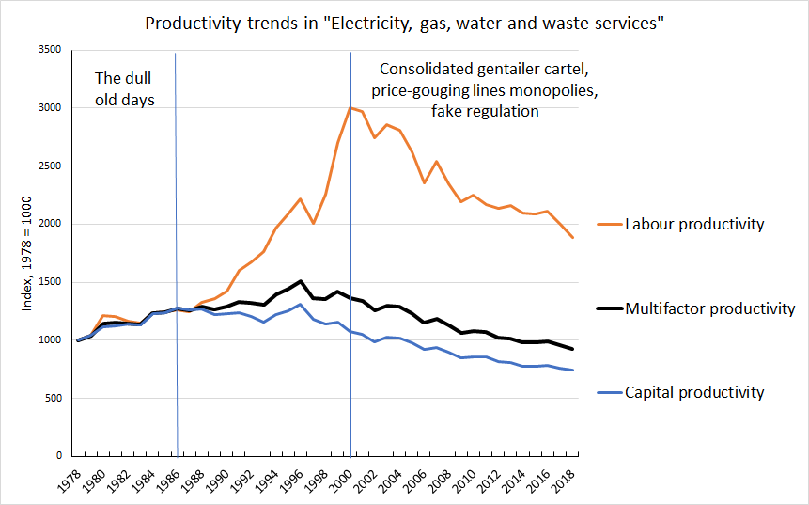
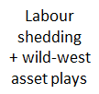
Statistics NZ, Infoshare Table PRD014AA

Slide 18
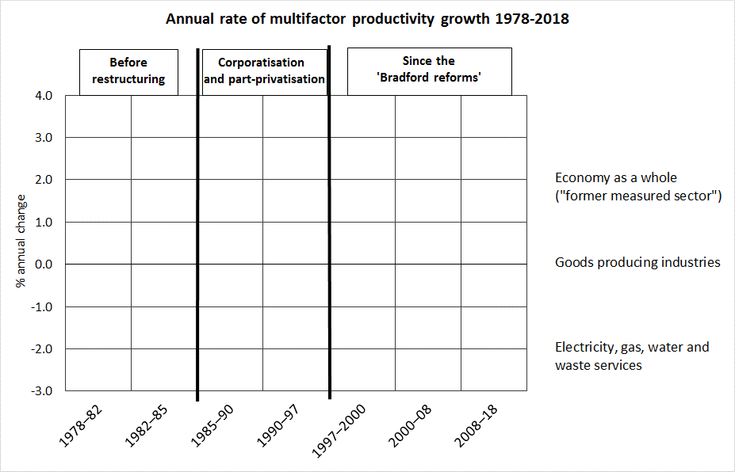

Slide 19
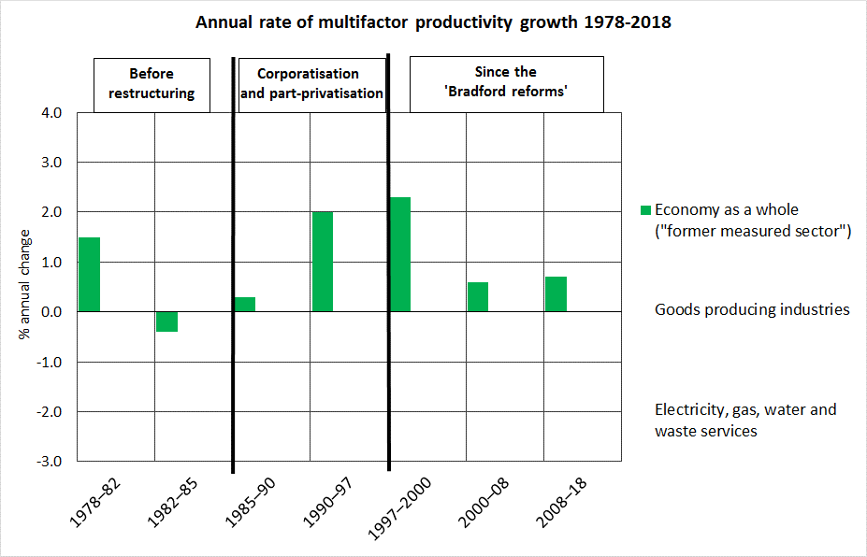
Source: Statistics NZ, Productivity Statistics 1978-2018 – productivity by industry https://www.stats.govt.nz/assets/Uploads/Productivity-statistics/Productivity-statistics-19782018/Download-data/productivity-statistics-1978-2018-productivity-by-industry.xlsx accessed 20 May 2019, Table 5.03.

Slide 20
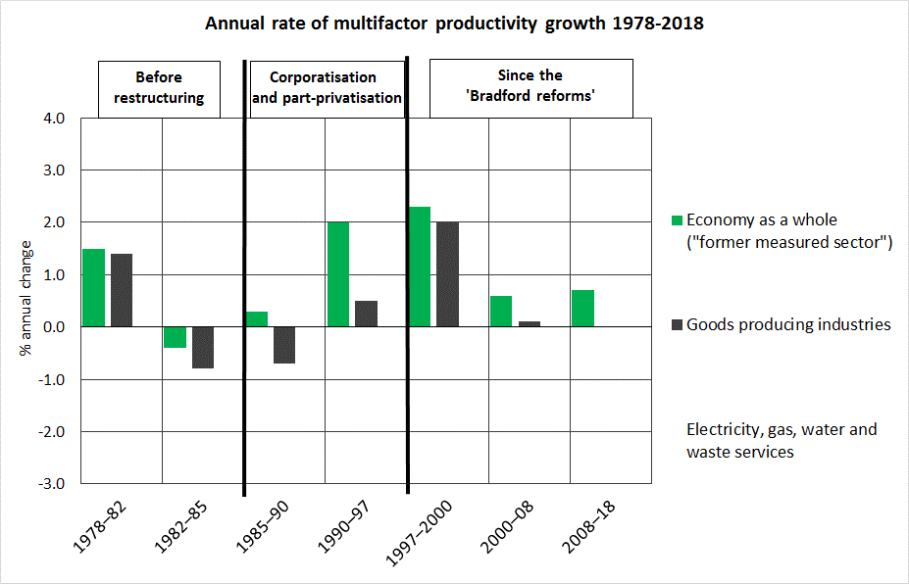
Source: Statistics NZ, Productivity Statistics 1978-2018 – productivity by industry https://www.stats.govt.nz/assets/Uploads/Productivity-statistics/Productivity-statistics-19782018/Download-data/productivity-statistics-1978-2018-productivity-by-industry.xlsx accessed 20 May 2019, Table 5.03.

Slide 21
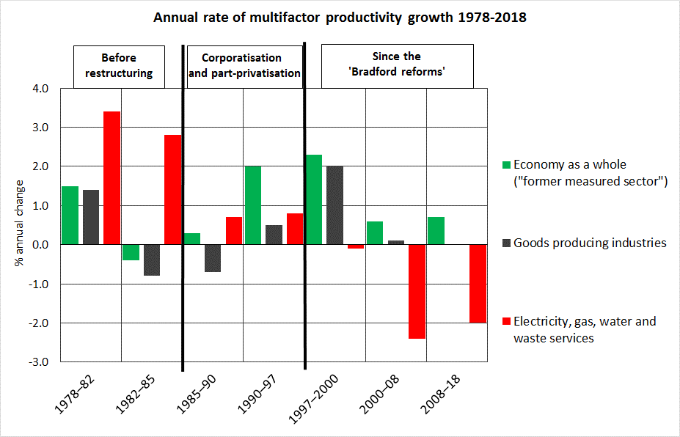
Source: Statistics NZ, Productivity Statistics 1978-2018 – productivity by industry https://www.stats.govt.nz/assets/Uploads/Productivity-statistics/Productivity-statistics-19782018/Download-data/productivity-statistics-1978-2018-productivity-by-industry.xlsx accessed 20 May 2019, Table 5.03.

Slide 22
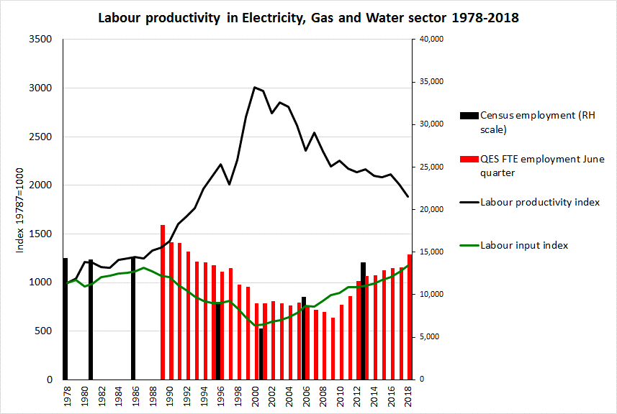
Sources: Statistics NXZ
Infoshare tables PRD016AA
and PRD014AA.
Quarterly Employment Survey data from Statistics New Zealand Infoshare table QEX019AA.
Census data 1996 on from http://nzdotstat.stats.govt.nz/WBOS/Index.aspx?DataSetCode=TABLECODE8212 downloaded 15 May 2019. Earlier census data from published volumes.

Slide 23
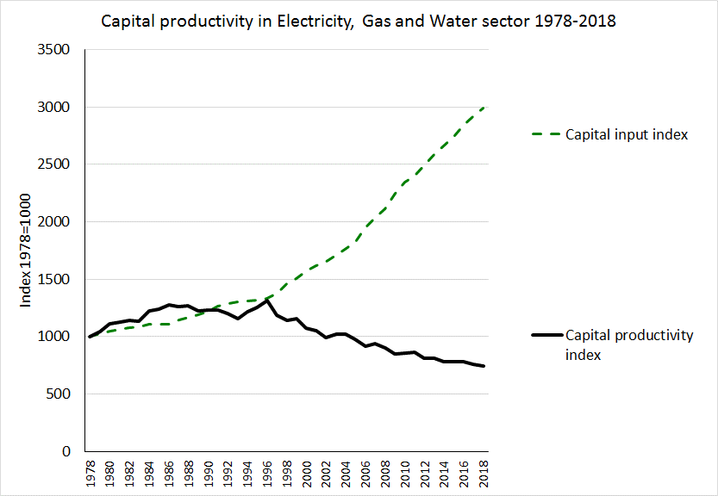
Remember Averch and Johnson 1962
Source: Statistics NZ
Infoshare tables PRD016AA
and PRD014AA

Slide 24
Bottom line: over the past two decades this sector has been loaded up with labour and capital engaged in unproductive activities
Pursuit of profit combined with complicated “competition” games and financial engineering has meant that increasing amounts of labour and capital have been allocated to high-paid sales, marketing, financial management and administrative work that adds nothing to the volume or quality of the electricity reaching consumers
Corporatisation and privatisation have culminated in a gigantic exercise in rent-seeking waste

Slide 25
Profits, of course, have been healthy!

Slide 26
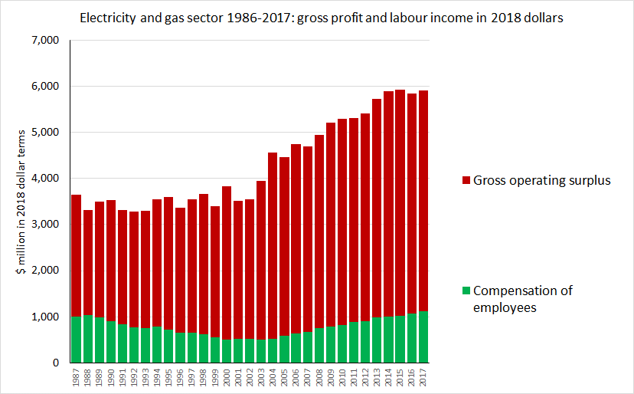
Source: Statistics NZ https://www.stats.govt.nz/assets/Uploads/National-accounts-industry-production-and-investment/National-accounts-industry-production-and-investment-Year-ended-March-2017/Download-data/national-accounts-industry-production-investment-year-ended-march-2017.xlsx downloaded 20 May 2019.

Slide 27
Price-cost margins in distribution lines networks ballooned after 1994, as costs fell with no pass-through to prices

Slide 28
Here’s how it was supposed to work:
Introduce the profit motive, remove regulatory constraints
Cost, price
From here on, consumers get long-term benefit of lower price, while society gets the benefit of saving on scarce resources
Initial price
Initial cost
“Short-term
pain” - for
how long?
Price follows cost as savings are passed through
Commercial management drives down cost
Cost
Time

Slide 29
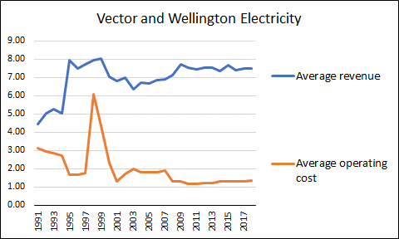
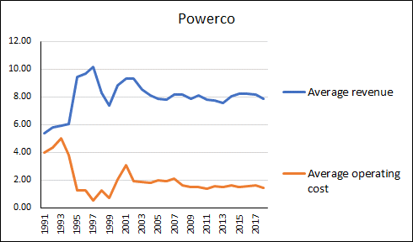
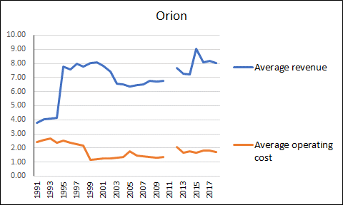
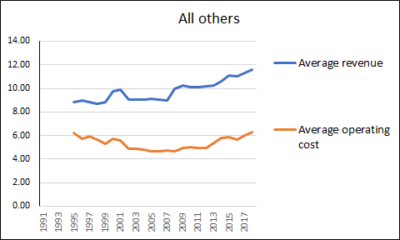
All in real terms, 2018 cents per kWh
Auckland CBD blackout
Cost reductions not sustained -
but profit margins stayed solid

Slide 30
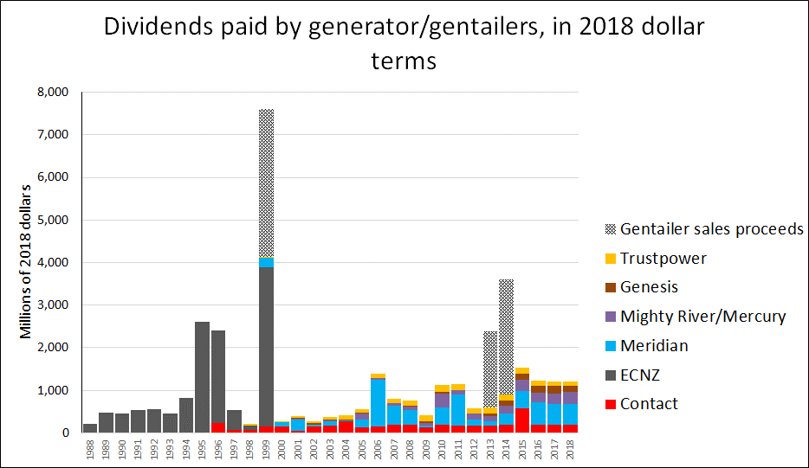

Slide 31
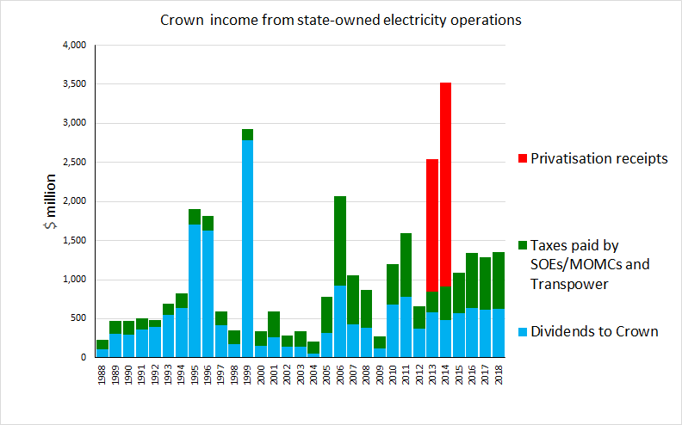
Sources company annual reports, plus TDB Review of Mixed Ownership Model July 2018 https://www.tdb.co.nz/wp-content/.../08/TDB-Mixed-Ownership-Review-Jul-18.pdf
Cash from selling 49% of Meridian, Genesis and Mercury
Cash from leveraging-up Contact at separation
Includes proceeds from Contact privatisation

Slide 32
These are not trivial sums relative to the economy as a whole

Slide 33
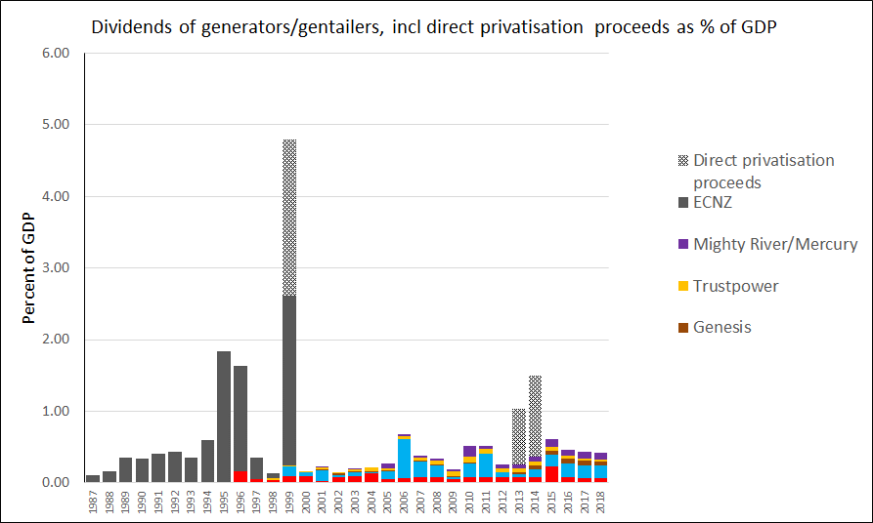

Slide 34
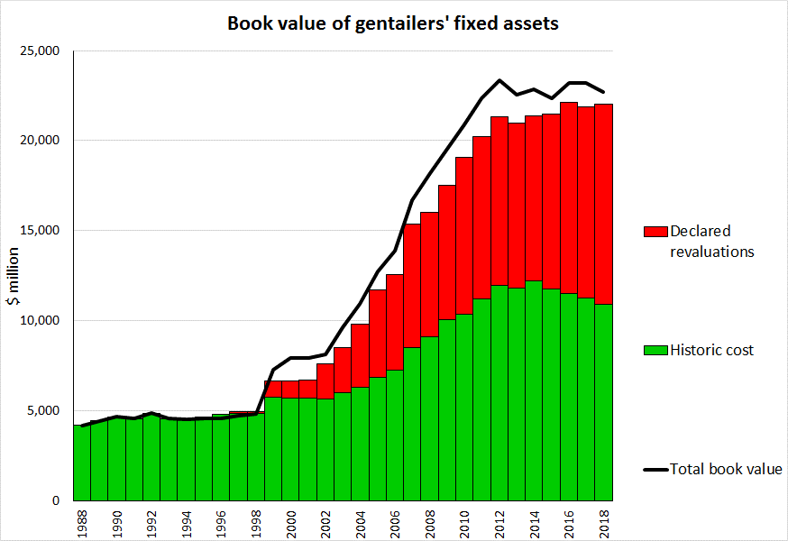
$23 billion book value
“Fair value” revaluations since 1999 ≈ $11 billion wealth transfers from consumers by 2016
Now right up against
the market limit
ECNZ pre-divestment was $4.5 billion
$11b
Source: Company annual reports

Slide 35
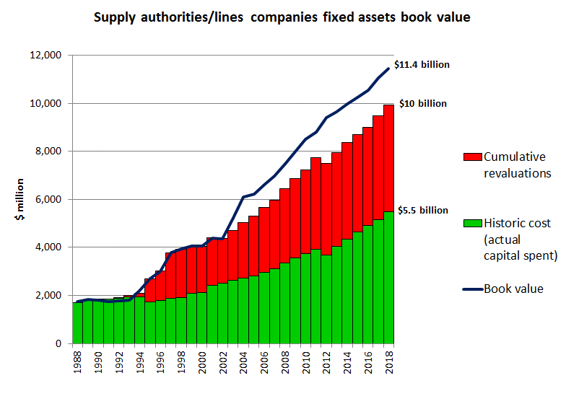
Sources: Disclosed information from Gazettes and Commerce Commission

Slide 36
In summary
Productivity has gone down 30% (and capital productivity down 42%) since 1986
Residential prices have gone up 90% since 1986 (while industrial prices hardly changed, and commercial prices fell 25%)
Operating surplus has gone up 81% in real dollars since 1986 (compared with a 12% real increase in labour income)
Redistribution of wealth from residential consumers to electricity asset owners and commercial users => increasing inequality and poverty (both child poverty and energy poverty in general)
Residential consumers have gone from having no choice in a low-priced market to having lots of so-called “choice” [but no voice] in a high-priced market

Slide 37
When are profits excessive?
New Zealand law is virtually silent, thanks to Parliament
The original Commerce Act 1986 never mentioned them – just relied on competition to solve everything
The Commerce Amendment Act 2008 directed the Commerce Commission to “limit”, not eliminate, excessive profits – and provided no definition (Commerce Act 1986 s.52A(1)(d))
Under Part 4 the Commission gets the job of regulating if the Minister wants – so far that affects lines networks and the grid
For the supposedly “competitive” parts of the sector, “the exercise of market power to earn market power rents is … a lawful, rational exploitation of the ability and incentives available to the generators” (Commerce Commission 2009, p.6)

Slide 38
Where can excess profits arise?

Slide 39
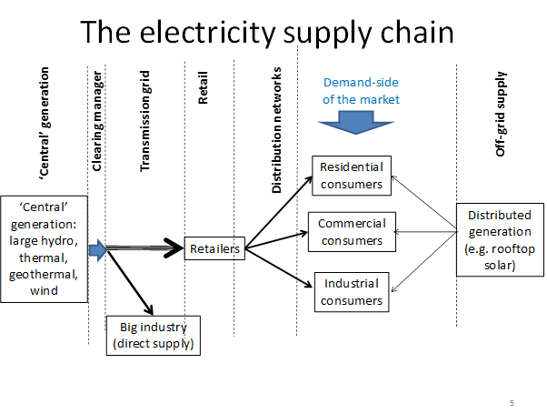
Ricardian rents, carbon rents, market manipulation rents
Ramsey pricing shifts the burden onto residential consumers
Predatory pricing and captured regulators combine to obstruct rooftop solar etc
Natural
monopoly
rents
Vertical integration rents
Natural
monopoly
rents

Slide 40
Generation rents

Slide 41
Here’s the supply/demand diagram for an increasing-cost industry with low-cost and high-cost producers:
Price
The total cost of supplying quantity Q_{E} is (A + B)
The total revenue from selling this quantity at the marginal-cost price P_{MC} is (A + B + C)
Area C is pure rent collected by the owners of the low cost plant
So which is the “true cost” - (A+B) or (A+B+C)?
P_{mc}
Supply
C . Low-cost producers’ market rent (profit)
Average-cost pricing (NZED)
Marginal-cost pricing (Treasury)
B. High-cost producers’ costs
P_{L}
A. Low-cost producers’ costs
Demand
Happier
consumers
Less happy
consumers
Q_{E}
Volume

Slide 42
Here’s the supply/demand diagram for an increasing-cost industry with low-cost and high-cost producers:
Those big profits C rely entirely on having high-cost supply at the margin
Price
P_{mc}
Supply
C . Low-cost producers’ market rent (profit)
B. High-cost producers’ costs
P_{L}
A. Low-cost producers’ costs
Demand
Q_{E}
Volume

Slide 43
Here’s the supply/demand diagram for an increasing-cost industry with low-cost and high-cost producers:
Those big profits C rely entirely on having high-cost supply at the margin
Shift the demand curve left (e.g. close the Tiwai Point smelter) and the price drops radically – and so do profits
Price
P_{mc}
Supply
C . Low-cost producers’ market rent (profit)
B. High-cost producers’ costs
P_{L}
A. Low-cost producers’ costs
Demand
Q_{E}
Volume

Slide 44
Here’s the supply/demand diagram for an increasing-cost industry with low-cost and high-cost producers:
Those big profits C rely entirely on having high-cost supply at the margin
Shift the demand curve left (e.g. close the Tiwai Point smelter) and the price drops radically – and so do profits
Price
P_{mc}
Supply
C . Low-cost producers’ market rent (profit)
B. High-cost producers’ costs
P_{L}
A. Low-cost producers’ costs
Demand
Q_{E}
Volume

Slide 45
Here’s the supply/demand diagram for an increasing-cost industry with low-cost and high-cost producers:
Those big profits C rely entirely on having high-cost supply at the margin
Shift the demand curve left (e.g. close the Tiwai Point smelter) and the price drops radically – and so do profits
Add more low-cost supply, pushing the high-cost suppliers out (off the margin) and the price drops radically – and so do profits
Price
P_{mc}
Supply
C . Low-cost producers’ market rent (profit)
B. High-cost producers’ costs
P_{L}
A. Low-cost producers’ costs
Demand
Q_{E}
Volume

Slide 46
Here’s the supply/demand diagram for an increasing-cost industry with low-cost and high-cost producers:
Those big profits C rely entirely on having high-cost supply at the margin
Shift the demand curve left (e.g. close the Tiwai Point smelter) and the price drops radically – and so do profits
Add more low-cost supply, pushing the high-cost suppliers out (off the margin) and the price drops radically – and so do profits
Core strategy for Contact, Meridian, Mercury and Genesis is:
Price
P_{mc}
Supply
C . Low-cost producers’ market rent (profit)
Keep demand up (keep the smelter open!)
Keep supply constrained (don’t build too many windfarms, and block rooftop solar if possible
B. High-cost producers’ costs
P_{L}
A. Low-cost producers’ costs
Demand
Q_{E}
Volume

Slide 47
With both a carbon charge on non-renewable generation and market manipulation:
Price
Long-run supply+ carbon charge
P7
Market manipulation rent – Wolak, Poletti
P6
Long-run competitive
supply
Carbon rent – Bertram and Terry
Ricardian rent –
Hydro NZ 1992
Demand
Renewables-based supply
Q8
Q7
Quantity
47

Slide 48
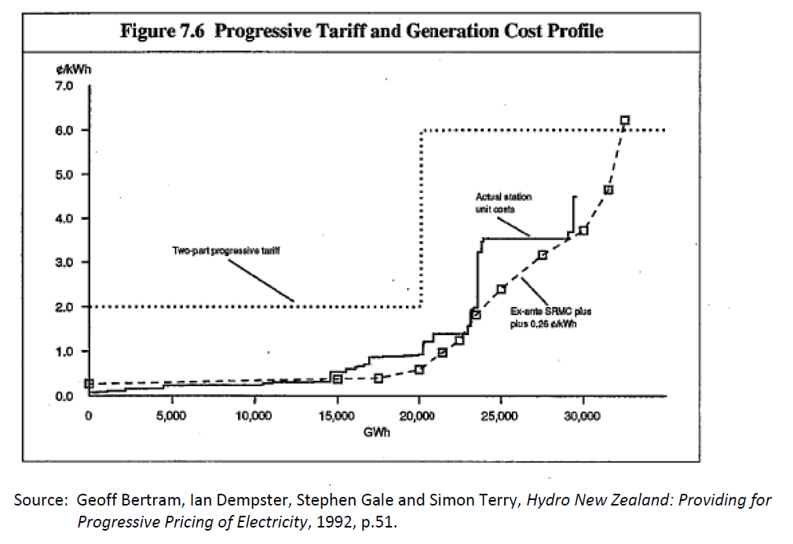
Casting our minds back twenty years….
We saw an easy $800 million here -
that’s $1.3 billion in 2018 dollars

Slide 49
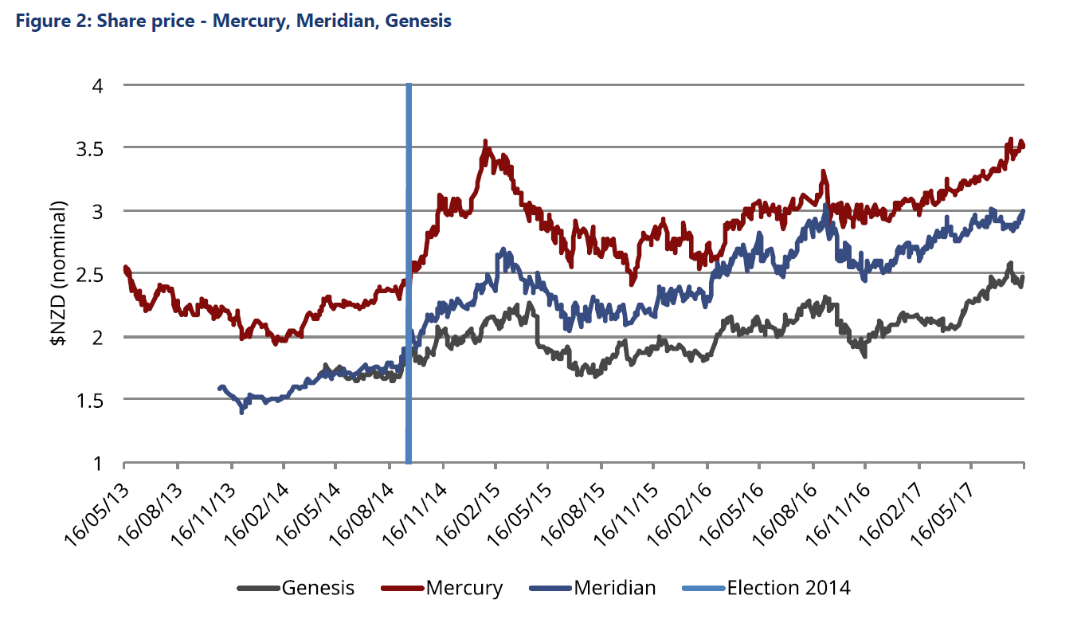
2014 election
Combined with Contact and Trustpower share movements, about $4 billion of market value change – consistent with $500-700m p.a. estimates of Power NZ impact – more if market discounted the probability

Slide 50
Bertram and Twaddle 2005 on distribution lines excess profits
Central issue was asset valuations used as the base for regulatory revenue-setting
Excess earnings estimated $200 million per year
Total wealth transfer 1992-2002 $2.6 billion at 2002 prices
Another sixteen years of data now available
Excess here defined as the difference between actual revenue and what a hypothetical real regulator might have allowed in place of the price-gouging and revaluation stampede of 1992-2008

Slide 51
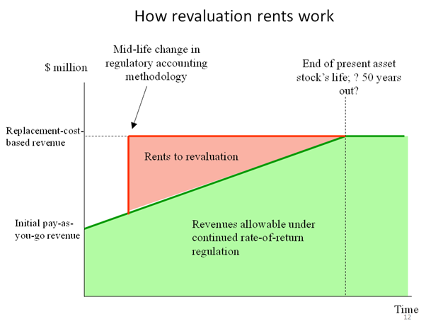

Slide 52
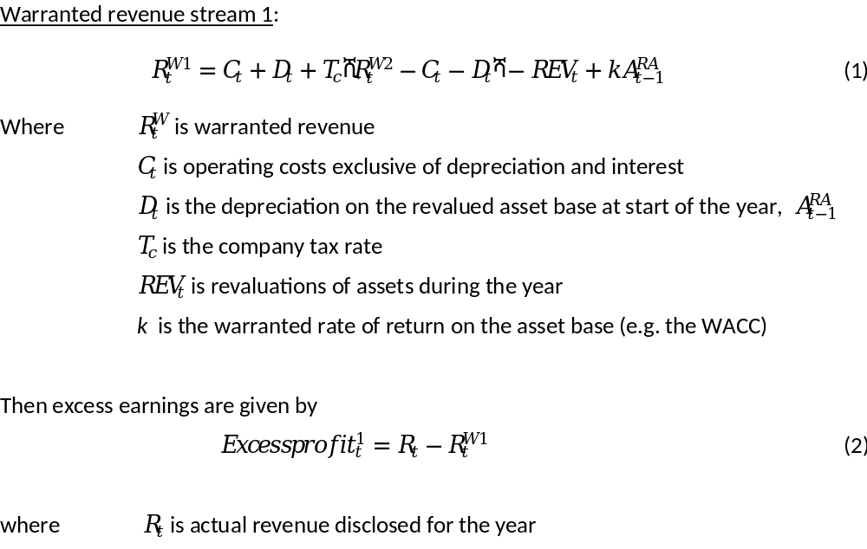
Model 1: revaluations are allowed by counted as income (accrued capital gains):

Slide 53
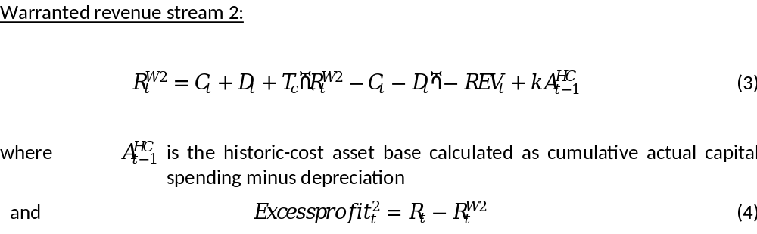
Model 2: WACC can be earned only on historic cost of assets

Slide 54
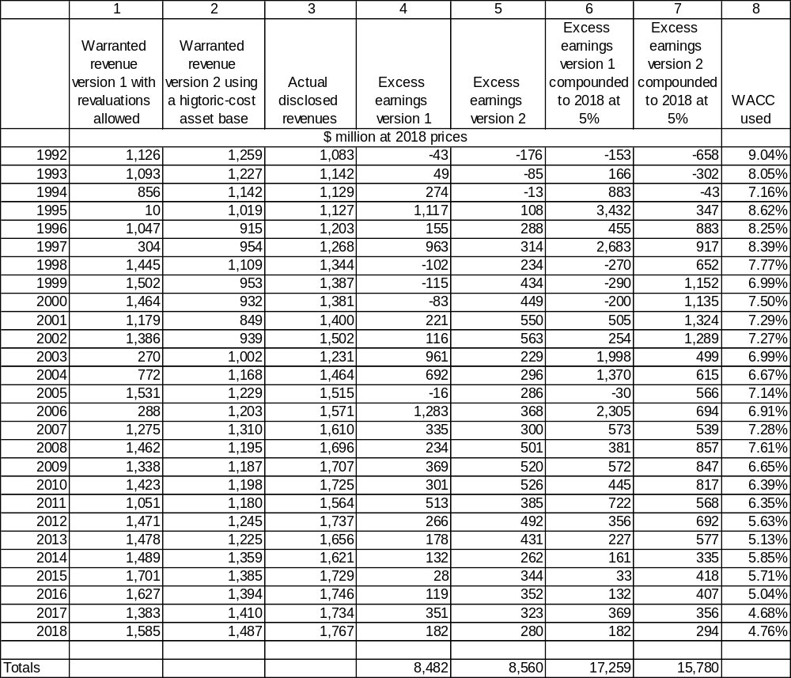
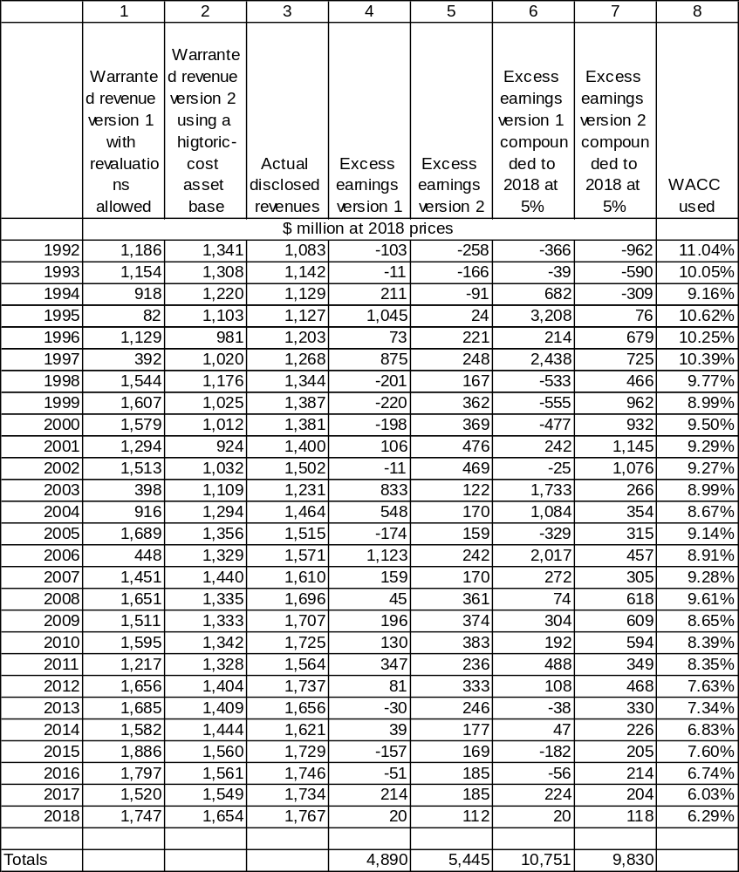
Table 1: Base estimates of excess profits of EDB, 1992-2018
Table 2: Calculations with WACC increased by 2%
Wealth transfers
1992-2018

Slide 55
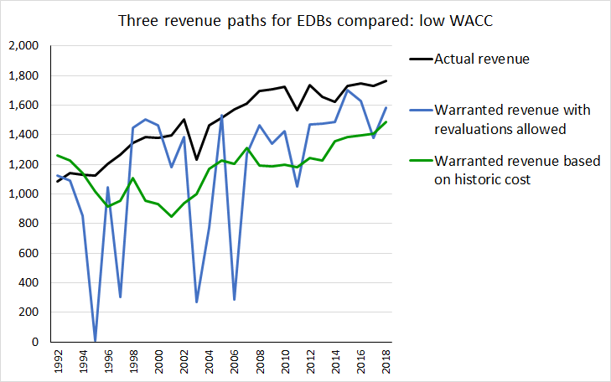

Slide 56
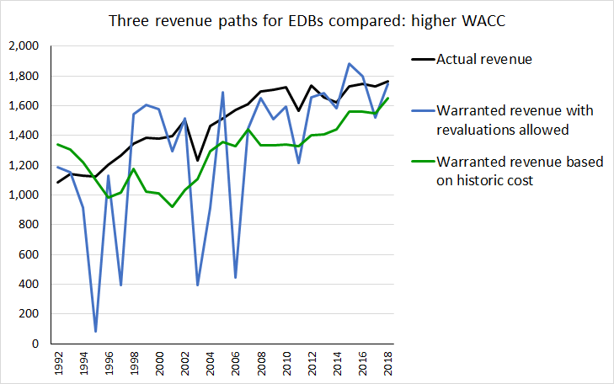

Slide 57
Some issues with the current regulatory model
Started by locking-in high asset values¹ => persistently allows too high a capital charge
Defended these before the High Court in 2013 by falsely claiming no historic cost figures existed²
Places no pressure on firms to improve efficiency: in (CPI-X), the X value is always zero
Having already forced consumers to pay for the assets a second time at inflated prices, now proposing “accelerated depreciation” to make them pay again
1. Commerce Commission, Regulation of Electricity Lines Businesses Targeted Control Regime Draft Decisions 23 December 2002, no longer accessible online.
2. See Wellington International Airport and Ors v Commerce Commission [2013] NZHC 3289 paragraph 428.

Slide 58
Conclusion
It’s not hard to estimate over $1 billion p.a. of excess earnings in the current $7 billion of industry total revenues
Plenty of room for changing assumptions to change the precise numbers
But you have to be very Panglossian to see no chance to benefit consumers by squeezing (a) total profits, and (b) the residential share of total charges
“Long term benefit of consumers” has never really been taken seriously by the policymakers

Slide 59
End

Slide 60
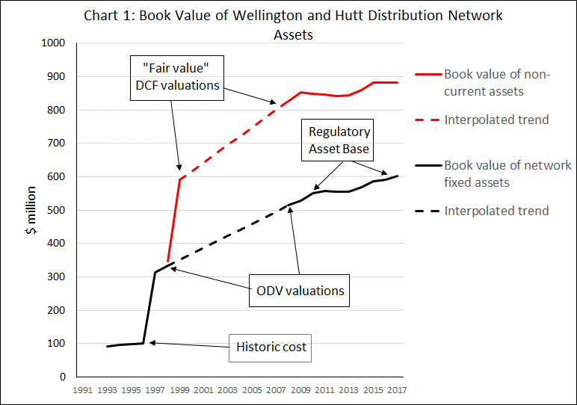

Slide 61
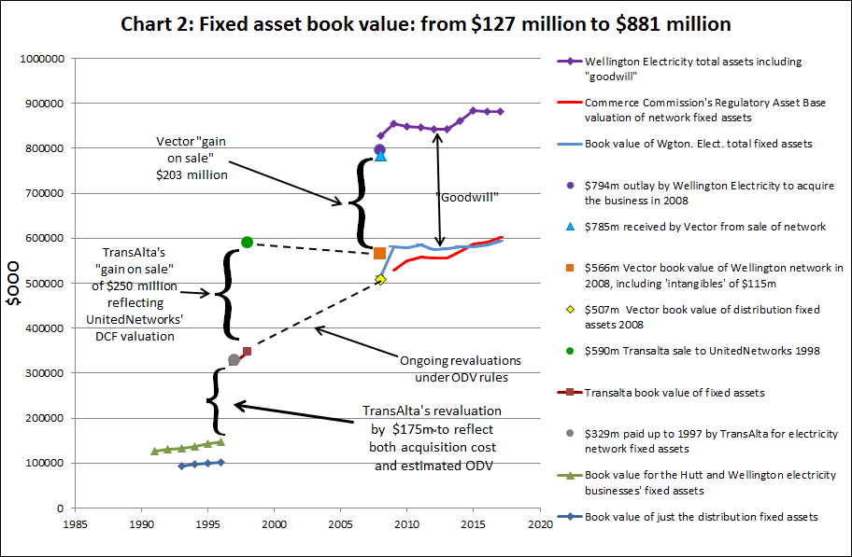

Slide 62
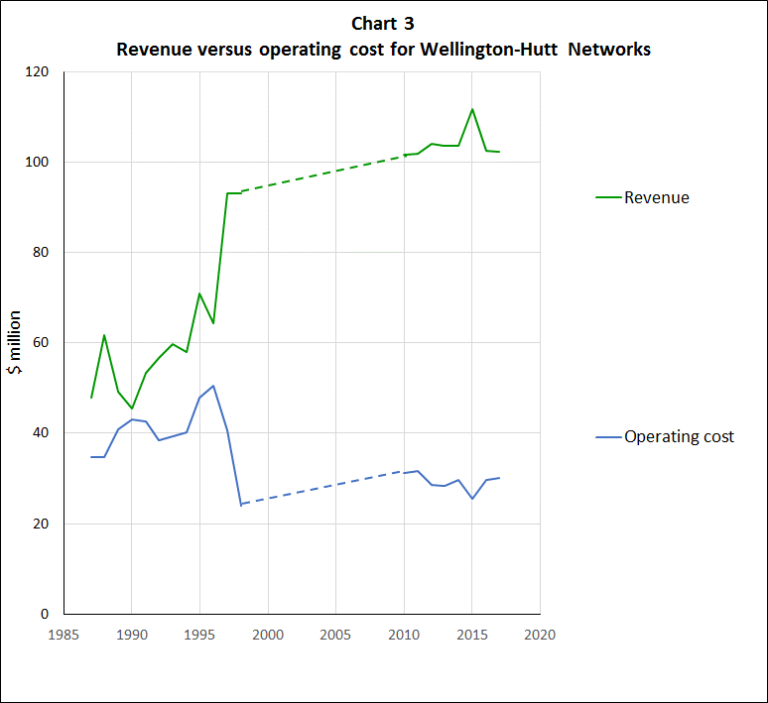

Slide 64
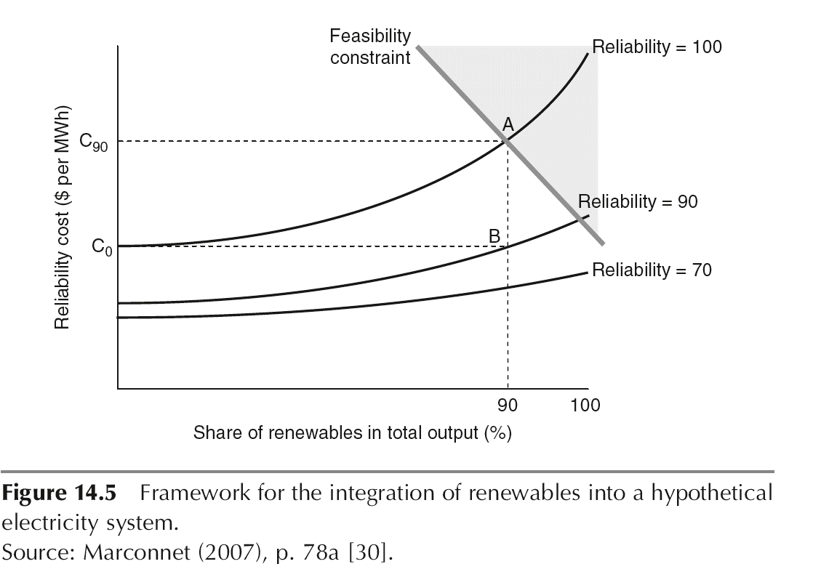
Geoff Bertram and Doug Clover, "Kicking the Fossil Fuel Habit: New Zealand's Case", Chapter 14 in F.P. Sioshansi (ed) Electricity Generation in a Carbon Constrained World, Elsevier, 2009, p.382.

