Slide 1
Electricity and climate change : two intertwined policy problems
Talk for Takaka U3A
9 December 2022
Geoff Bertram
Institute for Governance and Policy Studies
Victoria University of Wellington
My website: www.geoffbertram.com

Slide 2
Agenda
Electricity sector “reform” – neoliberal promises versus real-world outcomes
The NZ Emissions Trading Scheme as a market-mechanism-based way of pricing carbon: neoliberal promises versus real-world outcomes
Interaction of the market with the corporate-captured and ineffective ETS
Some comments on policy options
Geoff Bertram Takaka U3A 9 December 2022
2

Slide 3
The big promise from the electricity “reformers”
Back in the 1980s the proposition was that corporatizing, reorganising, and where possible privatising electricity, would bring gains for consumers because
  Commercial, profit-driven management would (1) raise efficiency and (2) cut costs
  Competition (or appropriate regulation) would (3) force efficiency and productivity gains to be passed through to prices
  Consumers would therefore enjoy better service and lower prices, while profits could rise under an SOE or private model – sharing the gains from more productive use of resources
Geoff Bertram Takaka U3A 9 December 2022
3

Slide 4
Transforming electricity
Before 1984
Since 1984
An “essential service” collectively provided
Priced as cheaply as possible to households: wellbeing the goal
Run by civil engineers committed to optimal planned outcomes
Integrated monopoly with non-profit objectives
A commodity allegedly like any other supplied by corporates
Priced to recover the full cost of the marginal generator plus the monopoly price for each lines-network operator plus a fat margin for dominant retailers
Run by corporate managers and financial engineers maximising profit and “shareholder value”
Multiple players in a complicated institutional landscape of some [allegedly] “competitive” and some [allegedly] “regulated” markets

Slide 5
The record

Slide 6
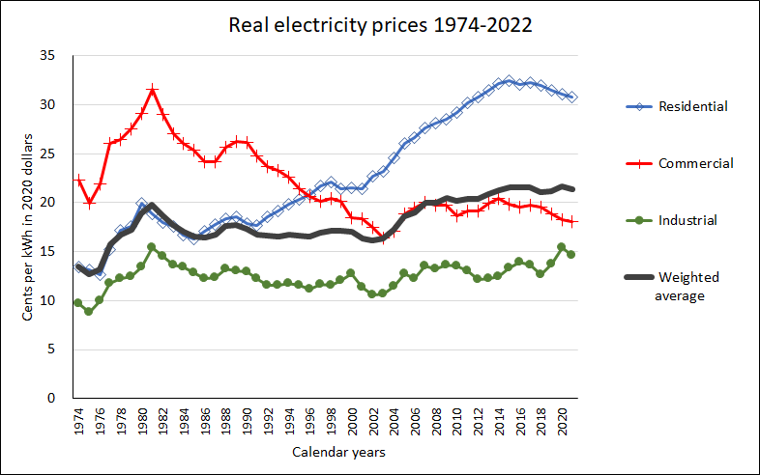

Slide 7
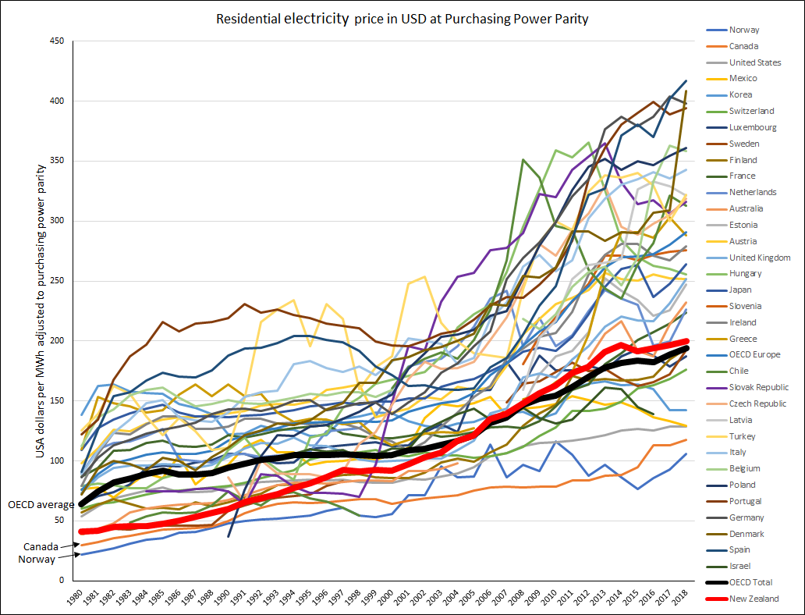
New Zealand used to be the third lowest, at 64% of the OECD average price.
In 2018 NZ was eleventh lowest, at 103% of the OECD average.
Source: International Energy Agency database accessed 3 October 2019.
NZ

Slide 8
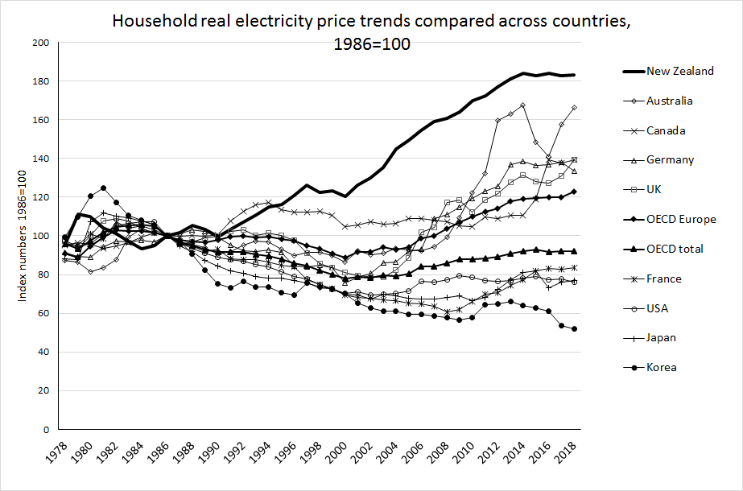
Source: International Energy Agency (2019), "End-use prices: Indices of energy prices by sector", IEA Energy Prices and Taxes Statistics (database), https://doi.org/10.1787/data-00444-en (accessed on 20 May 2019). Series rebased by author to 1986=100.

Slide 9
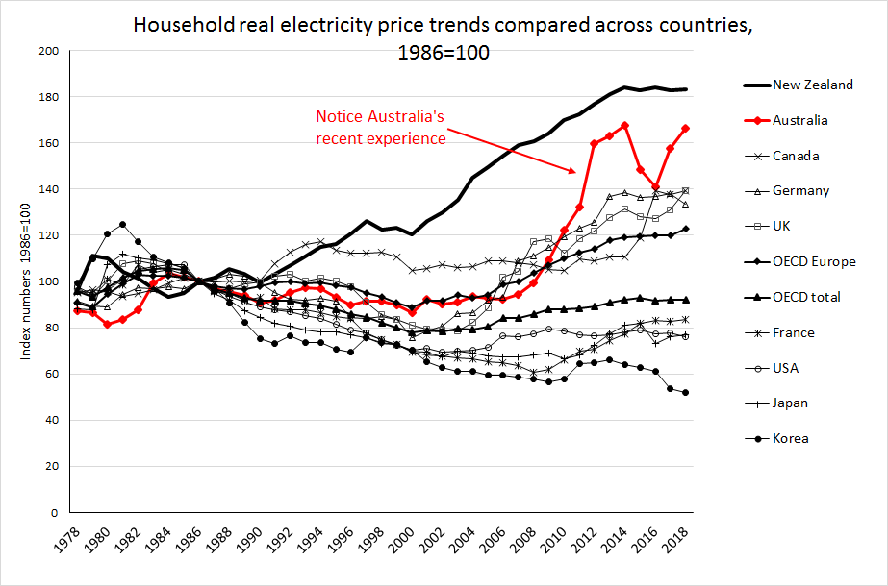

Slide 10
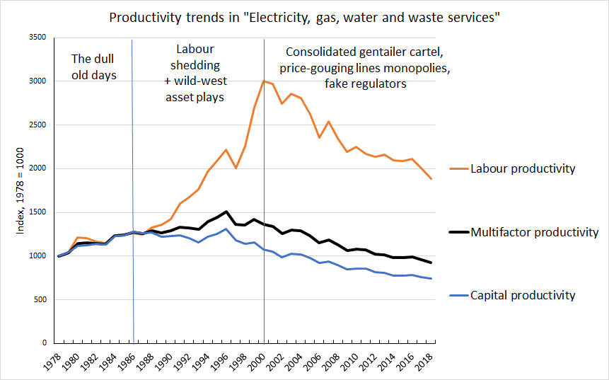
Source: Statistics NZ
Infoshare table PRD014AA

Slide 11
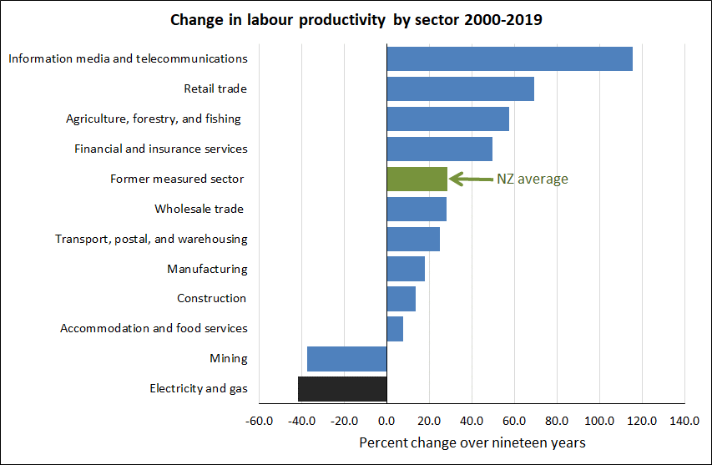

Slide 12
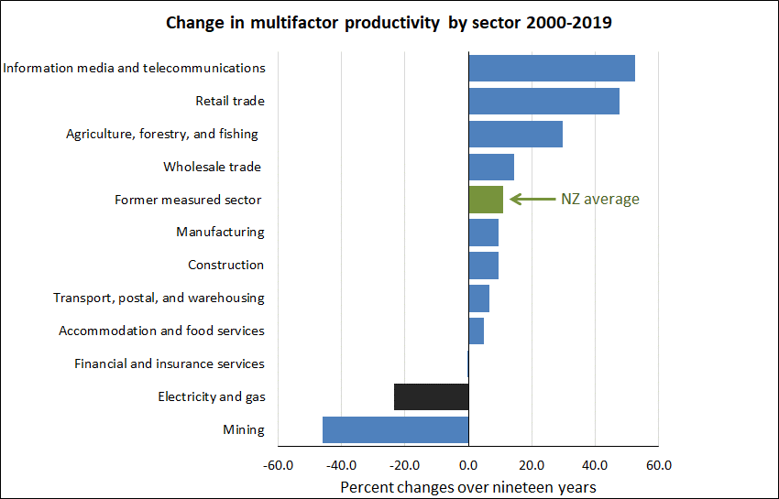

Slide 13
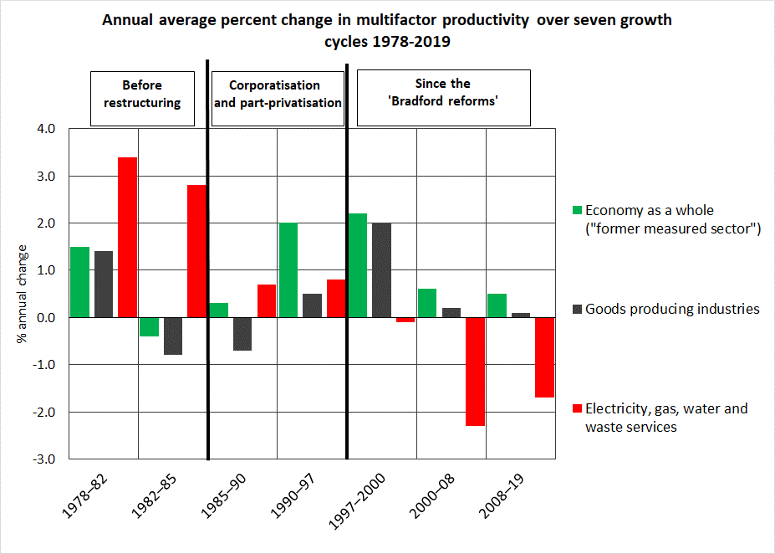

Slide 14
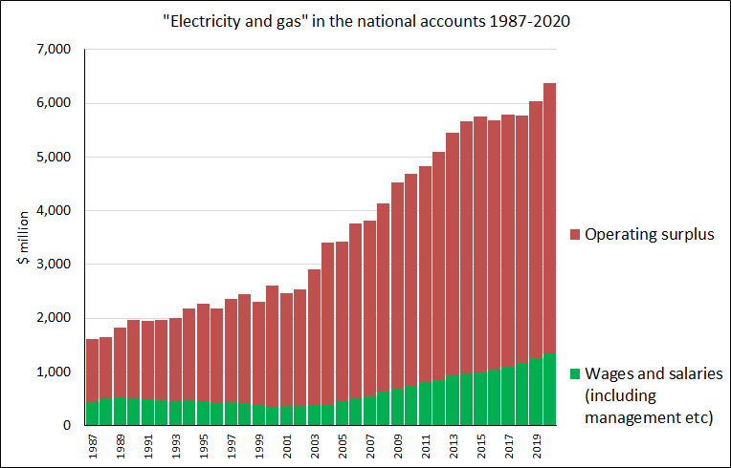
https://www.stats.govt.nz/assets/Uploads/National-accounts-industry-production-and-investment/National-accounts-industry-production-and-investment-Year-ended-March-2020/Download/national-accounts-industry-production-and-investment-year-ended-march-2020.xlsx downloaded 25 August 2022

Slide 15
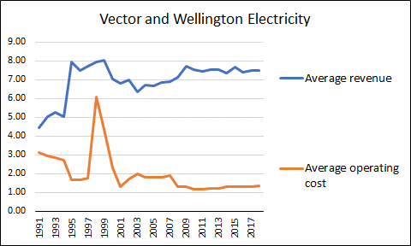
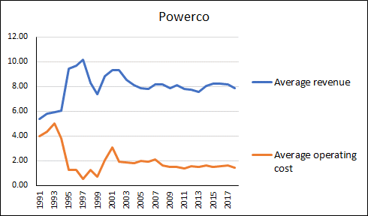
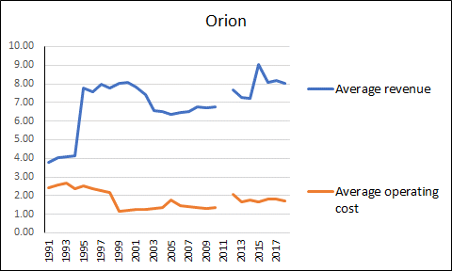
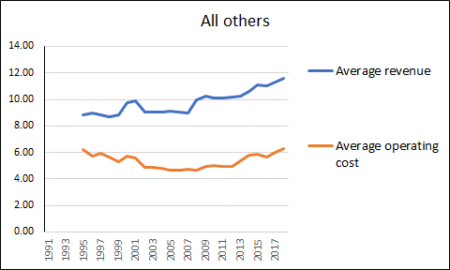
Lines networks, increased markups 1991-2018, in 2018 cents per kWh
Cost reductions not sustained -
but profit margins stayed solid

Slide 16
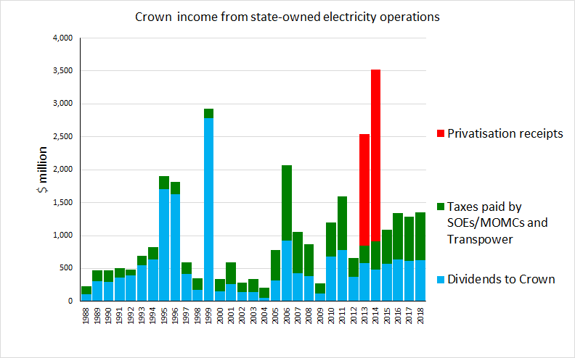
Sources company annual reports, plus TDB Review of Mixed Ownership Model July 2018 https://www.tdb.co.nz/wp-content/.../08/TDB-Mixed-Ownership-Review-Jul-18.pdf
Cash from selling 49% of Meridian, Genesis and Mercury
Cash from leveraging-up Contact at separation
Includes proceeds from Contact privatisation

Slide 17
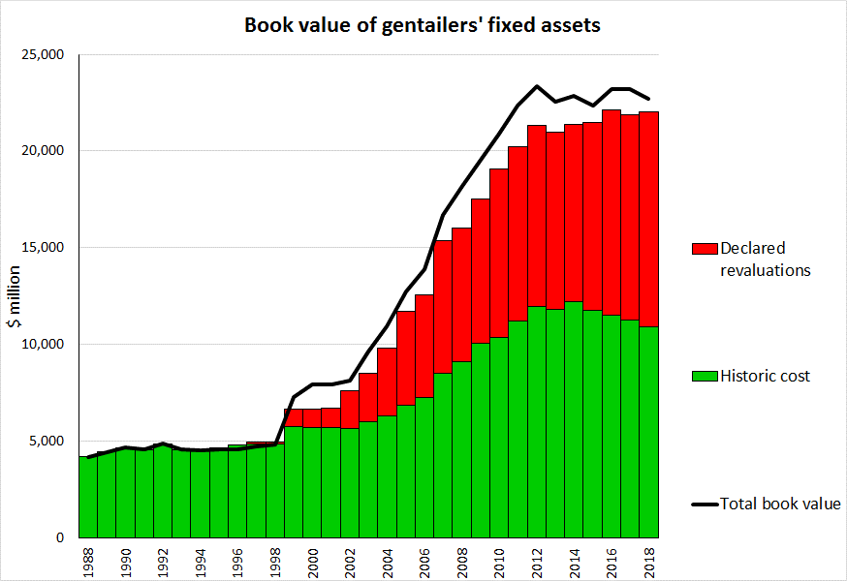
$23 billion book value
“Fair value” revaluations since 1999 ≈ $11 billion wealth transfers from consumers by 2016
Now right up against
the market limit
ECNZ pre-divestment was $4.5 billion
$11b
Source: Company annual reports

Slide 18
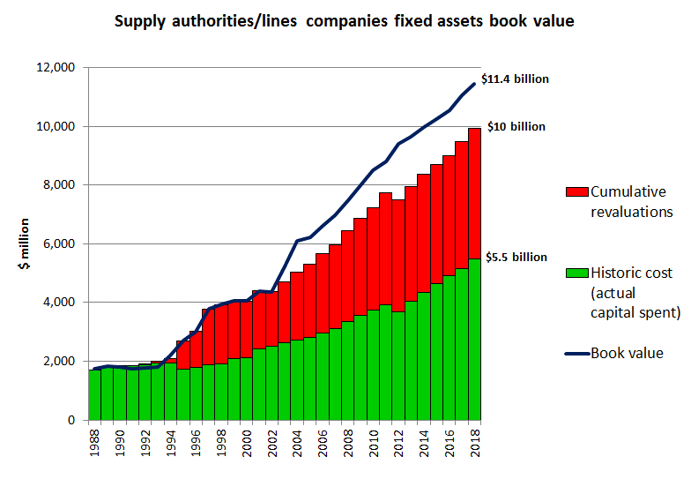
Sources: Disclosed information from Gazettes and Commerce Commission

Slide 19
The outcome 1986-2022
An uncompetitive oligopoly/cartel has been entrenched in control of our most strategic sector
Productivity is down 30% over three decades, gross profits are up 80%
Construction of renewable generation has been slowed down and new entrants to generation are being blocked by anti-competitive practices which are legal under the Commerce Act 1986, and supported by the “regulators” (Electricity Authority and Commerce Commission)
Prices for residential consumers have doubled in real terms and will rise further as the carbon price rises (perverse incentive)
Prices for industry are up just a couple of percent while prices for commercial users are down by a quarter. In other words, countervailing power is what really matters in uncompetitive markets
The electricity industry’s strategic goals are now hostile to equitable climate-change policy and will block progress unless and until the cartel is broken
Geoff Bertram Takaka U3A 9 December 2022
19

Slide 20
Bottom line: over the past two decades this sector has been loaded up with labour and capital engaged in unproductive activities
Pursuit of profit combined with complicated “competition” games and financial engineering has meant that increasing amounts of labour and capital have been allocated to high-paid sales, marketing, financial management and administrative work that adds nothing to the volume or quality of the electricity reaching consumers
Corporatisation and privatisation have culminated in a gigantic exercise in rent-seeking waste

Slide 21
The reason
The reformers either lacked understanding of the economics of the New Zealand electricity system – or didn’t care
They were applying one-size-fits-all cookie-cutter notions imported from the UK and USA where the economics of electricity were different and neoliberal ideas were on the rise
Deregulation opened the door for looting and rent-seeking
Ideology overwhelmed common sense
Geoff Bertram Takaka U3A 9 December 2022
21

Slide 22
The big promise of the Emissions Trading Scheme promoters
Market forces would be harnessed to trigger the most cost-effective options for emission reduction
We would have a “cap and trade” system as a viable alternative to a carbon tax, given that the tax route was judged politically impossible
All sectors/all gases would be covered by 2013 (including agriculture)
New Zealand/Aotearoa would have a credible record to hold up for scrutiny at international gatherings
Geoff Bertram Takaka U3A 9 December 2022
22

Slide 23
The record

Slide 24
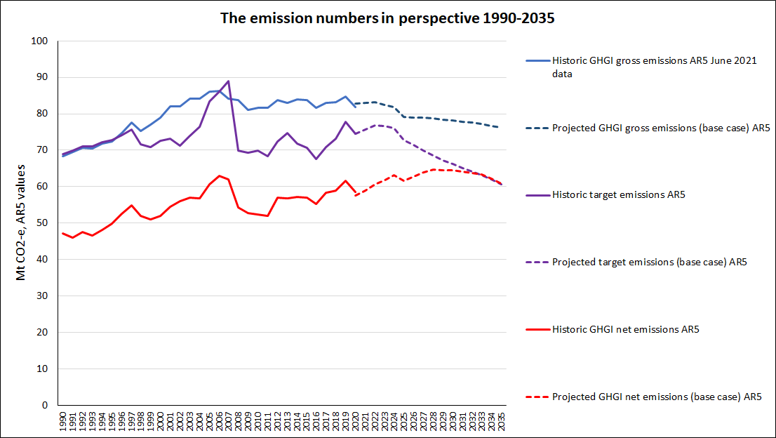
Carbon emissions have shot up since 1990 and are still rising

Slide 25
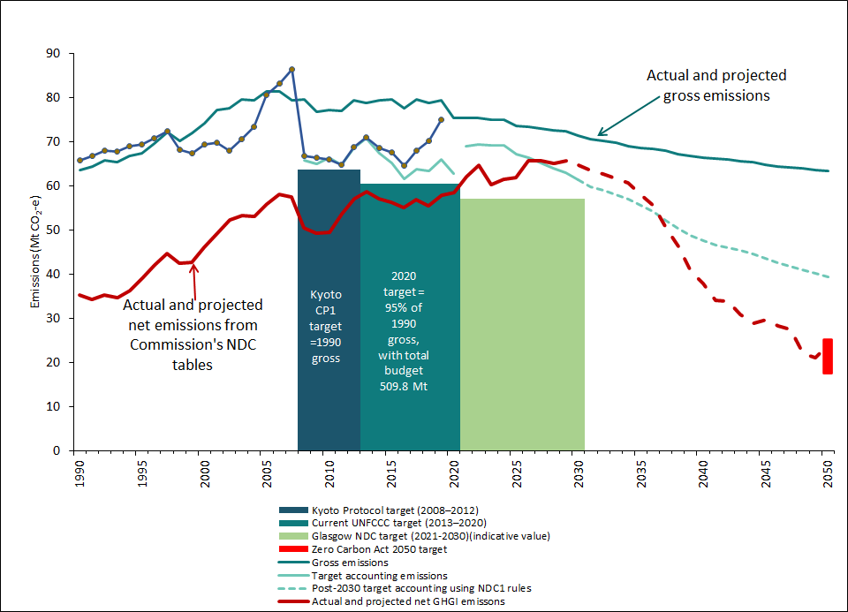
‘My version of target accounting data’ sheet ‘Assembled data’ columns BA-BO

Slide 26
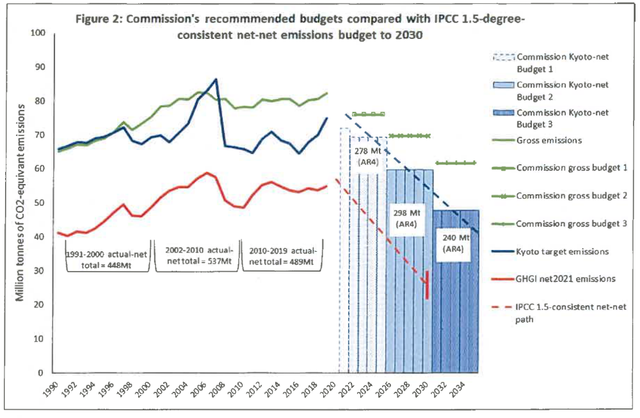

Slide 27
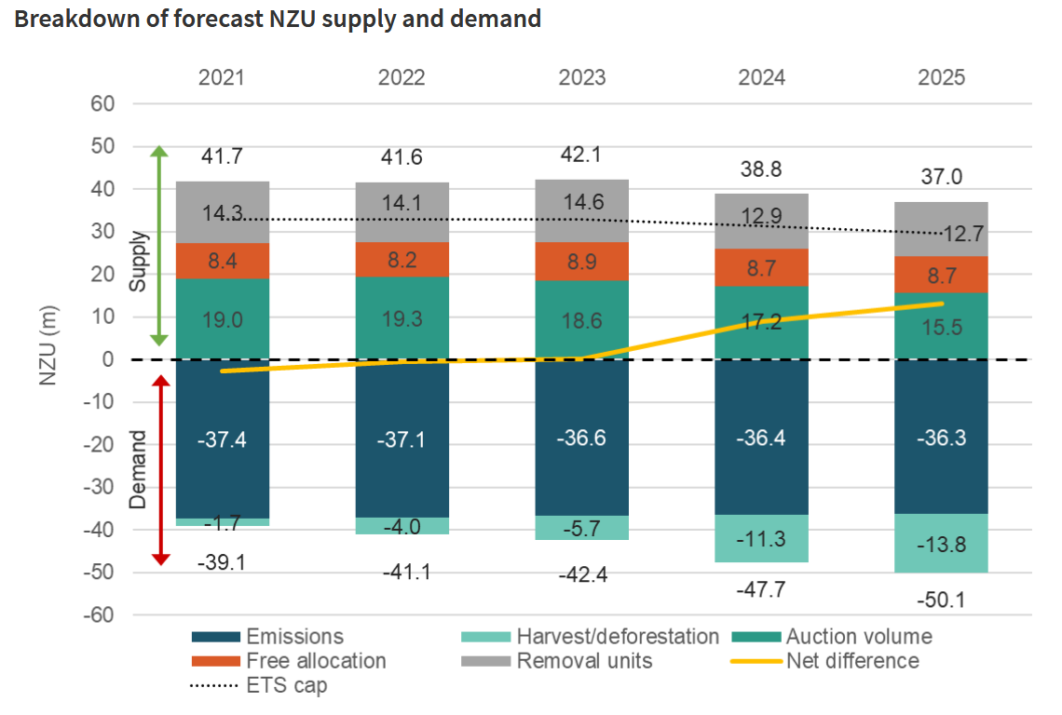
Removal units
Free allocation
Auction volume
Liable emissions
Deforestation
https://www.mfe.govt.nz/ets/market-info-portal

Slide 28
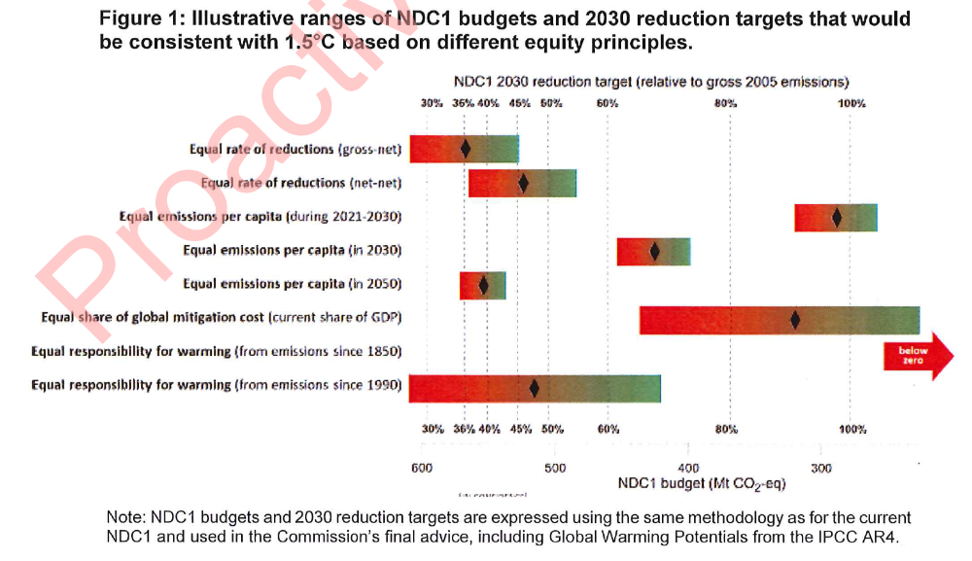
AMBITION
Low
High
Cabinet Paper 10 June 2021 https://environment.govt.nz/assets/publications/8-BRF-213-Consistency-of-NDC1-with-efforts-to-limitglobal-warming-to-1.5-degrees.pdf downloaded 9 June 2022 p.20.

Slide 29
Summing up 2008-2022
The Emissions Trading Scheme to date was from the start a massive scam designed (under corporate lobbying pressure) primarily to enrich corporate insiders – including the electricity gentailer cartel
There was no cap placed on emissions so it was never “cap-and-trade”. There is still no true binding cap
The door was left wide open for using “offsets” – both forests and often-dodgy overseas carbon credits - as a substitute for mitigation effort
That might have worked if the Kyoto Protocol had been a success in establishing global carbon prices and markets, but the Protocol never flew
Either price certainty or quantity certainty is required to incentivise behavioural changes. The ETS provided, and still provides, neither
The 2020 ETS “reforms” have left the scam intact and the uncertainty unchecked
Geoff Bertram Takaka U3A 9 December 2022
29

Slide 30
The reason
Emissions trading was never sensible in New Zealand’s tiny economy – carbon tax was always the better option but corporate stonewalling (channelled by New Zealand First in 2005) blocked that route
ETS design was captured from the outset by corporate vested interests and climate change deniers (Business Round Table and Treasury)
An institutional innovation that was designed and destined to fail from the start
Rent-seeking and vested interests overwhelmed common sense

Slide 31
My interpretation of these outcomes
High profits in electricity have come not from efficiency gains but from price-gouging residential consumers, under cover of entrenched market power, while the countervailing power of big business has protected industrial and commercial users.
Meantime, our electricity sector has become a major roadblock to dealing with climate change imperatives
The Emissions Trading Scheme is a scam that tarnishes NZ internationally and blocks genuine progress on decarbonisation
We would do better with a carbon tax, supplementary regulatory measures, and border adjustments
In a nutshell, the big promises were hollow.

Slide 32
So from here …
A primer on supply/demand diagrams
Some technical stuff on the NZ electricity “market”
Some technical stuff on the New Zealand Emissions Trading Scheme
A couple of modest suggestions for change…

Slide 33
Start by constructing two axes: a vertical one for price, and a horizontal one for quantity
Price
Quantity

Slide 34
Now draw a line to represent the [rather grandly named] “law of demand”
Price
Imagine ranking units of the product in order by the highest price anyone would be willing to pay for that unit, from highest willingness to pay to lowest
Demand curve
Quantity

Slide 35
The two end-points of the simple demand curve
Price
Choke price: nobody is willing to pay more than this for any of the product
The position of the curve depends on
How much income consumers have to spend
How income is distributed across the population
What tastes (“preferences”) people have for this product versus alternatives (“substitutes”)
Demand curve
Satiation: nobody wants any more than this even if it is given away
Quantity

Slide 36
The role of price is to ration the quantity demanded to q₁
Price
Consumers pay to suppliers the money amount p₁ x q₁
p₁
q₁
Quantity

Slide 37
An example of the price constraint is a carbon tax on emissions (or price of emission permits)
Price
Having to pay the carbon price means people have an incentive to cut their emissions to q1
Carbon price
Demand for emissions (i.e. people’s desire to emit CO2
q₁
Quantity

Slide 38
Where does the price come from in a competitive market? Answer: the supply curve (what has to be paid to get different amounts of the product)
Price
Supply curve
Imagine ranking units of the product in order by the lowest price any supplier would be willing to accept for that unit, from lowest willingness to the highest
Quantity

Slide 39
Two key features of the simple supply curve
Price
Supply curve
No supply at all is available below p₀
At higher prices, greater quantity supplied becomes available to buyers
1. Entry price
p₀
Quantity

Slide 40
Two key features of the simple supply curve
Price
Supply curve = MC
2. Each point on the supply curve shows the marginal cost of supply – that is, the price that has to be paid to bring one more unit of the product into the market
Quantity

Slide 41
We can think of the area under the curve up to any quantity q* as the total cost of supplying the product, calculated by adding up the supply price of all successive units of quantity supplied
Price
Supply curve
Total supply cost
q*
Quantity

Slide 42
The price corresponding to q* is p*. When this price prevails, suppliers collect p* x q* in total revenue of which ABC is “producer surplus”
Price
Supply curve
A
B
p*
Surplus
Total supply cost
C
q*
Quantity

Slide 43
Summary: competitive market equilibrium under standard assumptions
Price
Supply curve
p*
Producer surplus
Demand curve
Cost of supply
q*
Quantity

Slide 44
The New Zealand electricity wholesale market has a distinctive (short-run) supply curve and a very steep demand curve
Price (e.g. $ per Mwh)
Supply curve
Supply-price is the marginal cost of supplying the last unit of quantity
Market-clearing price
p_{E}
Operating surplus
Demand curve
q_{E}
Quantity (e.g. MWh) per period
Old hydro
Market-clearing quantity

Slide 45
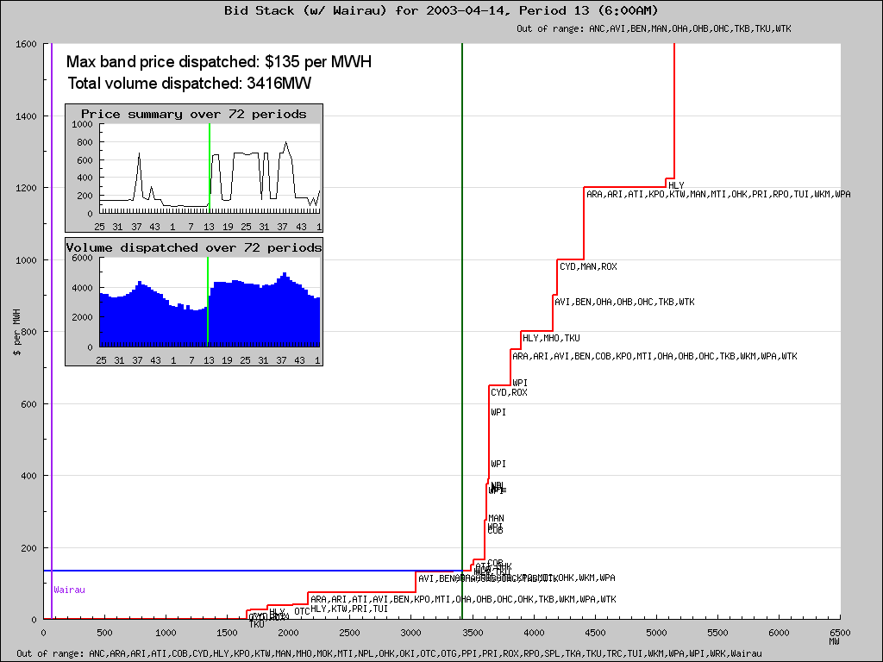
6.00-6.30am

Slide 46
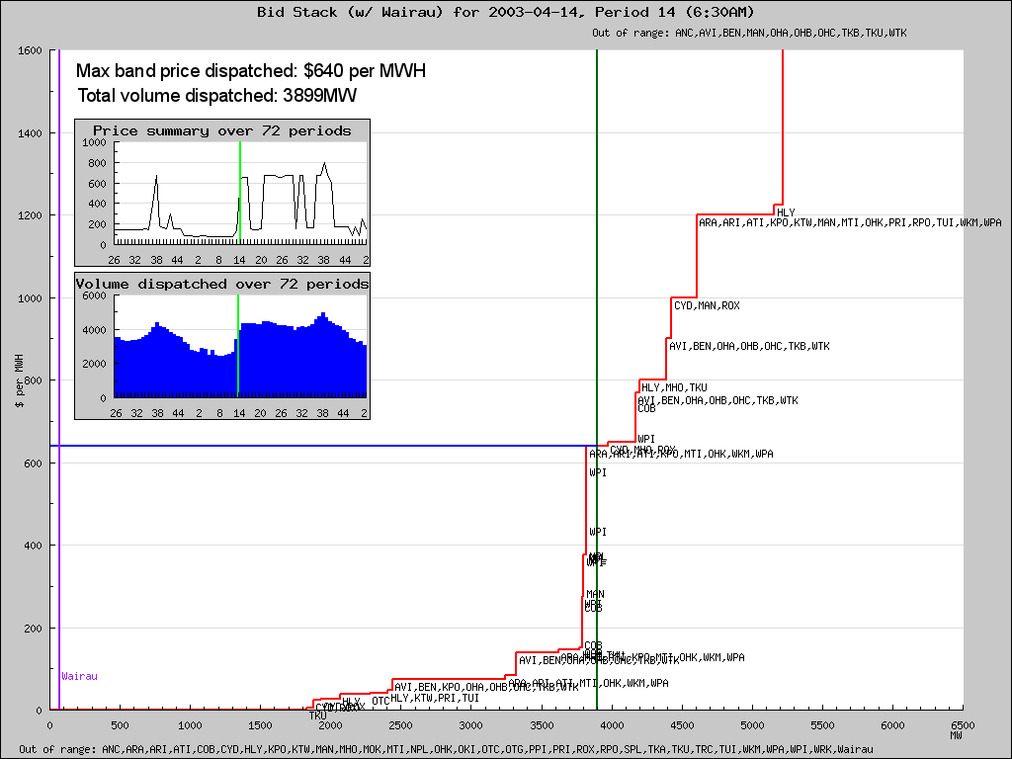
6.30-7.00am

Slide 47
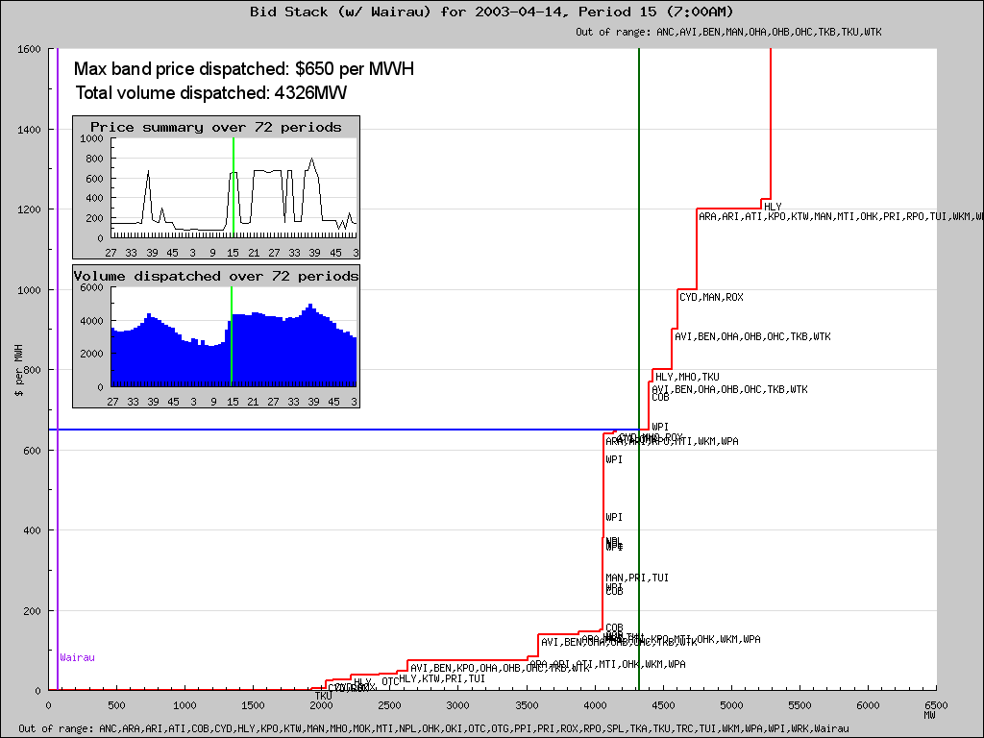
7.00-7.30am

Slide 48
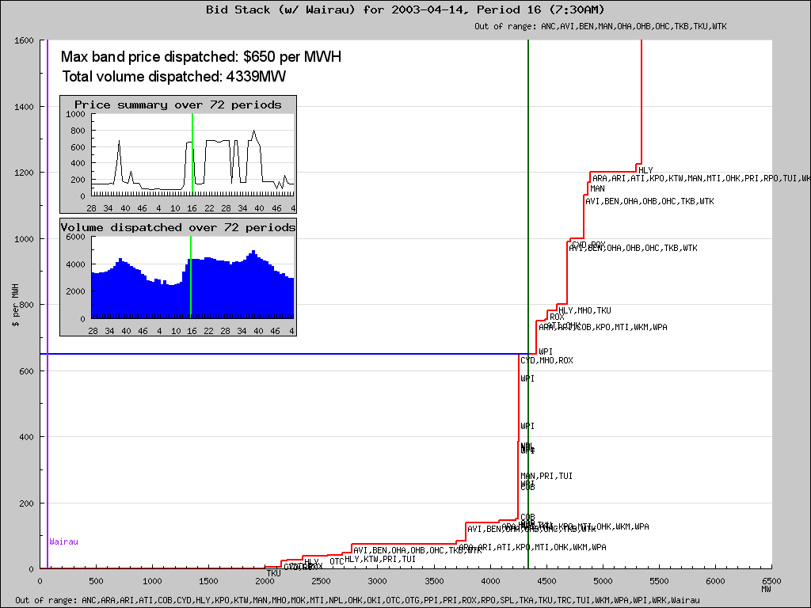
7.30-8.00am

Slide 49
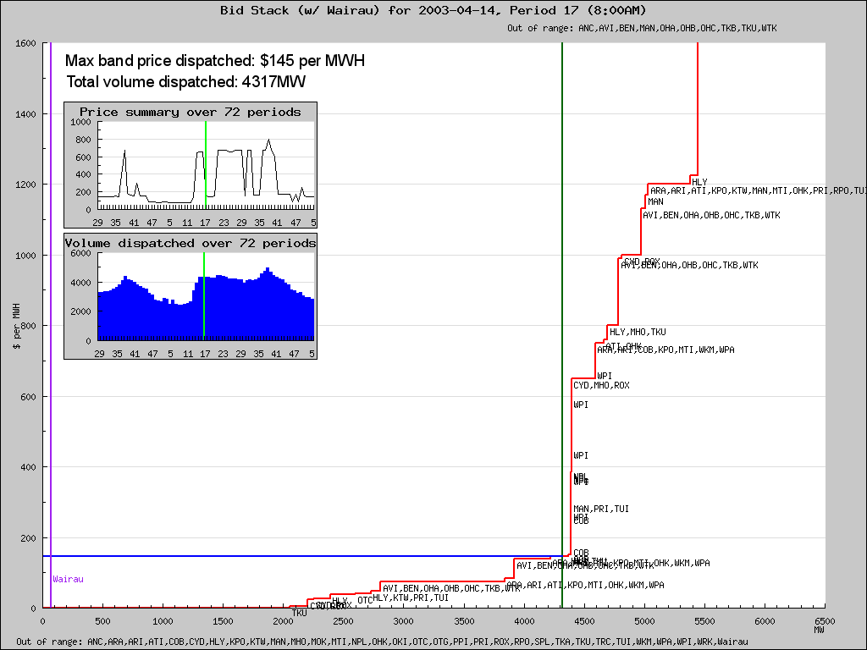
8.00-8.30am

Slide 50
Generation rents in the New Zealand wholesale electricity market:
Low-cost hydro operators collect big profits (actually rents)
High-cost fossil-fuel plants set the marginal cost and hence the price
Price
Supply
Tiwai Point smelter owners head off to the bank with a slice of the rents
P_{E}
Tiwai
Point
Gentailer profits
Cost of supply
Demand
Q_{E}
Volume
Institute for Governance and Policy Studies Kapiti WEA 27 August 2022
50

Slide 51
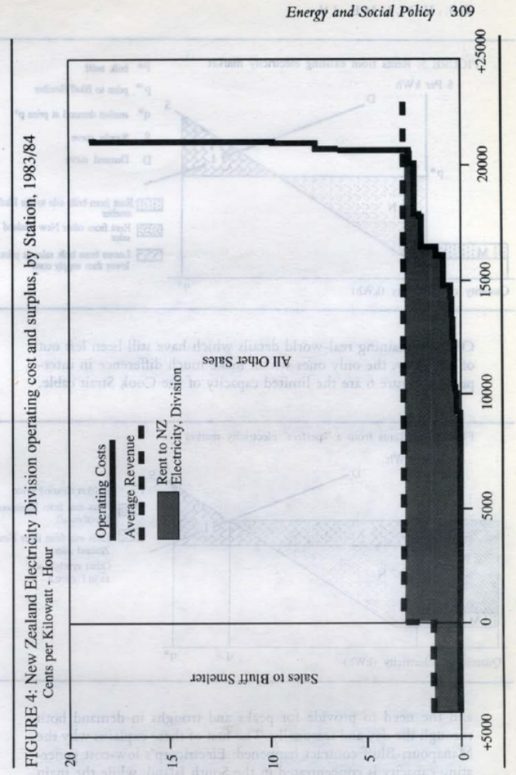
A chart from my 1988 paper for the Royal Commission on Social Policy
GWh

Slide 52
There are two big threats to those gentailer profits
1. A collapse in demand if Tiwai Point closes
2. An unwelcome increase in supply if lots of low-operating-cost renewables get installed

Slide 53
1. Suppose Tiwai Point closes…
Price
Smelter’s power use
}
p₁
Supply
curve
Gentailer profits
Tiwai
Point
Cost of supply
Demand₁
Q_{E}
Volume
Institute for Governance and Policy Studies Kapiti WEA 27 August 2022
53

Slide 54

1. Suppose Tiwai Point closes…
How to stop this: sign up another big user with a cheap power contract asap:
“green hydrogen”
big data centres
anything…..
Smelter’s power use vanishes
}
Price
Supply
curve
p₁
Price falls to p₂
Gentailer profits
gone!
p₂
Cost of supply
Demand₂
Demand₁
Q_{E}
Volume
Institute for Governance and Policy Studies Kapiti WEA 27 August 2022
54

Slide 55

1. Suppose Tiwai Point closes…
Even the Electricity Authority is balking at this! *
Inefficient Price Discrimination in very large electricity contracts: Proposed Code Amendment 18 August 2022, https://www.ea.govt.nz/assets/dms-assets/30/Inefficient-Price-Discrimination-in-very-large-electricity-contracts-Consultation-paper.pdf
In August 2022 the Authority made an urgent amendment to the Electricity Industry Participation Code to prohibit generators from giving effect to contracts of net 150MW or more unless certain conditions are met.
Price
Supply
curve
p₁
“Green
Hydrogen”
Cloud data centre
Gentailer profits back!
p₂
Cost of supply
Q_{E}
Volume
Institute for Governance and Policy Studies Kapiti WEA 27 August 2022
55

Slide 56
2. Suppose heaps of households install rooftop solar..
Price
Supply
curve
p₁
Tiwai
Point
Gentailer profits
p₂
Cost of supply
Demand₁
Q_{E}
Volume
Institute for Governance and Policy Studies Kapiti WEA 27 August 2022
56

Slide 57
2. Suppose heaps of households install rooftop solar..
Price
p₁
New supply
curve
Price falls to p₂
Tiwai
Point
Gentailer profits
additional supply
gone!
High-cost generation assets “stranded”
p₂
Cost of supply
Demand₁
q_{E}
Volume
Institute for Governance and Policy Studies Kapiti WEA 27 August 2022
57

Slide 58
2. Suppose heaps of households install rooftop solar..
How to prevent or limit the supply shock:
make it really hard for distributed renewables to get connected to users (regulatory obstruction using “rules”)
Pay minimal amounts for power from household panels (using market power from vertical integration of generation and retailing)
Price
p₁
New supply
curve
Price falls to p₂
Tiwai
Point
additional supply
p₂
Cost of supply
Demand₁
Q_{E}
Volume
Institute for Governance and Policy Studies Kapiti WEA 27 August 2022
58

Slide 59
2. Suppose heaps of households install rooftop solar..
And once again:
Sign up hydrogen plants, cloud data centres, anything power-hungry
Price
p₁
New supply
curve
Price back up to to p₁
Cloud data centre
Gentailer profits
back!
Tiwai
Point
“Green
Hydrogen”
p₂
Cost of supply
Q_{E}
Volume
59

Slide 60
So core strategy for Contact, Meridian, Mercury, Genesis and Trustpower is:
Keep demand up
(keep the Tiwai Point smelter open!)
(or have a huge hydrogen plant built!)
(or anything!)
Keep supply constrained (don’t build too many windfarms, and block rooftop solar if possible)

Slide 61
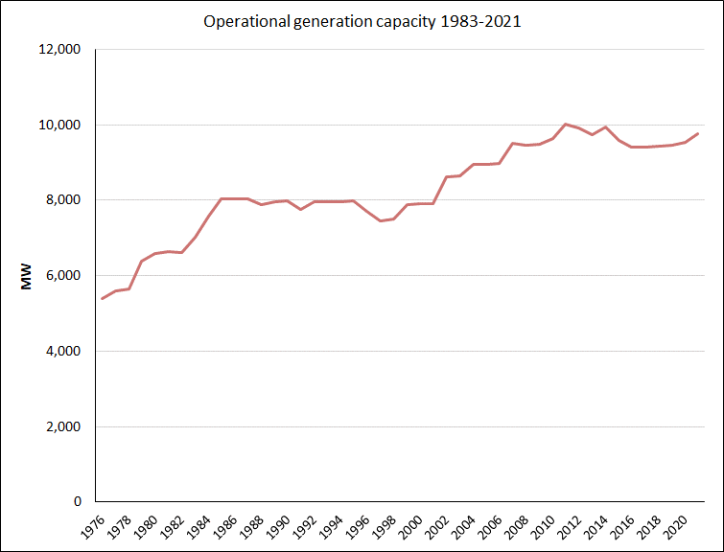
New Zealand total generation capacity
Reform starts
https://www.mbie.govt.nz/assets/Data-Files/Energy/nz-energy-quarterly-and-energy-in-nz/electricity.xlsx at 7 December 2022

Slide 62
Turn now to carbon charges and the price of renewable electricity

Slide 63
Here’s the New Zealand wholesale electricity market again:
Reminder: fossil-fuel plants set the marginal cost and hence the market price
Price
P_{mc}
Supply
Rents to gentailers and Tiwai
B. High-cost producers’ costs
P_{L}
Demand
A. Low-cost producers’ costs
q_{E}
Volume
63

Slide 64
Now impose a carbon charge on fossil-fuel generation
Reminder: fossil-fuel plants set the marginal cost and hence the market price
Price
P_{mc}
Supply
Rents to gentailers and Tiwai
B. High-cost producers’ costs
P_{L}
Demand
A. Low-cost producers’ costs
q_{E}
Volume
64

Slide 65
Now impose a carbon charge on fossil-fuel generation
That’s a major disincentive to electrification of the wider economy, which gets worse as the carbon price increases
Price
Price goes up to include the carbon charge on fossil fuels
P_{with tax}
Carbon tax is added to the cost of fossil-fuelled generation
Windfall carbon rents to hydro and geothermal owners
Carbon
tax
P_{mc}
Rents to gentailers and Tiwai
P_{L}
Demand
A. Low-cost producers’ costs
q_{E}
Volume
65

Slide 66
So who saw that carbon-price-driven-price hike coming?
Answer: the big corporate electricity users, right back in 2008 when the NZETS started up
Their solution: get the Government to hand them out free carbon credits sufficient to offset to extra cost of using electricity when the carbon price went up
The scheme is called the Electricity Allocation Factor
Government agreed - and since 2010 has handed out the free credits each year even though the carbon price did not go up as much as was expected => a corporate windfall at the expense of the rest of the population

Slide 67
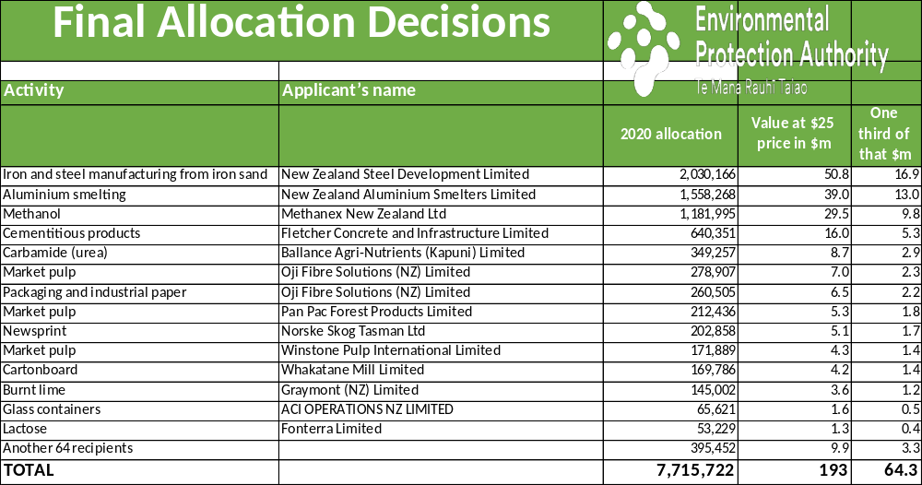
A quick rough look at who got the EAF benefits in 2020…
Treble this for the current price
https://www.epa.govt.nz/assets/Uploads/Documents/Emissions-Trading-Scheme/Reports/Industrial-Allocations/Industrial-Allocations-Final-Decisions.xlsx downloaded 25 August 2022.

Slide 68
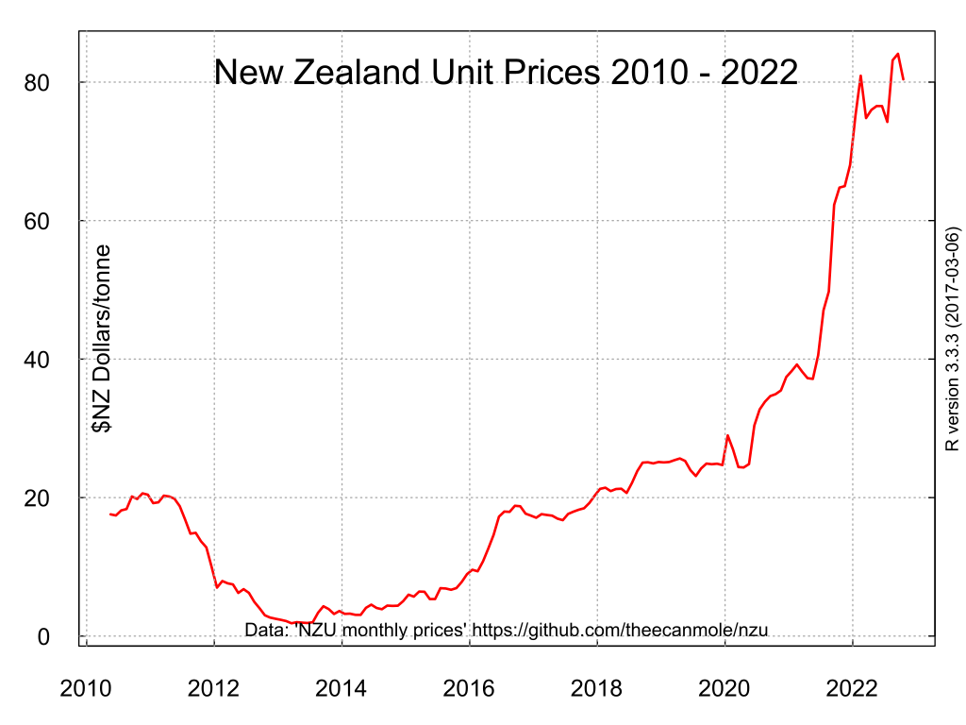
Imports of junk units
https://en.wikipedia.org/wiki/New_Zealand_Emissions_Trading_Scheme#/media/File:NZU-NZ-emission-unit-720by540.svg at 7 December 2022

Slide 69
Economics of emissions reduction

Slide 70
The “carbon market”
Demand for emissions = Marginal Product of Emissions = Marginal Abatement Cost
$ per tonne of CO₂-e
Unregulated emissions
Emissions, Mt
O
N

Slide 71
If the price of emissions rises to P_{e} then the quantity falls to OM and the emissions reduction (“abatement” or “mitigation”) is MN
$ per tonne of CO₂-e
Demand for emissions = Marginal Abatement Cost
Regulated emissions quantity OM
P_{e}
Unregulated emissions
Emissions, Mt
O
M
N

Slide 72
One way of doing it: a carbon tax of P_{e} would lead to MN of abatement
Think of this as the cost of emitting – i.e. the price of exercising the right to emit carbon
$ per tonne of CO₂-e
P_{e}
CARBON TAX
Revenue to Government
Emissions, Mt
O
M
N

Slide 73
Or the Government could impose a cap at M, issue permits, allow trading, and the carbon price would be bid up to P_{e}
$ per tonne of CO₂-e
Think of this as the [fixed] supply of rights to emit carbon
CAP
P_{e}
Revenue to Government
if permits are auctioned;
windfalls to recipients
if permits are given away
Emissions, Mt
O
M
N

Slide 74
With international emissions trading there is neither a cap nor a locally-set price
$ per tonne of CO₂-e
Domestic cap is irrelevant
P_{e}
P_{w}
Supply of offshore credits
Emitters must acquire OK of carbon units at price Pw for surrender to Government
Emissions, Mt
O
M
K
N

Slide 75
Under the NZETS
NZUs are issued free to corporate insiders (a) to prevent carbon leakage and (b) to compensate for any effect the ETS may have on the electricity price
NZUs can be earned by forestry operations if the forest owner opts in, and these units can be sold into the market if the owner chooses not to bank them
‘Banked’ NZUs can be used to cover current emissions (there is currently a big overhang of banked units)
Offshore carbon credits can be imported and used to cover local emissions if and when the Minister authorises this (by getting an Order in Council)
The quantity of NZUs released for auction by Government is at the whim of politicians subject to corporate capture

Slide 76
CARBON TAX
Tax imposed
High price
weeds out
less
efficient polluters
Price of carbon driven up
=price certainty
Limited quota rights allocated
CAP AND TRADE
=quantity certainty
Emissions fall
Central authority imposes enforceable limits on all emitters
Production restricted to meet commands
COMMAND AND CONTROL
=quantity certainty
Emissions fall only if world price is above MAC. Otherwise no change
Emitters required to cover all emissions with carbon credits including offshore-issued units
Price of units settles at the world price
EMISSIONS TRADING
= uncertainty

Slide 77
Ineffectual attempts to create certainty
The ‘trigger price’ reflects Government’s terror of a high carbon price – but may not be sustainable in the face of market developments (cf the housing market 2000-2021)
Promises to not allow too much importing of units can be broken at any time – e.g. after a change of government
Leaving agriculture out is of uncertain credibility
Forestry decisions and hence claims to earn NZUs are inherently hard to predict – and policy on forests keeps changing, partly because of the risk that so much will be planted that the NZETS will have no effect on actual emissions
The future world price and availability of offshore credits is unknowable

Slide 78
Why a carbon tax with border adjustments would have been the smart move (and still could be)
The tax can be imposed across the entire economy with no exemptions and can be adjusted regularly as conditions change (cf the RBNZ’s use of the OCR)
Border adjustments mean that the carbon tax is automatically rebated on all export goods – just like GST - so no need to rush around arranging special deals for farmers, Tiwai Point, Carter Holt Harvey and all. That kills the “competitiveness at risk” argument for special favours
The revenue can be recycled as a dividend to all households (a sort of Universal Basic Income) or can be hypothecated to funding green investments
Certainty can be locked in if there’s bipartisan support
Harmonisation with other countries’ carbon-tax regimes is straightforward and international commitments can be made (=> “carbon clubs”)

Slide 79
What does this mean for tackling climate change?
Getting emissions down and moving towards a zero-carbon economy requires (among other things of course)
  Rapid electrification of all possible areas of the economy to push out fossil fuels – so need the lowest possible electricity prices as incentive
  Maximum possible deployment of renewable/nondepleting sources of electricity: wind, solar, tidal, waves, hydro, geothermal….
Two essential requirements for success are that
  Price incentives like carbon taxes or emission pricing penalise fossil fuel use while at the same time encouraging use of renewable electricity
  Vested interests must not be able to place barriers to entry in the way of renewables (including small-scale distributed ones like rooftop solar and backyard wind)

Slide 80
The required level of regulatory intervention may be “politically unfeasible”
But the bottom line is that Nature does not negotiate

Slide 81
The present electricity market setup ensures that
Feed-in tariffs, retail pricing structure, and entry barriers to rooftop solar, have been manipulated by the gentailer cartel and its enablers to make ‘prosumer’ investments unprofitable
Carbon charges drive up the price of grid-connected renewable electricity
Parliament has repeatedly failed to confront these problems

Slide 82
Why so little distributed renewable generation?
For example rooftop solar, local community energy networks with wind, solar, micro-hydro and batteries
MY ANSWER:
  because that threatens the profits of the gentailer cartel
  and the so-called regulatory agencies have been captured by the big players

Slide 83
The electricity industry’s central strategic goal: maximize electricity demand while blocking the path to 100% renewables
So long as fossil fuels stay in the mix, they are at the wholesale market margin and so set the spot price way above the supply cost of hydro, geothermal and wind
So long as fossil fuels are on the margin, every increase in the carbon price - whether via the ETS or otherwise - pushes up the price of all electricity, including renewables
That means wealth transfers to the gentailers as other desperate policy measures drive electrification against the electricity-pricing tide
The commercial (as distinct from lifestyle) viability of small-scale distributed generation such as rooftop solar and small windfarms is quite sensitive to the price structure facing households: removing the low-fixed-charge regulation was a quick way to make rooftop solar less economic.
A big threat to gentailer profits is the huge potential wind resource, but the gentailer cartel has locked up and “banked” the best sites (plus several hydro options)
Without institutional change, Government policy is hostage to the cartel’s stranglehold

Slide 84
Five modest policy suggestions
1. Reorganise existing electricity assets to perform two key roles:
  i Backstop intermittent renewables
  ii. Supply low-priced contract blocks of electricity for supply to low-income households and climate-friendly activity
  That boils down to renationalising hydro plus maybe some other assets
2. Immediately enable/encourage local/regional small-medium scale distributed renewable generation => generous feed-in tariff and remove regulatory barriers
3. Abolish the lines/energy split – certainly at local level => distribution networks can become local pools/coordinators
4. Dump the NZETS and switch to a carbon tax with border adjustments tailored to a world of carbon clubs
5. Make the statutory carbon budget binding, not “aspirational”

