Slide 1
Sovereignty and Material Welfare in Small Island Jurisdictions
Geoff Bertram
Stout Centre Winter Research Seminar Series
3 August 2011

Slide 2
Three bits of conventional wisdom under threat in small islands
The presumption that there are economies of scale and scope in government
The presumption that there are crucial economies of scale and scope in economic development
The presumption that developmental success in a small open economy requires strong trading performance on the export side to sustain material standards of living.
Over the past three decades I have gradually worked my way up that list, using data on a widening set of small islands around the world.

Slide 3
Empirically observed unimportance of strong trade performance to sustain living standards
MIRAB model: Bertram and Watters 1985; Bertram 1986, 1993, 1998, 2006.
Strength of tourism as a leading sector: McElroy 2006
Wide range of other options - “resourcefulness of jurisdiction: Baldacchino and Milne 2000; Baldacchino 2006
Synthesis of nine development strategies with export-led growth only one: Bertram and Poirine 2009

Slide 4
Empirically observed failure of the ‘vulnerability paradigm’
Small islands intuitively seen as vulnerable: Streeten 1993, Briguglio 1995
Empirical work showed ‘vulnerability’ was inversely related to income per head: Armstrong et al 1998, Easterly and Kraay 2002, Sampson 2005
Alternative model emphasises the power of local agency and the strategic-flexibility model of island success: Baldacchino and Bertram 2009

Slide 5
World Development indicators Top Ten Countries by 2007 GNI per capita (Atlas method)
1 | Monaco | 173,310
2 | Liechtenstein | 111,690
3 | Luxembourg | 78,470
4 | Norway | 76,190
5 | Channel Islands | 68,600
6 | Iceland | 58,430
7 | Switzerland | 57,020
8 | Denmark | 54,700
9 | Isle of Man | 49,300
10 | Sweden | 48,900
http://data.worldbank.org/data-catalog/world-development-indicators accessed 2 August 2011

Slide 6
That’s six very small countries, three of them islands, in the top ten
WDI misses a lot of small islands: Bermuda, Aruba, Cayman Islands, Sint Maarten…..
Easterly and Kraay 2002 p.2015: “if we control for the location by continent of all countries, whether they are oil producers, and whether they belong to the OECD, then small states are actually significantly richer than other states”.
Diseconomies of scale and scope did not turn out crippling – again this led to the research on development strategies I mentioned earlier

Slide 7
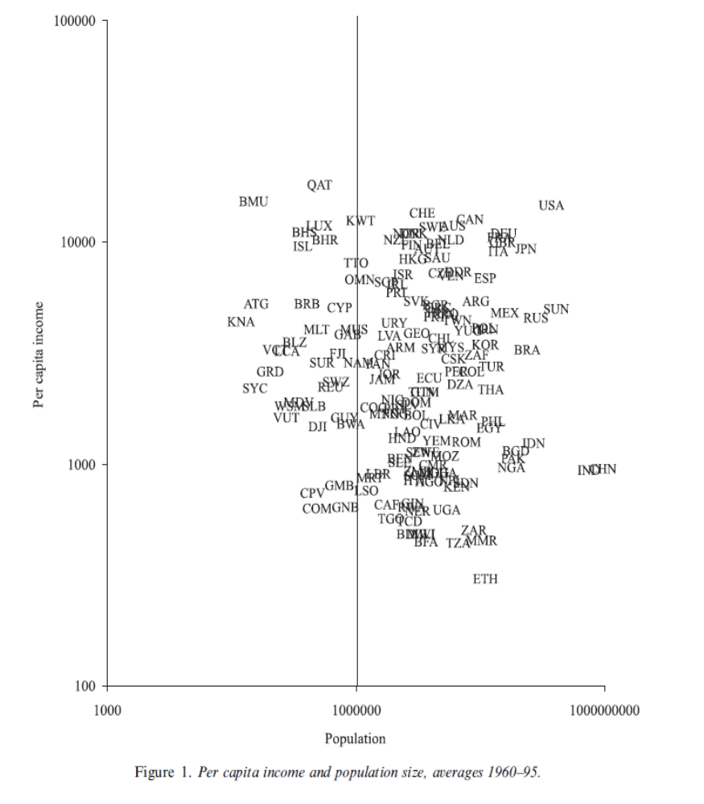
Easterly and Kraay’s (2002) scatter relating population to income per capita
Easterly, W. and A. Kraay, 2002 “Small States, Small Problems? Income, Growth, and
Volatility in Small States” World Development 28(11): 2013-2027, November

Slide 8
A by-product of the empirical work on size and import financing was the explanatory power of political status
Strong statistical evidence that non-sovereign status is positive for the level of per capita GDP: Armstrong et al (1998, 2002), Bertram (2004), McElroy and Pearce (2006), and Sampson (2005 p.7)
Sampson found, however, no significant effect of sovereignty status on the growth rate, and a negative effect on growth of being a small state, after controlling for sovereignty. Higher incomes today, in other words, seemed to be explained by past, not current, economic growth.
Bertram (1987)
  reviewed the various options for decolonisation: sovereign independence, integration with another state, self-government in free association, and possible unspecified other options
  argued the case that sovereign independence was likely to be an inferior option for very small islands
  further argued that integration – if done on the right terms – could well be superior to free association.
Bertram (2004): Integrated political status was estimated to add between $5,600 and $7,500 in USD to per capita income, relative to sovereign independence

Slide 9
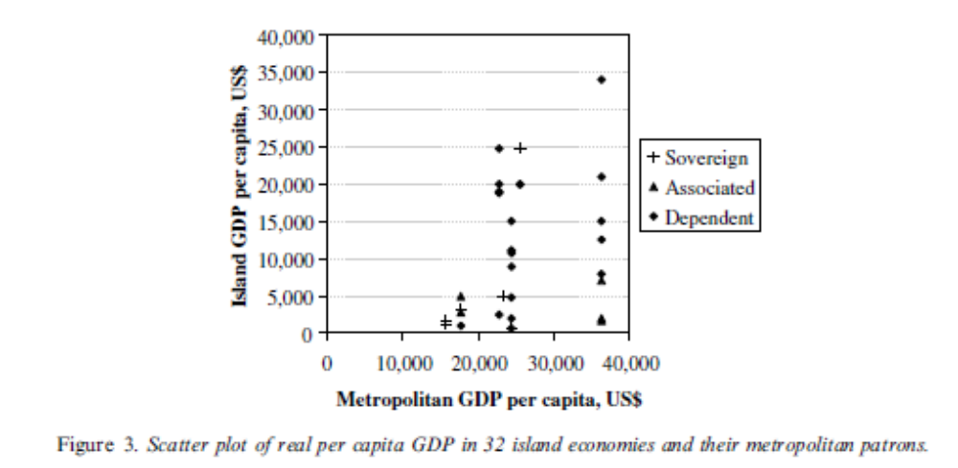
G. Bertram, 2004, ‘On the convergence of small island economies with their metropolitan patrons’, World Development 32(2): 343-364, p.346

Slide 10
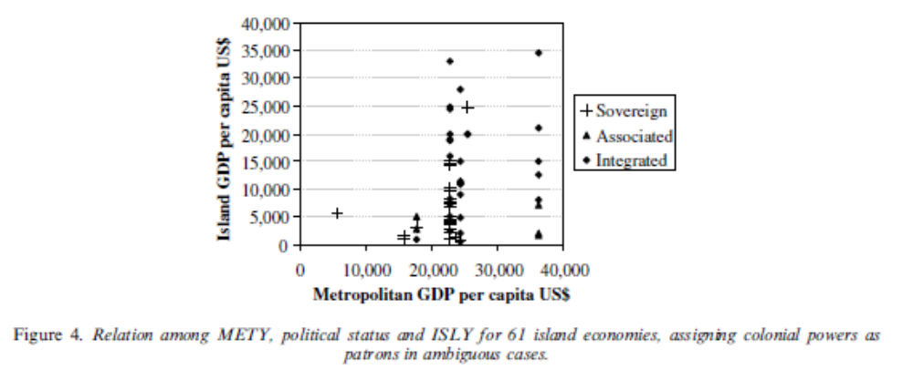
G. Bertram, 2004, ‘On the convergence of small island economies with their metropolitan patrons’, World Development 32(2): 343-364, p.352.

Slide 11
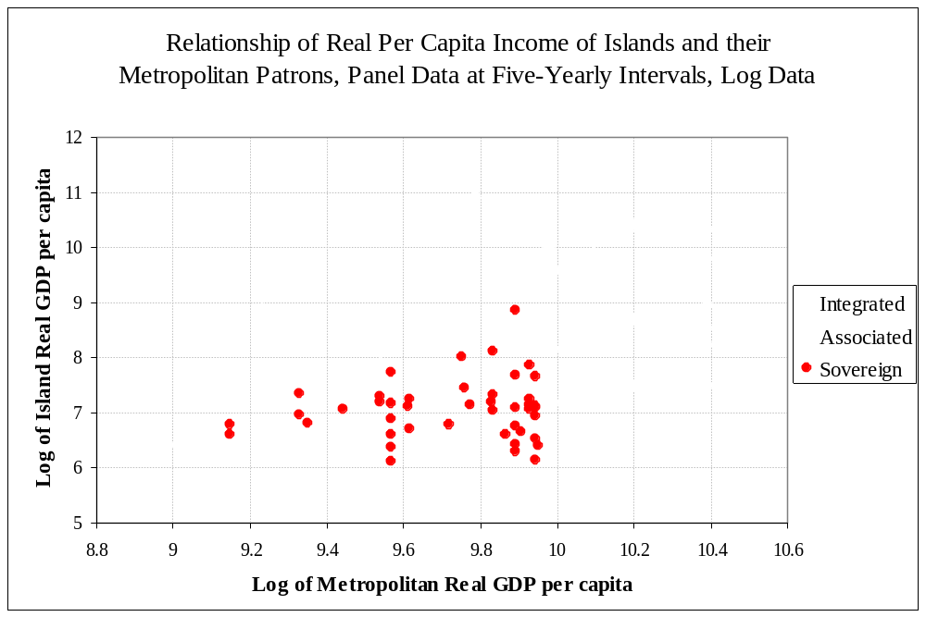
Source: Geoff Bertram, “On the Convergence of Small Island Economies with their Metropolitan Patrons”, World Development 32, 2 (February 2004) pp.343-364.

Slide 12
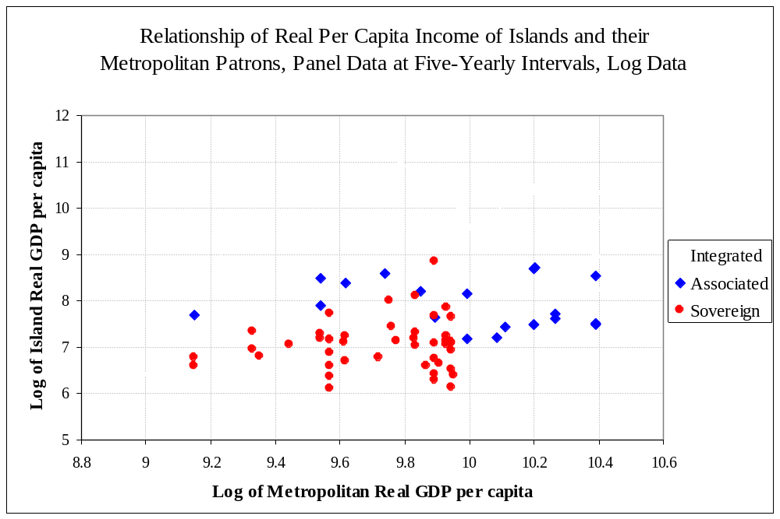
Source: Geoff Bertram, “On the Convergence of Small Island Economies with their Metropolitan Patrons”, World Development 32, 2 (February 2004) pp.343-364.

Slide 13
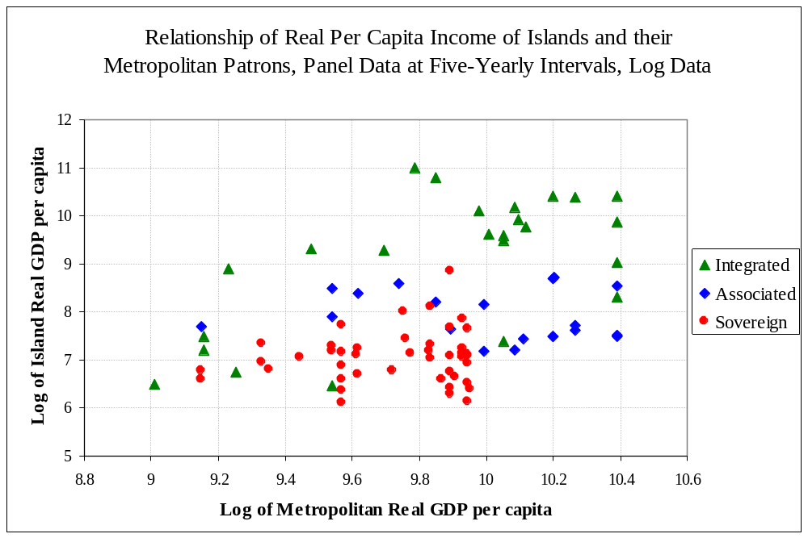
Source: Geoff Bertram, “On the Convergence of Small Island Economies with their Metropolitan Patrons”, World Development 32, 2 (February 2004) pp.343-364.

Slide 14
I hypothesised that non-sovereign political status conferred advantages in political-economy terms, because by being integrated with a larger, usually richer, economy, a small island community could secure more favourable treatment in terms of financial aid, migration access, other market access, and ability to leverage off some functions of large-country government services such as education and health.
Poirine (1999) demonstrated that in the 1990s not only did islands receive more aid per capita than larger, non-island countries, but that non-sovereign islands secured 36 times more bilateral aid than comparable sovereign independent island states.
Feyer and Sacerdote 2009 began to nail down the long-term effects of colonialism – and hence the outcomes of decolonisation - across a sample of 81 islands
They found “a robust positive relationship between colonial tenure and modern outcomes. “
They also found that (2009 p.256) “Being a colony at the end of the twentieth century remains very positively associated with income.”
For them, this was an accidental by-product of statistically establishing a separate result, that “Conditional on making it to the end of the century as a colony, years as a colony in the twentieth century are negatively associated with income.”

Slide 15
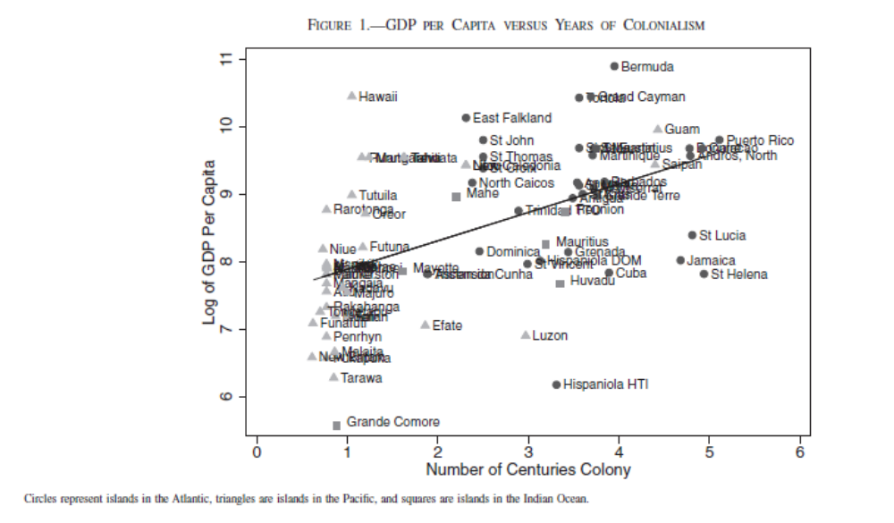
Feyrer, J. and B. Sacerdote, 2009, “Colonialism and Modern Income: Islands as Natural Experiments” Review of Economics and Statistics, May, 91(2): 245–262, p.251.

Slide 16
By “remaining as a colony”, Feyrer and Sacerdote meant being a sub-national political unit, subordinated in some sense to a larger metropolitan power.
But this misconstrues the issue
Decolonisation does not necessarily have to consist of moving to a sovereign independent nation state.
On the contrary, small islands have been the laboratory for exploring various ways of exiting from the colonial era, and sub-national status in the early twenty-first century is fully compatible with genuine exercise of autonomous local agency in economic and social development, as Godfrey Baldacchino and I have been arguing (Baldacchino and Bertram 2009).
To develop and explore this issue, more historical data research is needed, and so I have been working towards assembling a data set to trace case-by-case outcomes from different sorts of decolonisation.

Slide 17
Some history
Decolonisation was one of the great historical transformations of the twentieth century
But it has to be borne in mind that in the Americas there was a similar political upheaval in the years 1775 to 1825, as a colonial order operated on the North and South American continents by Britain, Spain, Portugal and France was supplanted by a swarm of new sovereign nation states.
The dominant process in both cases was installation of sovereign national governments in place of the colonial administrators
That resulted in other options getting relatively little attention in the past half-century, so that sub-national jurisdictions tend to be confused with colonies
The real issue is the extent of local autonomy, agency and initiative, and decolonisation in the sub-national context is a change in degree rather than in kind on these dimensions

Slide 18
Note that the decolonisation of the Americas ran aground on the islands of the Caribbean
Only in Haiti did an independent nation state emerge
Initially, the elites controlling the Caribbean islands threw in their lot with the metropolitan colonial powers as a matter of straightforward self-interest.
Over time the number of groups that benefited from the colonial relationship grew to encompass a growing proportion of the islander population
Eventually this developed into the great post-World War II burst of West Indian migration to Britain; between 1948 and 1970 about half a million people moved out of a population in the British West Indies of 3-4 million – about 15% out-migration.
Spanish colonial rule in the Caribbean was broken by the USA in 1898 by conquest - but the outcome was one nation state (Cuba) and one sub-national jurisdiction (Puerto Rico) which remains cheerfully non-sovereign
And then the USA went and bought the US Virgin Islands from Denmark (1917) – still an “unincorporated organized territory”

Slide 19
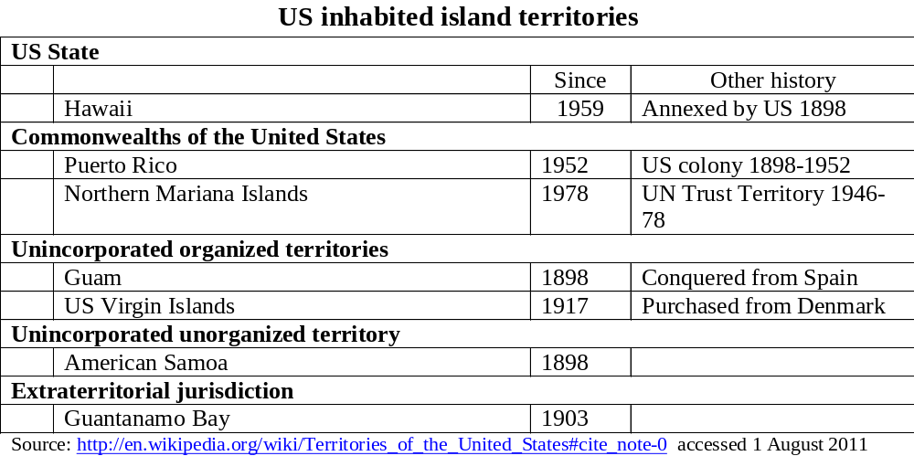
None of these really think of themselves as colonies any more

Slide 20
After World War II the UN progressively became the agent of decolonisation worldwide
Chapter XI of the United Nations Charter contains a “Declaration Regarding Non-Self-Governing Territories”.
Administering powers were to foster self-government and local political aspirations (Article 73(b)) and to report to the UN on their administration (Article 73(3))
In 1946 a list was produced of such territories
The list missed the Portuguese territories and several small British possessions, and did not include the trust and mandate territories which had separate reporting lines
A further list was prepared in 1963, with substantially different coverage

Slide 21
The two UN lists provide me with two samples for analysis of the impact of decolonisation
In each case I take out the small island countries as a representative sample of candidates for “decolonisation”
I divide them between those that (as of 2011) have moved to become sovereign states, and those that have become sub-national island jurisdictions (SNIJs)
I aim to compare the two groups on indicators such as population, income per head, life expectancy, early childhood mortality, imports per head
This is only work in progress at this stage, though – the time-series data sets are still being assembled

Slide 22
Sample 1: the 1946 UN list
Under Article 73(e) of the UN Charter, administering powers were required to report on non-self-governing territories under their control
In 1946 the UN produced a list of the territories covered by this requirement.
The list contained 64 named territories of which 33 were islands or groups of islands
Decomposing the island groups according to their eventual identities and excluding Madagascar (but including its previous dependency the Comoros) the 33 island listings in the 1946 list contained 50 individual islands or archipelagoes with distinct identities
The number drops to 46 if the Netherlands Antilles excluding Aruba but including Curacao are treated as a single entity (which will be done here, although the political unit was dissolved in 2010, since statistics usually refer to the group)
Two of the islands, Singapore and Puerto Rico, are marginal as “small islands”, coming in under the 5 million population mark but much bigger than the rest of the sample
Excluding those two gives 44 small islands that were non-self governing in 1946
Dividing them between those which are now sovereigns and those which are SNIJs we can check whether it was the big ones that became independent (20) and the small ones that did not (26):

Slide 23
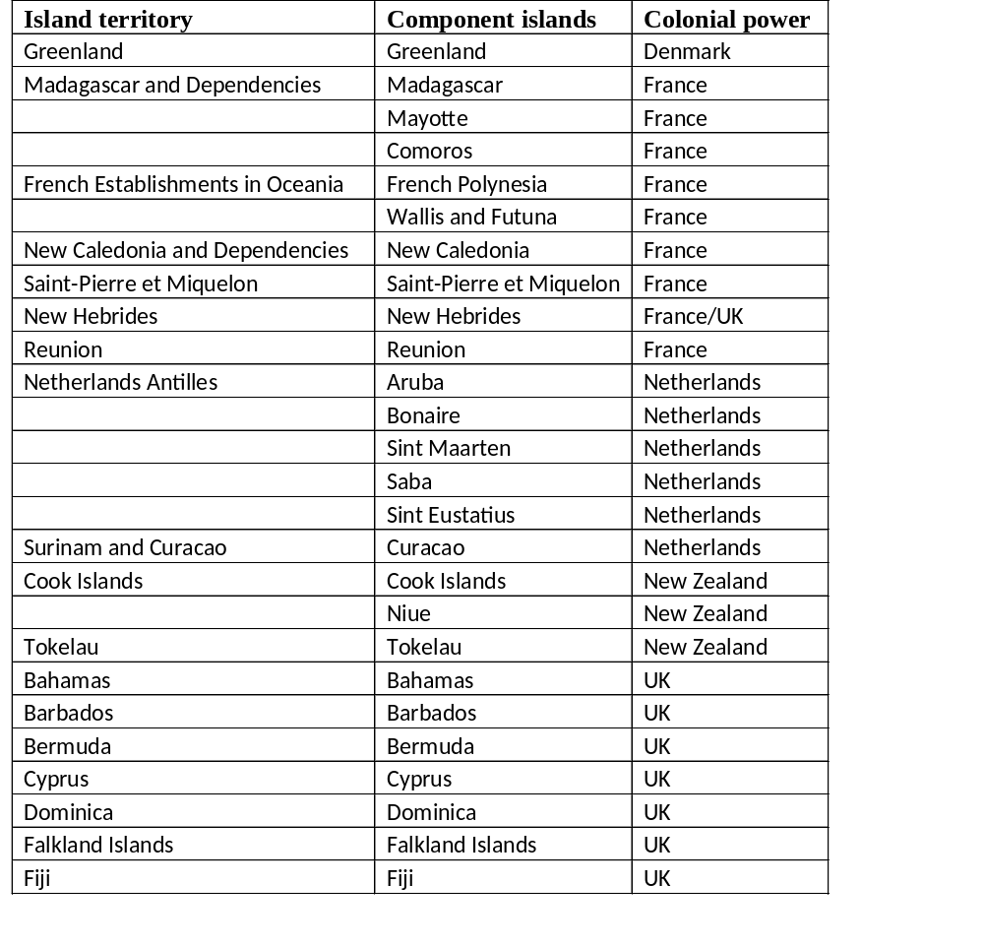
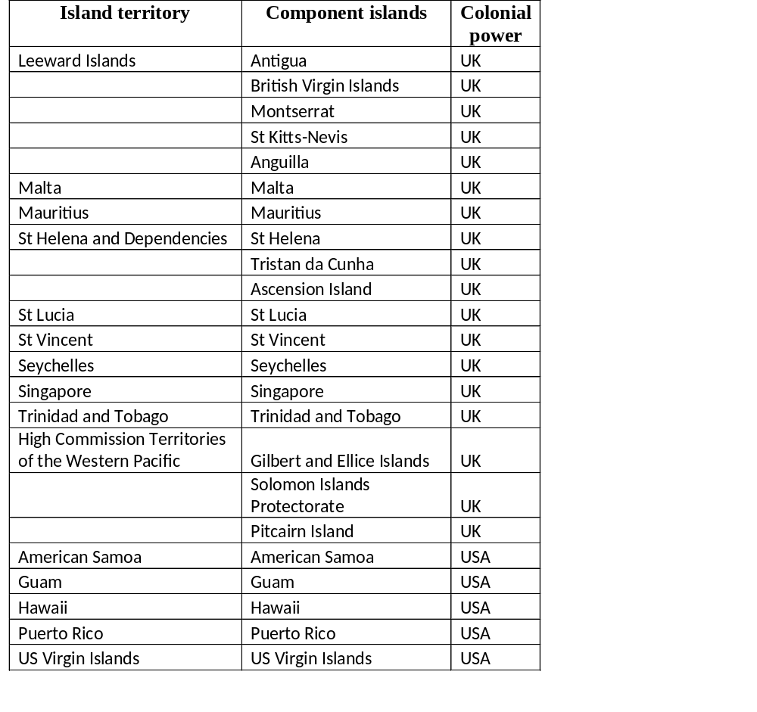
Islands in the UN’s 1946 list of non-self-governing territories

Slide 24
First question: was it that bigger islands became sovereigns and smaller islands became SNIJs?

Slide 27
There’s certainly a tendency for larger entities to have become sovereign independent states, but there’s a wide range of sizes on both sides
The average population of the sovereigns at about 2006 is 371,000 and the average of the SNIJs is 145,000
But the standard deviations are 394,000 and 293,000 respectively, which means the relationship of size with propensity to become sovereign is pretty weak
Ask now how the two sets of islands rank in terms of GDP per capita half a century after being listed by the UN in 1946

Slide 28
Independence and GDP per capita
There’s an immediate data problem: the big databases (Penn World Tables, World Development Indicators, UN National Accounts Statistics) cover sovereign states well but only a few sub-national jurisdictions
  PWT incudes Bermuda but none of the other SNIJs
  WDI has no sub-nationals at all
  UN National Accounts Statistics cover Greenland, French Polynesia, New Caledonia, Aruba and Netherlands Antilles, Cook Islands, Bermuda, British Virgin Islands, Montserrat and Anguilla – that’s ten entities, or nine of the 25 SNIJs in the earlier charts (we now separate Aruba from the rest of the Netherlands Antilles); but data is not PPP-adjusted
The CIA World Factbook covers all the SNIJs with PPP estimates of per capita GDP but is a bit dodgy

Slide 29
Try first the UN data

Slide 30
Now the CIA’s 2005 PPP-adjusted data as collated by McElroy and Parry

Slide 31
Still looks as though SNIJs ended up ahead
Weighting each entity’s observation by population and then taking the population-weighted average for those that became sovereign and those that became SNIJs gives some confidence that the result is robust
But the data are still not good enough to support much statistical sophistication
The good sources - PWT and WDI - have virtually no SNIJ observations, so we’re stuck with comparisons from the other two sources
UN Statistical Division is probably better data, but CIA has at least tried PPP adjustment
Summary findings:

Slide 33
Other indicators of welfare
Life expectancy and child mortality both seem to correlate with material welfare
The UN life expectancy statistical database at http://unstats.un.org/unsd/demographic/products/dyb/dyb2008.htm has 35 of the 46 islands in the 1946 list (including Singapore and Puerto Rico), including 17 SNIJs
The WHO life expectancy database at http://apps.who.int/ghodata/?vid=710# has 2009 data for 21 islands but only 2 of them are SNIJs
Although the UN data is more mixed in its dates – mainly around 2000 – I use it here to get coverage except for the Comoros where the WHO figure is used (no UN figure)
This gives me 19 sovereigns and 17 SNIJs

Slide 35
There is also data at http://unstats.un.org/unsd/demographic/products/socind/health.htm showing life expectancy estimates mainly for 2010-2015 but a few older figures) for 17 sovereigns and 16 SNIJs
This gives a second chart with slightly different samples

Slide 37
Here again the SNIJs seem, if anything, a nose in front.
On a population-weighted basis, in the first chart the sovereigns have average life expectancy at birth of 74.8 years and the SNIJs have an average of 77.7 years
In the second, more up-to-date, data set, the population-weighted averages are 76.5 years for the sovereigns and 76.83 for the SNIJs
This provisionally says that the SNIJs have certainly come out no worse, and may have come out ahead

Slide 38
How about trends over time?
An historical supplement to the UN Demographic Yearbook at http://unstats.un.org/unsd/demographic/products/dyb/dybhist.htm has historical data from 1948 to 1997
The coverage matches some of the 1946 UN sample of small islands
A quick plot of the data (next slide) indicates that
  there is convergence over time (low starters improve more rapidly than high starters)
  Territories that started out with low life expectance were somewhat more likely to become sovereigns
  Solomon Islands, Trinidad and Tobago, and Vanuatu, may be slipping in the past decade, whereas no SNIJs slipped
  SNIJs are among the best performers but have shared the space with plenty of sovereigns
  There does seem some basis for suggesting that the poorest colonies were especially apt to get independence

Slide 40
Here’s the movie…

Slide 51
Sample 2: the 1963 UN list
The UN role in decolonisation became strongly pro-active in 1960
Resolution 1514 set out a Declaration on Granting of Independence to Colonial Countries and Peoples
Resolution 1541 spelled out the types of political change that could relieve governing powers of their reporting obligations under Article 73(e).
In 1961, General Assembly Resolution 1654 established a Special Committee to push decolonisation along.
In 1963 a new list of non-self-governing territories was produced
  This list had 65 territories, of which 40 were small islands or collections of small islands
  When decomposed into identifiable islands and island groups the list contains 42
  Of these, 26 had been on the 1946 list and 16 were new additions – mainly the Portuguese island colonies, the US Pacific Trust Territories, Nauru, HongKong, and several small Caribbean islands that missed the cut in 1946 or were buried in larger entities then
Spectacular disappearances since1946 were the French territories which were accepted as having been decolonised by integration into the French Republic in 1947, and the Netherlands Antilles which had been similarly integrated to the Kingdom of the Netherlands in 1951
The same procedures have been repeated for the 1963 sample

Slide 52
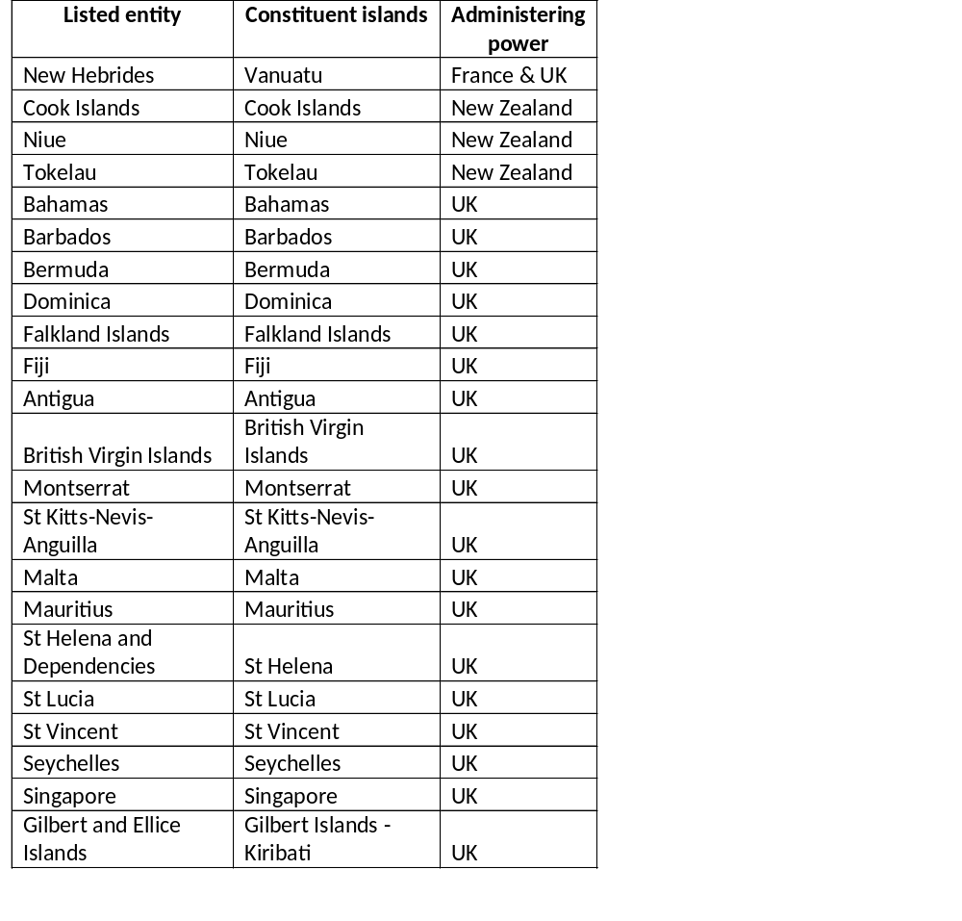
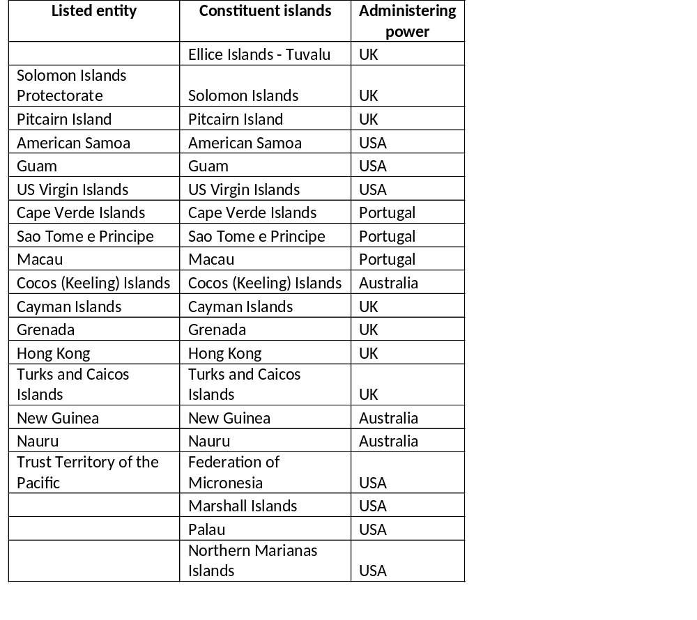
Islands in the UN’s 1963 list of non-self-governing territories

Slide 53
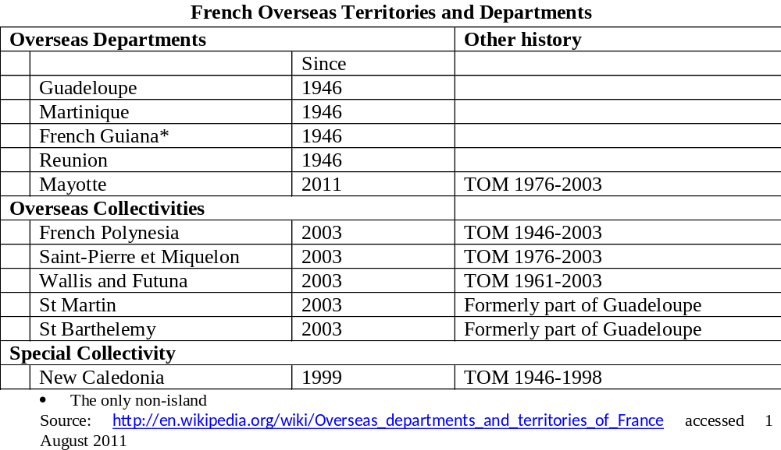

Slide 54
The new sample contains 24 territories that have became sovereign states and 18
that are SNIJs.
Again there are three large territories with 2011 populations around the 5 million mark: Hong Kong, Singapore, and Papua New Guinea
Excluding these gives the second chart when we ask whether it was just big islands that became independent

Slide 57
Here selection by size seems more apparent
Again, however, the range of sizes in both groups is very wide
With HongKong, Singapore and PNG excluded,
  The sovereigns have mean population of 245,000 with standard deviation of 302,000
  The SNIJs have mean population of 75,000 with standard deviation 126,000
Conclusion is still that there is a lot more than size driving the choice of political status

Slide 58
GDP per capita today
Again there are data problems with only 2 SNIJs from the list in the Penn World Tables 6.3, and only 3 in the WDI
So again at this stage I’m using the CIA and UN data

Slide 62
Again all the results point in the same direction despite diversity of sources and gaps in the data
There’s a wide spread of incomes in both sets of islands, which means one can’t say that any particular island would necessarily have ended up better by changing its historical track out of colonialism
But in terms of tendencies, the SNIJ success stories seem to outnumber the sovereigns

Slide 63
The next stage is to make serious progress on time-series data for GDP per head and imports per head
One possibility will be pair-wise comparisons of entities that share some characteristic but followed different paths. There the bi problem is to make sure international comparabiity is maintained….
Look, e.g., at the UN data for three former French-dominated Pacific territories….

