Slide 1
Electricity prices, asset values, regulation, and renewables
SEF presentation
20 July 2012

Slide 2
Quick potted history
Late nineteenth and early twentieth centuries: local initiatives, “islanded” markets
WWI to 1986: state-controlled generation and transmission; local-government distribution and retail
1986 – present: series of structural changes pushing towards corporate management and profit motivation

Slide 3
Evolving industry structure
Retail Distribution
Lines
Distribution lines companies
ESAs
MEDs
ESAs
MEDs
Distribution
companies
Energy
Retail
companies
Gentailers:
Contact
Meridian
Genesis
Mighty River
Trustpower
Generation
Generators:
Contact
Meridian
Genesis
Mighty River
Trustpower
TransAlta/OnEnergy
ECNZ
NZED
ECNZ
Transmission
Grid & System Operator
Transpower
1987
1994
1999
2001
Change events

Slide 4
Technology is changing
Economies of scope and scale in C20 => state ownership made good sense and not much scope for fringe competition
Now, only a small part of the next generation projects will be giants. Solar, wind, wave, geothermal, microhydro etc are modular
Not only no need the state to undertake investment now – need is to facilitate new entry of distributed and renewables
But the commanding height (scope economies) is still the market operator – unless local networks replace the grid

Slide 5
The present industry structure does not match the new situation
Cartel of five generators locks in dominance of C20 technologies and locks out efficiently-scaled new generation and smart metering
Incentive and ownership structure of lines companies locks out real-time pricing, peak-load control, smart metering
Regulation is effectively non-existent in any serious sense

Slide 6
Change in the aims of state ownership
Until 1986 it was to make electricity available to all at lowest possible cost, with emphasis on meeting household needs
After 1986 it was to extract profit (“maximise value”) and treat households as taxable captive customers
Transformation to the “predator-state” model has brought energy poverty back
The companies now to be privatised have been fattened for sale to bring in early cash rather than waiting to collect it over time

Slide 7
Here’s how it’s done
Contact Energy separated from ECNZ

Slide 8
What sustains the valuations?
Around half of the book value of electricity companies is accounting fiction, as distinct from real costs actually incurred to supply the product
“Revaluation” is self-help capital gains
Accountants and economists provide impressive-sounding explanations but they are hollow: the process is circular
Capital gains are untaxed but only turn into cash when the enterprise is sold off
Hence the prevalence of mergers and acquisitions, especially in the lines businesses but also in generation
The Mixed Ownership Model is geared to this process

Slide 9
Source: company accounts and information disclosures

Slide 10
Two quite separate sets of revaluations
Distribution companies under “light-handed regulation” from 1994 on were told to value their assets at “optimised deprival value” which in practice meant replacement cost.. That doubled their value, and drove up their charges, with no compensation to the consumers thereby expropriated. It was “just a wealth transfer”
Then generator-retailers (unregulated) were allowed to do “fair value” revaluations which roughly doubled their book values compared with historic cost. Again this was a transfer of wealth from consumers to the companies
Because domestic consumers were captive and had no effective voice, the burden fell almost entirely on them – industry and commerce got off lightly

Slide 11
The lines companies were first onto the bandwagon, with ODV
The ODV boom 1994-2003
Source: company accounts and information disclosures

Slide 12
Then the gentailers got into an orgy of “fair value” revaluation…
“Fair value” revaluations 2001-
Source: company accounts and information disclosures

Slide 14
US lesson: “fair value” is not historic cost and is not fair
New Zealand failed to learn from the USA’s experience.
After the antitrust laws were passed in the USA around 1900 it took four decades to sort out the propensity of businesses and their accountants to puff up their asset values in order to justify inflated prices
All the economists’ and accountants’ rhetoric seen here since 1987 was on show in the USA regulatory hearings of the 1920s and 1930s.
In the “Hope” case 1944 the Supreme Court put a stop to that by decreeing that asset values must be based on historic cost with revaluations not allowed.
As actual costs rise, companies reflect these in their balance sheets by recording the value of new assets at cost
But pre-existing assets stay at their historic actual cost
This rule still holds in the USA
New Zealand took no notice. Hence the current mess.
Here, generator-retailers project high prices and profits, then write up asset values to reflect the present value of their dreams, then charge prices to recover a return on the inflated values, and so make their dreams come true.

Slide 15
The balance-sheet revaluations that the SOEs (and Contact/Trustpower) have been banking on are only "fair value" exercises, which means fiction – CEO profit and bonus dreams translated into price gouging of residential consumers.
They do not reflect any genuine costs actually incurred by the companies and hence lack any defensible moral basis whatever outside the theology of Wall Street.
Bear in mind the contrast with the ODV/replacement-cost valuations that have been given regulatory approval for lines companies and gas transmission (over my strong principled objections, since these are not reflecting genuine costs actually incurred either - but the theology is different).
The central point about "fair value" is that it rests on nothing more substantial than "expectations" - i.e. hot air, accompanied by government inaction.
That means that over half the book value of the SOEs is at risk from a deflation of expectations. Even a hint of willingness to regulate prices and/or profits would cause jitters. This is potentially a house of cards.....

Slide 16
 |  | 2005 | 2006 | 2007 | 2008 | 2009 | 2010 | 2011
Book value at which generation fixed assets are carried
 | Contact | 3.66 | 3.65 | 4.03 | 4.05 | 4.07 | 3.70 | 4.14
 | Genesis | 1.02 | 1.02 | 1.51 | 1.46 | 1.48 | 1.42 | 2.54
 | Meridian | 3.44 | 4.61 | 6.12 | 6.01 | 5.90 | 7.75 | 7.28
 | Mighty River | 2.29 | 2.26 | 2.09 | 2.98 | 3.48 | 4.06 | 4.42
 | Trustpower | 1.22 | 1.22 | 1.85 | 2.01 | 2.31 | 2.30 | 2.37
 | Total | 11.63 | 12.76 | 15.60 | 16.51 | 17.24 | 19.24 | 20.75
 | Total excluding Contact | 7.97 | 9.11 | 11.57 | 12.46 | 13.17 | 15.53 | 16.61
Value if a cost basis were used
 | Contact | 1.70 | 1.71 | 1.86 | 1.56 | 1.61 | * | *
 | Genesis |  |  |  | 1.17 | 1.19 | 0.92 | 1.65
 | Meridian |  |  | 2.34 | 2.28 | 2.23 | 2.90 | 2.90
 | Mighty River |  |  | 1.24 | 1.24 | 1.46 | 1.71 | 1.72
 | Trustpower |  |  | 1.00 | 1.14 | 1.18 | 1.17 | 1.23
 | Total where available |  |  |  | 7.38 | 7.67
 | Total excluding Contact |  |  |  | 5.82 | 6.06 | 6.70 | 7.50
Compiled from company annual reports. This table updated 15 June 2012

Slide 17
 |  | 2005 | 2006 | 2007 | 2008 | 2009 | 2010 | 2011
Book value at which generation fixed assets are carried
 | Contact | 3.66 | 3.65 | 4.03 | 4.05 | 4.07 | 3.70 | 4.14
 | Genesis | 1.02 | 1.02 | 1.51 | 1.46 | 1.48 | 1.42 | 2.54
 | Meridian | 3.44 | 4.61 | 6.12 | 6.01 | 5.90 | 7.75 | 7.28
 | Mighty River | 2.29 | 2.26 | 2.09 | 2.98 | 3.48 | 4.06 | 4.42
 | Trustpower | 1.22 | 1.22 | 1.85 | 2.01 | 2.31 | 2.30 | 2.37
 | Total | 11.63 | 12.76 | 15.60 | 16.51 | 17.24 | 19.24 | 20.75
 | Total excluding Contact | 7.97 | 9.11 | 11.57 | 12.46 | 13.17 | 15.53 | 16.61
Value if a cost basis were used
 | Contact | 1.70 | 1.71 | 1.86 | 1.56 | 1.61 | * | *
 | Genesis |  |  |  | 1.17 | 1.19 | 0.92 | 1.65
 | Meridian |  |  | 2.34 | 2.28 | 2.23 | 2.90 | 2.90
 | Mighty River |  |  | 1.24 | 1.24 | 1.46 | 1.71 | 1.72
 | Trustpower |  |  | 1.00 | 1.14 | 1.18 | 1.17 | 1.23
 | Total where available |  |  |  | 7.38 | 7.67
 | Total excluding Contact |  |  |  | 5.82 | 6.06 | 6.70 | 7.50
Compiled from company annual reports. This table updated 15 June 2012

Slide 18
What is to be done?
The big need is for proper regulation to prevent monopolistic price-gouging of consumers and opportunistic rent grabs, and to reinstate the common-law “consumer surplus standard” as the benchmark for the Commerce Commission, Electricity Authority, etc
At the same time the market needs to be opened up for wider supply-side participation – small generation, demand-side response

Slide 19
My four initial areas to tackle
Regulation to wind back asset values to historic cost for all generator-retailers, and require price cuts to match
Windfall profits tax to prevent profiteering from the Emissions Trading Scheme and its successors
Progressive pricing to tackle energy poverty head-on and put ordinary household consumers back at the centre of policy. E.g. the first 300 kWh per month free.
Incentives for new technology – feed-in tariffs, smart metering, guaranteed market access via a ‘single buyer’ or something similar

Slide 20
Investment and innovation needs/opportunities
Performance prior to restructuring was up with world best practice
Performance since is far below, and worsening
Uncoordinated, volatile investment as animal spirit flop about
Smart meters that aren’t smart
Smart grid that isn’t there
No feed-in tariff or any secure market access for new-entrant independent generators; and market rules designed by incumbents to protect incumbents
Zero planning or provision yet for electric vehicles, which are quite likely to be 40-50% of the light passenger fleet by 2030

Slide 21
The essential requirement here is to bring on twilight of the gods…
Break the cartel’s iron grip on market access
That means the market must be genuinely open to small scale entry on fair and reasonable terms
Coordination and hedging have to be provided on a system-wide scale which means a broker/provider is essential
Separation between heritage assets and the new wave is required: vesting contracts, ring-fencing or divestment?

Slide 22
Regulating prices and profits on the heritage assets
Much of the generation sector’s operating surplus is rent (unearned increment) on long-established hydro and geothermal plant whose capital costs are long sunk
The generated electricity is sold at a wholesale price determined at the margin of the market, then marked up massively for retail sale, raising serious issues in relation to energy poverty, income and wealth distribution, and basic fairness;
Household prices are arguably double what they would have been under old-fashioned regulation, with no loss of supply security or quality of supply. Quite possibly they are more than double
Back to the old common law for essential services: consumer interest should rule and suppliers should get only fair and reasonable returns

Slide 23
The ETS belongs with the new wave – so stop it yielding windfalls to the heritage owners at consumers’ expense
There is an important sting in the tail of New Zealand’s wholesale electricity market design, when carbon pricing is factored in. The market price of electricity is set equal to the offer price submitted by the highest-priced tranche of generation capacity in each half-hour period.
Whenever that marginal generator is using fossil fuels, under the ETS it will be liable to cover the resulting emissions by purchasing New Zealand Units, or equivalent carbon credits, and the cost of this will have to be covered by its offer-price into the market. Then the electricity price received by all generators, whether renewables-based or fossil-fuel-based, goes up by that amount, even though only a small fraction of generators actually have to pay for permits; owners of existing renewable capacity simply collect the extra revenue as windfall profits.
On the assumption of a (capped) permit price of $25 per tonne of carbon, and with the two-tonnes-for-one-permit arrangement under the ETS as amended in 2009, Simon Terry and I estimated in 2010 that the ETS would raise the electricity price by nearly $6 per MWh 2010-2012, rising to $12 thereafter when the two-for-one concession was to expire.

Slide 24
Of $769 million to be collected 2010-2012 only $203 million would be required to pay for the generators’ total carbon emissions
The remaining $566 million is windfall profit. (Official estimates of the effects of the ETS give similar results.)
So when a consumer buys electricity with the ETS unit price at $12.50 per tonne (as now), the ETS cost embodied in the electricity price is equivalent to paying a carbon charge of $40-50 per tonne on the CO2 emissions actually incurred to generate the electricity
This is a perverse incentive from the point of view of reducing the nation’s greenhouse gas emissions, but it is a much-valued side-effect of the ETS from the point of view of the generators, including the SOEs – another wealth transfer.
As carbon prices go up, so will the volume of windfall profits to owners of old-established renewable generation.

Slide 25
The obvious policy to neutralise this is a tax on ETS-derived windfall profits
Might finance rebates to electricity consumers sufficient to ensure that they pay for the actual carbon emissions embodied in the electricity they consume, but no more.
A future Parliament is, in my judgment, highly likely to legislate for such a tax as the Emissions Trading Scheme (or its successor policy) is tightened up.
The prospect of such a tax places an element of uncertainty over the true market value of shares in the electricity SOEs, and most especially Mighty River Power which is heavily weighted towards old-established renewables in its generation portfolio

Slide 26
Progressive pricing/vesting contracts were
Recommended by Parliament’s Commerce and Marketing Select Committee in 1992
Designed and recommended by the Hydro New Zealand study in 1992
Considered by WEMDG 1993-1994
Still on the MED’s table in 2006
BUT
Opposed tooth and claw by the industry
AND
Trashed by MED officials in a [braindead or totally industry-captured] Cabinet paper in 2007

Slide 27
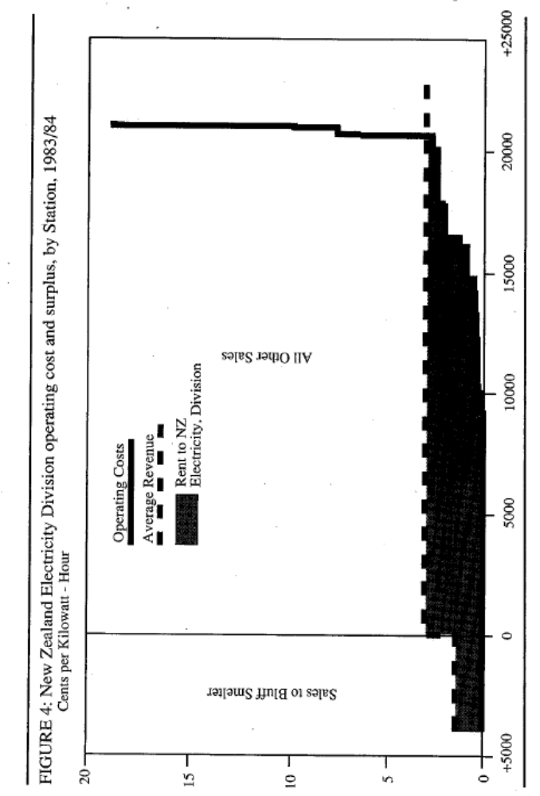
Source: Geoff Bertram, “Rents in the Energy Sector”, in Royal Commission on Social Policy, The April Report, 1988, Volume IV p.310.

Slide 28
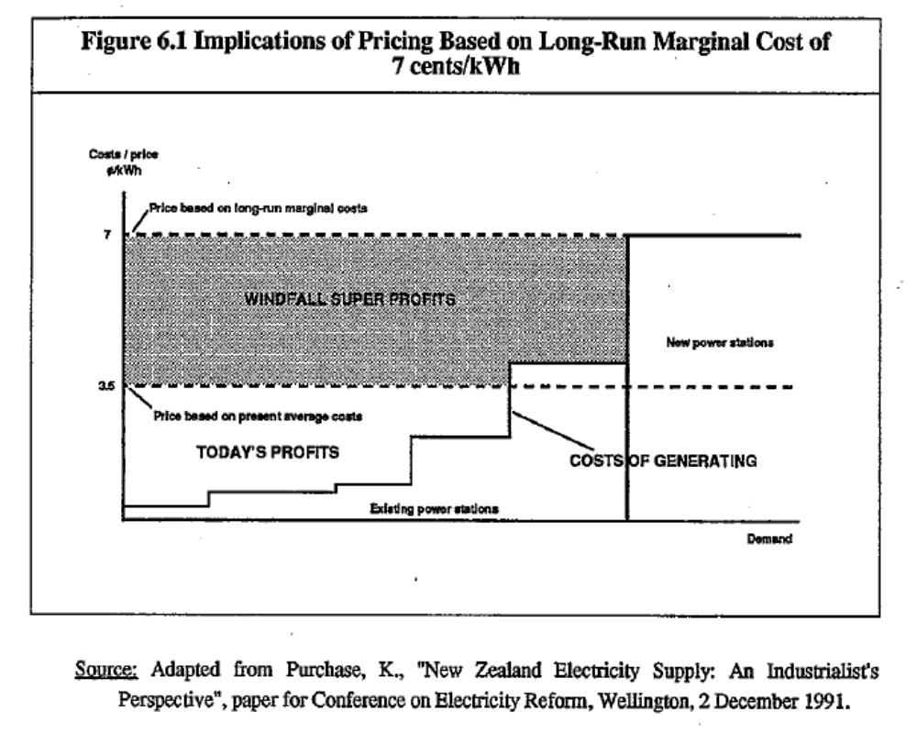
Source: Geoff Bertram, Ian Dempster, Stephen Gale and Simon Terry, Hydro New Zealand” Providing for Progressive Pricing of Electricity, 1992, p.40.

Slide 29
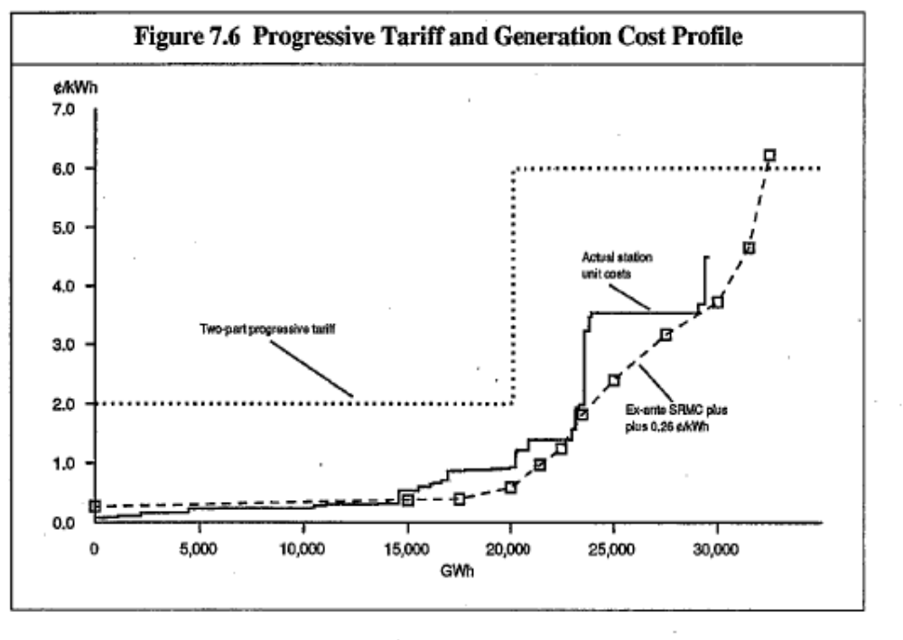
Source: Geoff Bertram, Ian Dempster, Stephen Gale and Simon Terry, Hydro New Zealand” Providing for Progressive Pricing of Electricity, 1992, p.51.

Slide 30
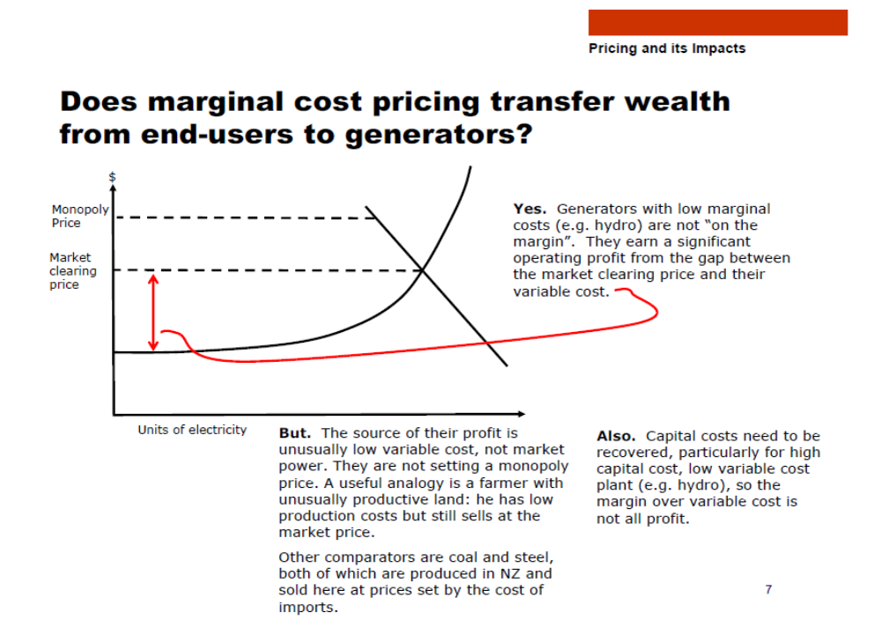
Source: Pricing in the New Zealand Electricity Market and its Economic Impact, MED, 6 March 2006, downloaded 12 April 2012 from http://www.med.govt.nz/sectors-industries/energy/electricity/industry/chronology-of-new-zealand-electricity-reform/electricity-market-review-2006 p.7.

Slide 31
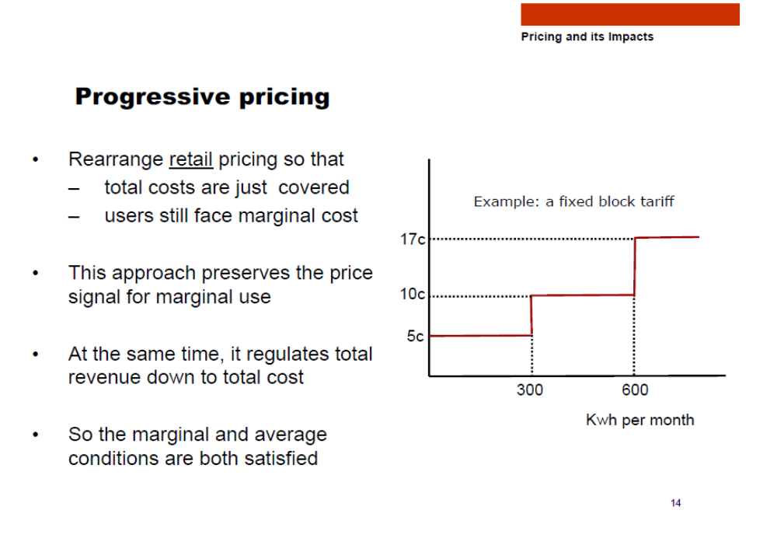
Source: Pricing in the New Zealand Electricity Market and its Economic Impact, MED, 6 March 2006, downloaded 12 April 2012 from http://www.med.govt.nz/sectors-industries/energy/electricity/industry/chronology-of-new-zealand-electricity-reform/electricity-market-review-2006 p.14.

Slide 32
‘TARGETED ASSISTANCE TO LOW INCOME CONSUMERS’
Cabinet Paper 2 November 2007
On progressive pricing:
128 There are a large number of complex design issues with such a scheme, including the interaction with the low fixed charge scheme and whether the level of the benefit (eg 4000kWh) should be differentiated by income, regional consumption levels (coldness) and season.
129 One perverse outcome from such a scheme is that retailers may actively seek to shed loss-making smaller consumers. Attempting to prevent this would be difficult. Additionally, attempting to prevent retailers from increasing other prices to recover the loss of revenue from the low charge for the 4000kWh would greatly increase design and administrative complexity.
Cont….

Slide 33
130 To the extent that retailers could recover loss of revenue from the low tariff on the first 4000kWh through higher tariffs for the balance of consumption (and in the absence of a differentiated level of assistance):
• colder (higher consumption) regions would subsidise warmer regions
• regions without alternative fuels (such as gas) would subsidise those with such fuels
• large (high-use) low-income households would subsidise low-use households, including wealthy low-use households.
131 Finally, from an efficiency perspective, progressive pricing tends to distort marginal cost price signals (how much it costs to produce power), resulting in less efficient consumption and investment decisions, and therefore loss of overall welfare.
http://www.parliament.nz/NR/rdonlyres/396F0E95-BD04-48E6-9190-579C3791D3B3/69524/Departmentalreport1.pdf

Slide 34
Conclusion from that: these MED staff were evidently unaware of the Comalco/RioTinto contract for the Bluff smelter….
(let alone the 1992 Hydro New Zealand report)

Slide 35
Two other areas to watch
Water pricing: the generator book values incorporate the fact that they don’t have to pay for their water
  The prospect of water charges would drive down the value to investors
  1987 deed gave ECNZ free water with no reference to competing claims…
Huge increase recently in financial engineering
  hedges, reserves, endless “fair value” adjustments
  Gentailers are turning into financial-market players
  Beware the scope for big “unexpected” gains and losses from non-transparent deals controlled by senior management on Wall Street salaries

Slide 36
The asset sales will falter if there is uncertainty and/or worry about future policy
Future regulation of prices and profits
Windfall taxes
Genuine openness of the market to new entry
Progressive pricing
Promise to buy back the assets for no more than they sell for (but possibly for less)

Slide 37
But be careful what you wish for
In the worst of possible worlds the sales go ahead but the price is rock-bottom because of policy uncertainties
Then policy turns out to have no regulation, no buy-backs, no windfall taxes, no lifeline tariffs, no new entry……
The opportunistic buyers could then clean up big time, with taxpayers the losers and no gain to consumers
Remember Telecom …….

