Slide 1
Paths not taken in electricity restructuring: alternatives to the asset sale programme
Geoff Bertram
Institute of Policy Studies,
Victoria University of Wellington
13 April 2012

Slide 2
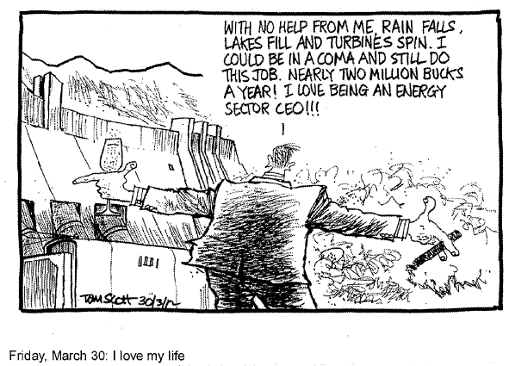

Slide 3
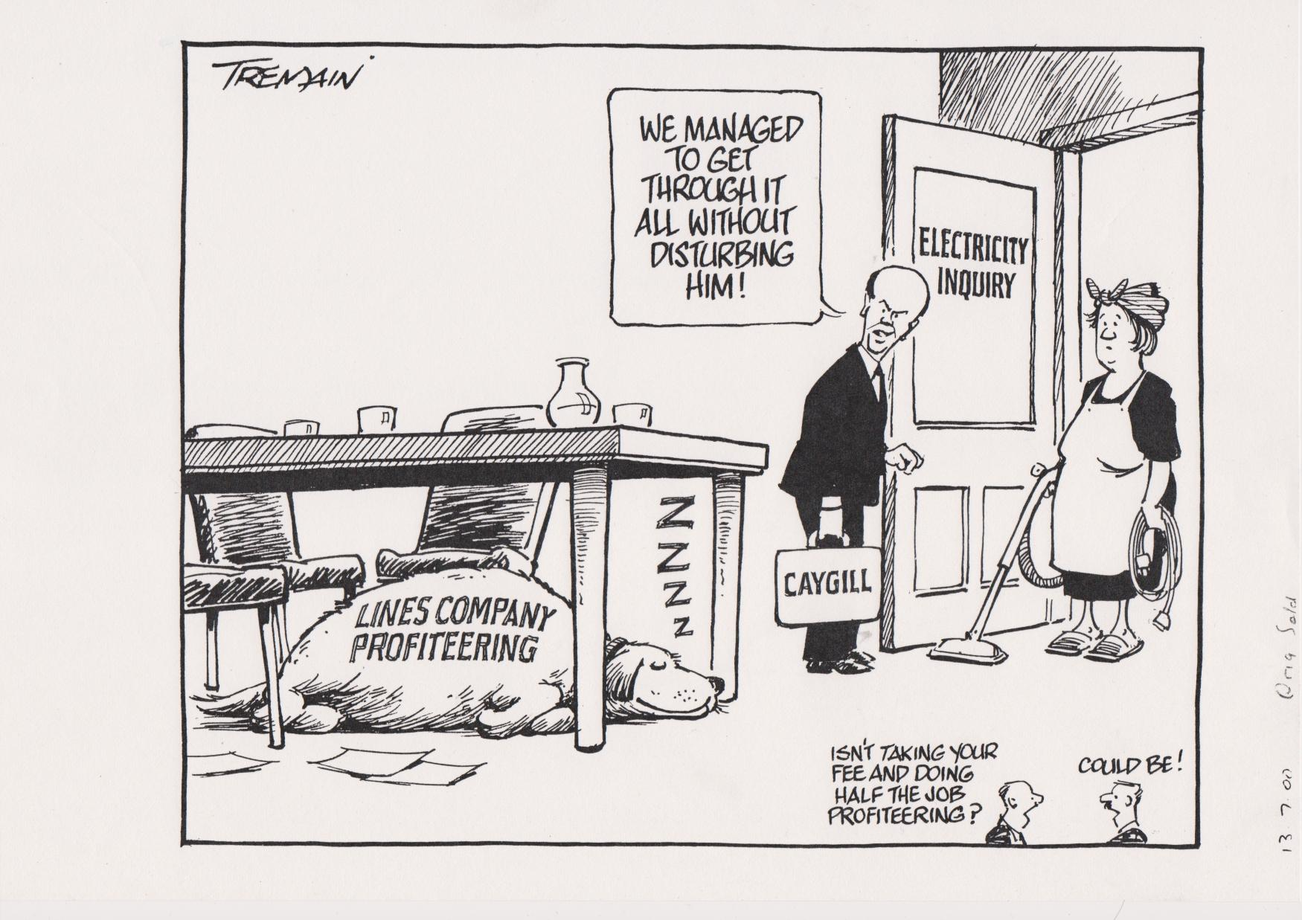
The Caygill Inquiry 2000

Slide 4
Background
Restructuring of the New Zealand electricity sector began in the late 1980s
By the mid-1990s the key elements of a new market structure were in pace:
  a wholesale spot market,
  separation of line operations from energy generation and retailing,
  corporatised governance arrangements at all levels of the industry,
  an independent system operator (ISO) located within the national grid company, Transpower.
Despite fine-tuning since, the basic structure is still in place in 2011.
The declared aims of industry reform included more effective investment planning and long-run benefits to consumers from improved quality of supply and lower prices than would have been achieved by the previous vertically-integrated fully-state-owned system.

Slide 5
The pre-restructuring electricity sector was built and operated to meet social objectives
Supplied at average-cost wholesale price (the Bulk Supply Tariff)
BST subject to democratic control: minister of Electricity reported to Parliament
Retail distribution handled by ESAs and MEDs, elected local-body “creatures of statute”
Price relativities across residential, commercial and industrial users reflected political priorities and involved delivery of benefit in kind to households

Slide 6
Pricing structure
Prior to 1987, the NZED’s Bulk Supply Tariff was set by Parliament to cover cash outlays, including investment and transmission costs; Electric Power Boards (EPBs) and Municipal Electricity Departments (MEDs) charged a retail markup similarly calculated to cover costs of distribution and retail
The industry was thus a two-tier arrangement of publicly-owned monopolies: a national generation and transmission monopoly (NZED, later ECNZ until 1994) and local/regional distribution monopolies run by elected boards (EPBs) or councils (MEDs).
Investment was funded on a pay-as-you-go basis with the BST set to include a capital-funding component, and distributors expensing much run-of-the-mill capital expenditure
When gentailer spokespersons talk of a need to raise prices today in order to fund investment tomorrow they are appealing back to that pre-corporatisation approach – but without the democratic political accountability that constrained NZED and ESA pricing decisions

Slide 7
Evolving industry structure
Lines
Lines companies
Distribution
ESAs
MEDs
ESAs
MEDs
Distribution
companies
Energy
Retail
companies
Gentailer oligopoly/cartel:
Contact
Meridian
Genesis
Mighty River
Trustpower
Generation
Generators:
Contact
Meridian
Genesis
Mighty River
Trustpower
TransAlta
ECNZ
NZED
ECNZ
Transmission
Transpower
Trans
power
Transpower
1987
1994
1999
2001
“Change moments”

Slide 8
The post-restructuring industry is run by corporate entities with profit-maximising objectives
Wholesale price is now set on the margin of a “pool” into which generators submit bids for each half-hour
The resulting price is far above average cost
Pricing is no longer subject to democratic control unless Parliament changes the law or ministerial powers to regulate are exercised on a political decision under Part IV of the Commerce Act 1986
The history of corporate behaviour since restructuring has been pretty much as expected by anyone familiar with this industry here and overseas

Slide 9
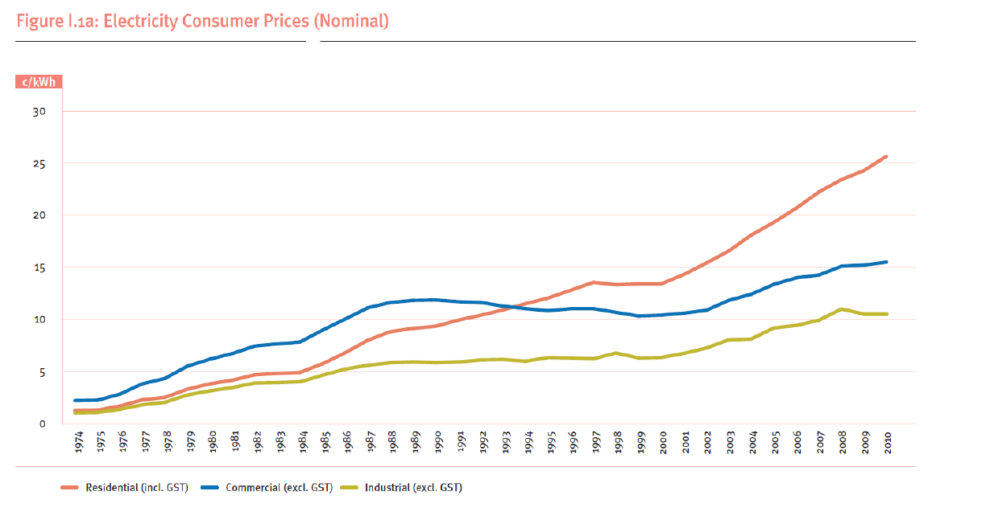
The price structure has shifted against residential and in favour of industrial and commercial users

Slide 10
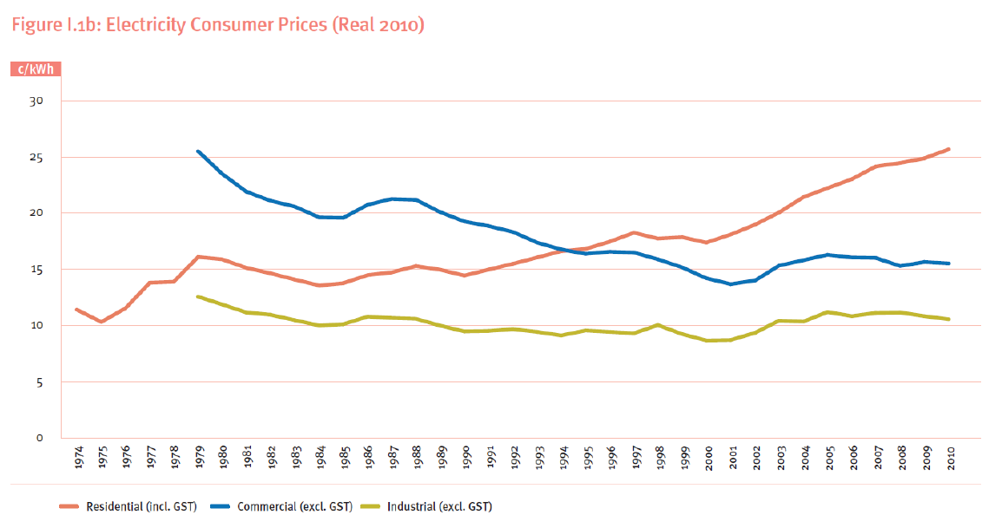
Political lobbying power has driven the price relativities

Slide 11
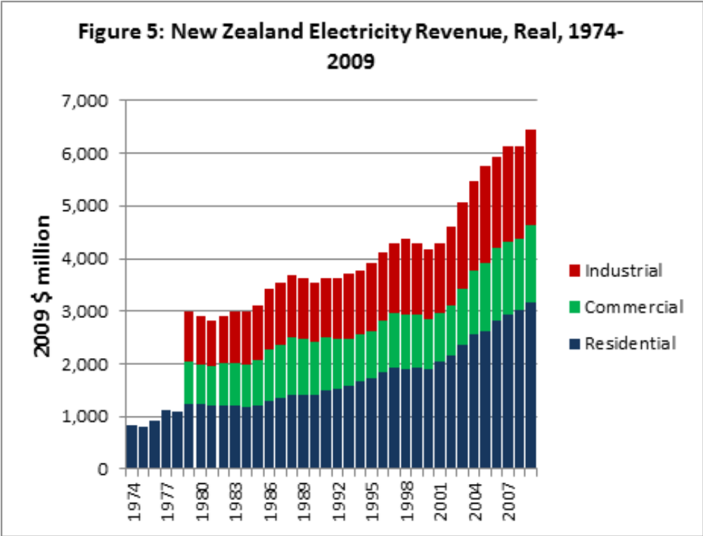

Political lobbying power has replaced household welfare as the main driver of relativities…

Slide 12
Where does the consumer’s money go?

Slide 13
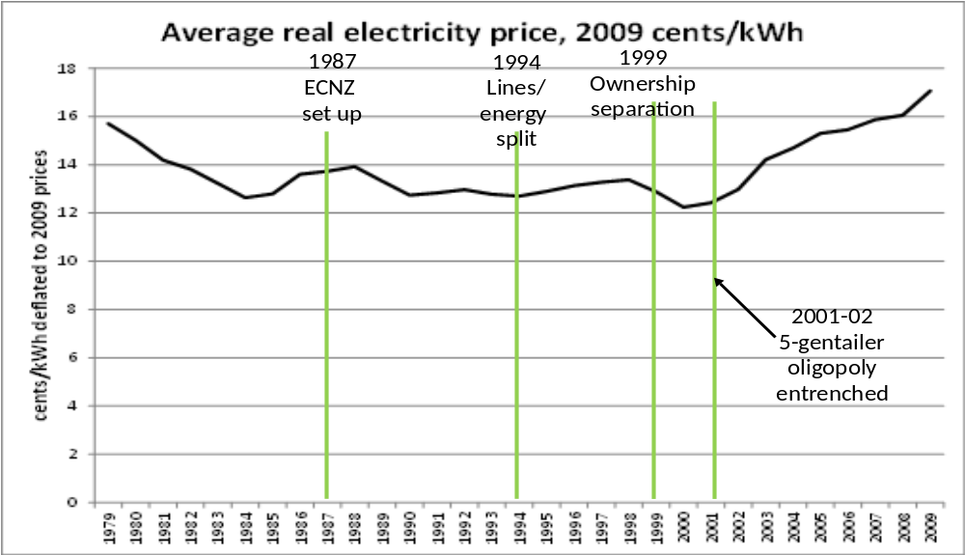
Meanwhile, in real terms the average overall real price has surged since 2000
Source: Geoff Bertram “A Stocktake of Profitability and Investment Performance in the New Zealand Electricity Market After Two Decades” paper presented to IAEE International Conference, Stockholm, June 2011.

Slide 14
An interesting trend …
This is the supposedly “competitive” arena with no price regulation
This is the “natural-monopoly” arena with “regulation” NZ-style

Slide 15
In summary
From the point of view of the average end-user, the real price fell prior to regulatory reform, stabilised for a decade until the gentailer oligopoly emerged in 2001-02, and since then has climbed 40% in real terms.
This raises doubt (to say the least) over how effective the light-handed regulatory regime, and its gradually more assertive successors since 2001, have been in curbing cost and price inflation in the sector
A second question is the investment performance of the deregulated and restructured sector

Slide 16
Investment in new capacity has shifted from steady to erratic
Source: Statistics NZ National Accounts

Slide 17
The amount of operating surplus required to fund a dollar of new investment has gone up sharply (dividends are now more important)
Source: Statistics NZ National Accounts

Slide 18
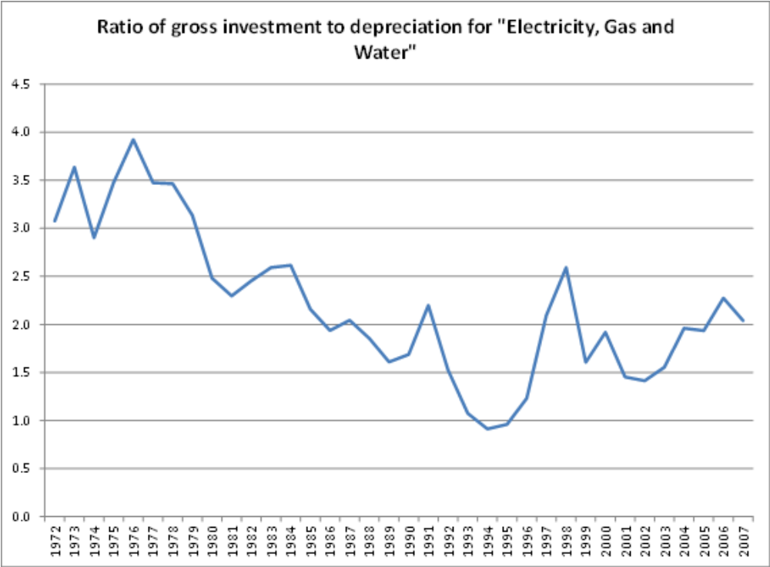

Slide 19
Meantime, operating costs have gone sky-high since the 5 gentailers established their oligopoly back around 2000
Source: Geoff Bertram “A Stocktake of Profitability and Investment Performance in the New Zealand Electricity Market After Two Decades” paper presented to IAEE International Conference, Stockholm, June 2011.

Slide 20
Source: Geoff Bertram “A Stocktake of Profitability and Investment Performance in the New Zealand Electricity Market After Two Decades” paper presented to IAEE International Conference, Stockholm, June 2011.

Slide 22
Source: Statistics NZ National Accounts

Slide 23
Deflate to real terms (using the CPI – not perfect but it exists for the whole period)

Slide 25
A note on that national accounts data
Electricity is aggregated together with gas and water supply into a single sector
But electricity dominates this sector: the 1996 input-output table shows that electricity generation, transmission and supply make up 85% of the total output and total value added of the “electricity, gas and water” aggregate.
The same picture emerges from aggregating across company annual reports and information disclosures

Slide 26
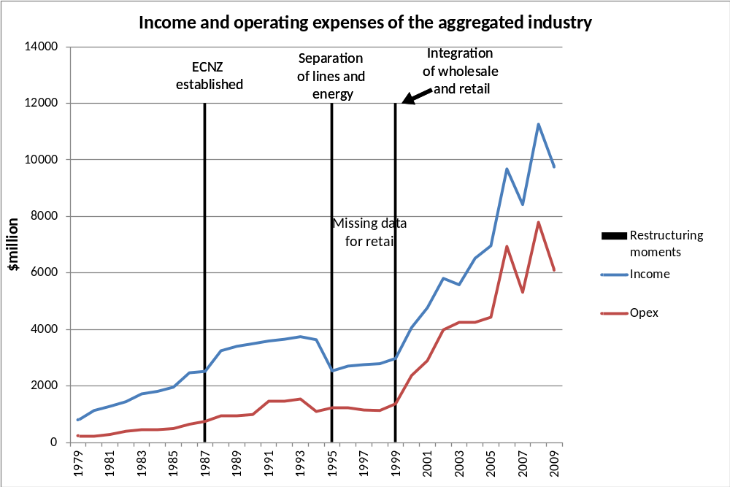
Source: Geoff Bertram “A Stocktake of Profitability and Investment Performance in the New Zealand Electricity Market After Two Decades” paper presented to IAEE International Conference, Stockholm, June 2011. Data from information disclosure and company accounts.

Slide 27
The opex blowout occurred across all but one of the gentailers: Trustpower provides a benchmark against which the others can be rated
Missing
retail detail

Slide 28
Those last figures were in nominal terms; to ensure that it’s not just inflation I’ve deflated them to real terms using the PPI (Inputs)

Slide 29
The operating cost blowout was in unregulated generating/retailing, not the regulated lines sector

Slide 30
Things are never altogether simple, of course – Trustpower started as the high-cost generator, and Genesis’ high fuel bill has to be borne in mind…

Slide 31
Pride of place in the corporate record goes to asset revaluation…
Source: company accounts and information disclosures

Slide 32
The lines companies were first onto the bandwagon, with ODV
Source: company accounts and information disclosures

Slide 33
Then the gentailers got into an orgy of “fair value” revaluation…
Source: company accounts and information disclosures

Slide 34
And yes, those revaluations were then used to justify subsequent price hikes to make the “fair values” look reasonable
And yes again, that involves circular reasoning
Economists have known about this since Marshal’s Principles of Economic (1890)
US regulators and practitioners have known about this since the Hope Natural Gas case in 1944
New Zealand regulators only just began to catch on (corporate managements, their accountants and consultants have known all about it from the outset)
And NZ GAAP still holds the stable door open for the horses to bolt through…

Slide 35
Meantime, basic information such as sales volume by company vanished off the public radar for several years
Calendar years | Contact | Meridian | Mighty River | Genesis | Trustpower
1999
2000
2001 |  |  |  |  | 1,400
2002 | 994 |  |  |  | 2,600
2003 | 4,094 |  |  |  | 4,900
2004 | 5,683 | 2,992 |  |  | 5,747
2005 | 2,590 | 5,951 |  |  | 5,833
2006 | 2,590 | 6,168 |  |  | 6,495
2007 | 3,607 | 6,822 |  | 3,552 | 5,656
2008 | 7,287 | 7,169 | 3,783 | 7,101 | 5,873
2009 | 7,463 | 7,092 | 3,893 | 7,230 | 4,724
2010 | 7,682 | 7,322 | 4,655 | 7,253 | 4,575
Source: company accounts plus responses to direct author requests for data

Slide 36
The irony of neoliberal rhetoric:
The era of “information disclosure”, “accountability” and “transparency” has been one of
  concealment
  misinformation
  wilful ignorance of basic economic principles regarding valuation of assets
  constant changes of accounting rules and definitions
  shortage of officially-published consistent time-series data or analysis
  repeated official “inquiries” by carefully selected panels subject to regulatory capture by the industry
  absence of institutions, rules, or legislation to protect consumer interests
As a result the public is entitled to be extremely suspicious of any and all claims made by industry or ministry spokespersons appealing to “the public interest”, “fairness”, and “consumer benefits”
Hence a role, I guess (sigh) for academics to appraise the record of industry performance and behaviour in the new market environment

Slide 37
Turn now to paths not taken

Slide 38
Four areas of regulatory concern:
The very large proportion of the generation sector’s operating surplus that arises as rent (unearned increment) on long-established hydro and geothermal plant whose capital costs are long sunk, and which were paid for by a previous generation of New Zealanders, but from which the generated electricity is sold at a price determined at the margin of the market, raising serious issues in relation to energy poverty, income and wealth distribution, and basic fairness;
The inadequate regulation of pricing behaviour at all levels of the industry since restructuring, and the ongoing absence of price regulation on generation and retail, notwithstanding the industry’s record of continual unwarranted price rises underpinned by repeated asset revaluations;

Slide 39
The way in which the electricity market in its current form imposes a very large multiplier on carbon prices imposed by policies such as the Emissions Trading Scheme (ETS), thereby distorting relative-price incentives and securing large windfall profits to owners of existing renewables-based generation; and
The consistent failure of the corporatised and part-privatised (Contact and Trustpower) electricity industry to deliver either orderly investment in new capacity, or ready access for new technologies and distributed generation, with the overall result that New Zealand has lagged increasingly far behind international best-practice in terms of market entry by independent power producers, smart metering and smart grid technologies, forward-looking planning in relation to the pending arrival of electric vehicles, and demand-side conservation incentives and opportunities.

Slide 40
Rents on heritage generation and progressive pricing
A key decision made at the time of the establishment of the wholesale electricity market in the mid-1990s was the imposition of the marginal-cost price across all generation, rather than merely on marginal and incremental generation.
This meant that all increases in the operating costs of the small group of generating stations at the margin of the market are automatically translated into windfall rents secured by al the old-established low-cost plant inside the margin. In turn this means that residential electricity consumers are forced to pay far more than the actual total cost of supplying the electricity they consume, fattening the profits of all owners of low-cost generation.
A simple mechanism for transferring rents back to consumers, and thereby reversing this unnecessary squeeze on household budgets, would be a long-term contract with generators specifying that a certain quantity of electricity is to be delivered to residential consumers (or to an agency acting on consumers’ behalf) at a fixed price below the market price.
This mechanism is already the basis for the main contracts under which electricity has been supplied cheaply to the Bluff aluminium smelter since it opened in 1971.

Slide 41
Progressive pricing/vesting contracts were
Recommended by Parliament’s Commerce and Marketing Select Committee in 1992
Designed and recommended by the Hydro New Zealand study in 1992
Considered by WEMDG 1993-1994
Still on the MED’s table in 2006
BUT
Opposed tooth and claw by the industry

Slide 42
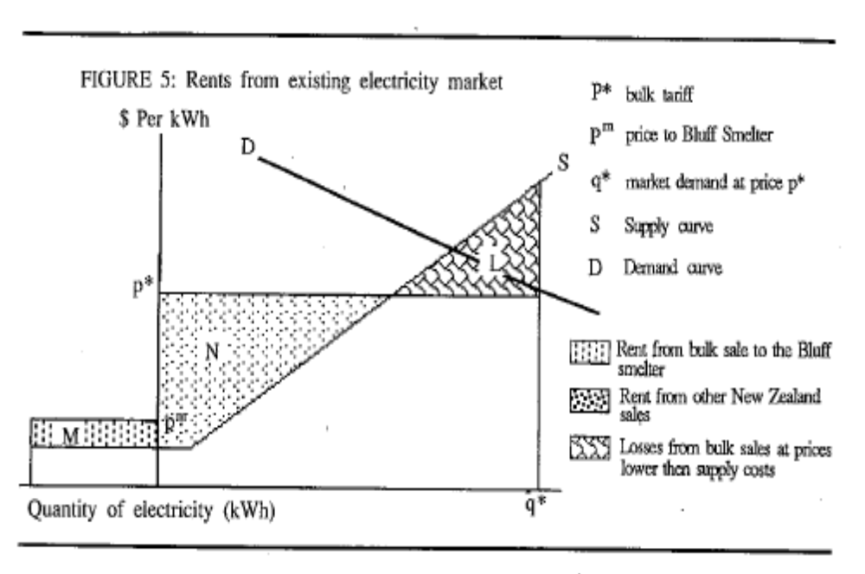
Source: Geoff Bertram, “Rents in the Energy Sector”, in Royal Commission on Social Policy, The April Report, 1988, Volume IV p.310.

Slide 43
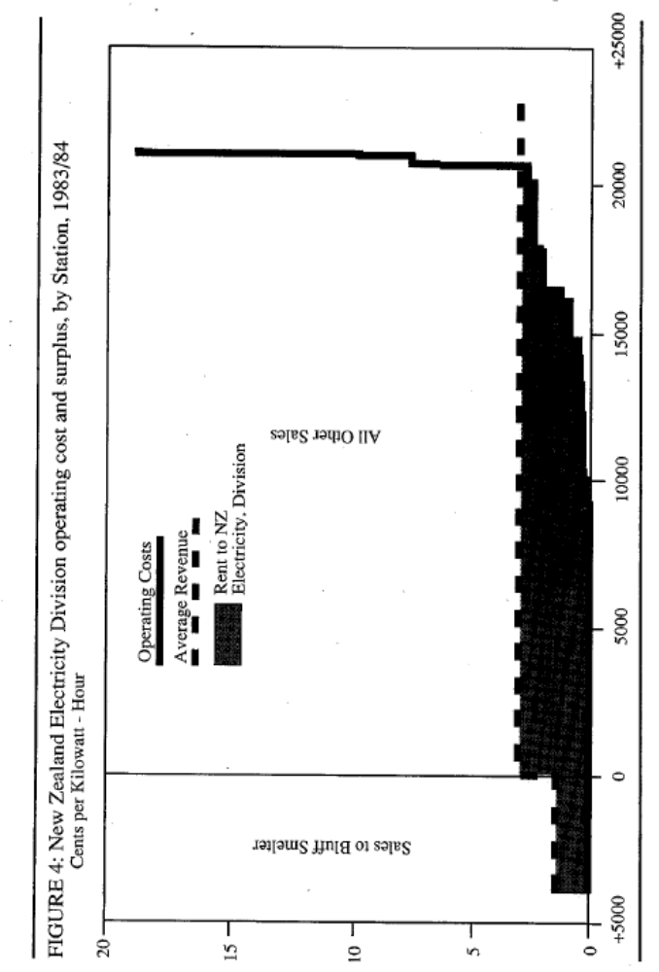
Source: Geoff Bertram, “Rents in the Energy Sector”, in Royal Commission on Social Policy, The April Report, 1988, Volume IV p.310.

Slide 44
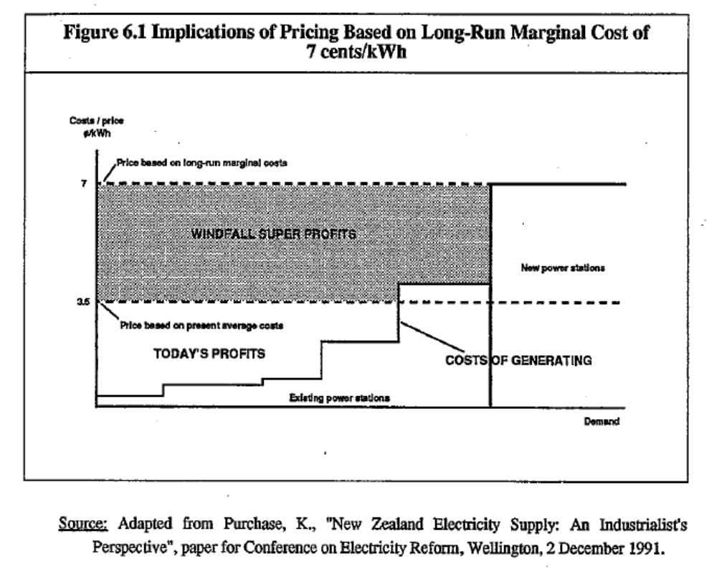
Source: Geoff Bertram, Ian Dempster, Stephen Gale and Simon Terry, Hydro New Zealand” Providing for Progressive Pricing of Electricity, 1992, p.40.

Slide 45
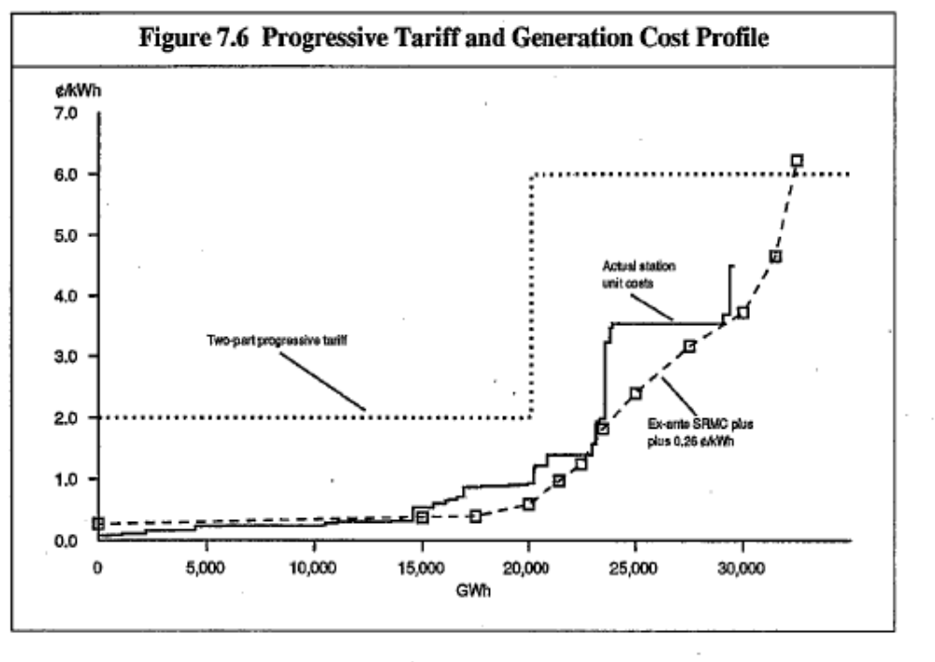
Source: Geoff Bertram, Ian Dempster, Stephen Gale and Simon Terry, Hydro New Zealand” Providing for Progressive Pricing of Electricity, 1992, p.51.

Slide 46
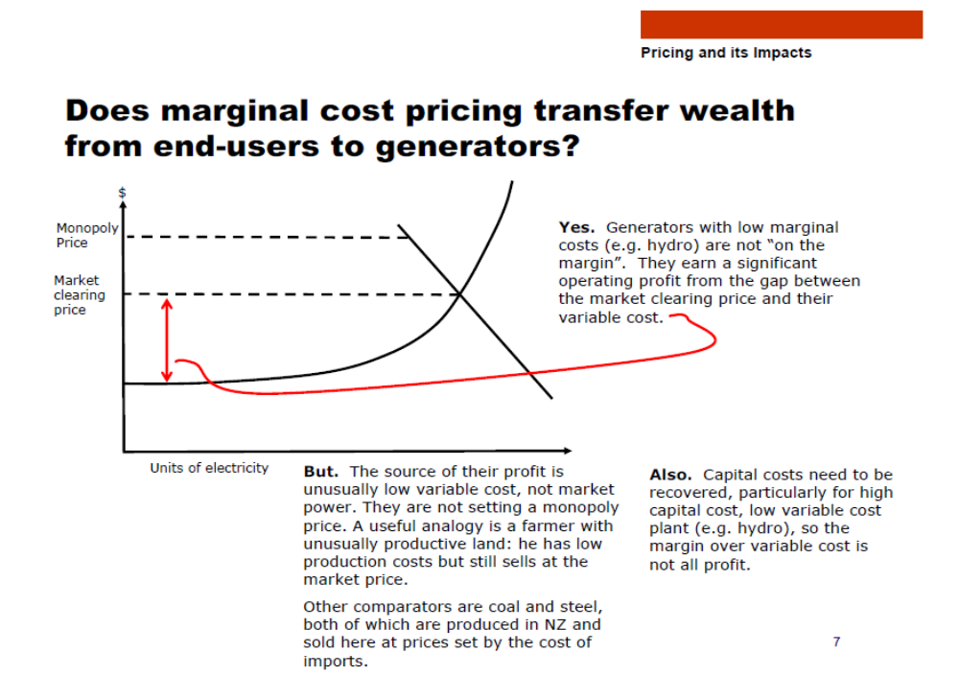
Source: Pricing in the New Zealand Electricity Market and its Economic Impact, MED, 6 March 2006, downloaded 12 April 2012 from http://www.med.govt.nz/sectors-industries/energy/electricity/industry/chronology-of-new-zealand-electricity-reform/electricity-market-review-2006 p.7.

Slide 47
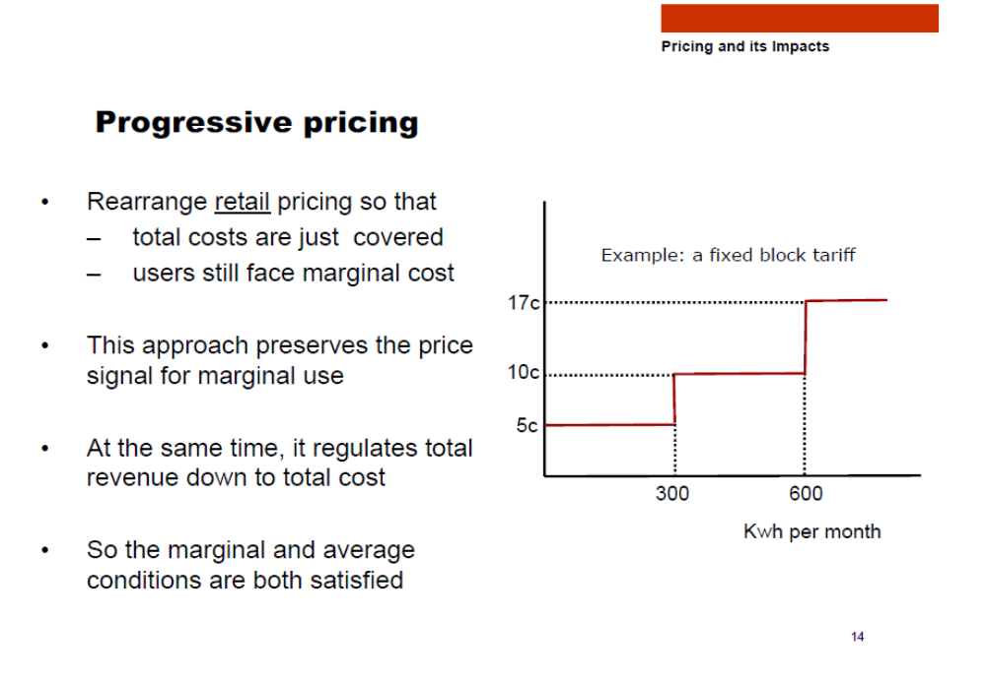
Source: Pricing in the New Zealand Electricity Market and its Economic Impact, MED, 6 March 2006, downloaded 12 April 2012 from http://www.med.govt.nz/sectors-industries/energy/electricity/industry/chronology-of-new-zealand-electricity-reform/electricity-market-review-2006 p.14.

Slide 48
I have recently suggested* that the assets held by the existing electricity SOEs could sustain free delivery of the first 300 kWh per month consumed by each New Zealand household.
That would make a substantial and sustainable contribution to overcoming energy poverty, without compromising the operation of the electricity market.
Adoption of the Mixed Ownership model effectively forecloses that as a future policy option.
*“Another approach to state asset sales programme”, Dominion Post, 28 March 2012 Page B5.

Slide 49
Asset revaluation and price regulation
Asset revaluations are income
NZ GAAP conceals them by parking them in the revaluation reserve and excluding them from the P&L account, hence from reported earnings
The lines companies ran rampant from 1994 to 2004 before the Government and Commerce Commission caught up, and the resulting asset values are still there, with associated charges to consumers
The gentailers have run rampant since 2000 without restraint
Since the new IFRS standards came in in 2007-8, all the generators except Meridian have reported what their generation fixed assets would have been worth under historic-cost accountng (but starting from the acquisition cost of their assets in 1996-1999)
Here’s the result:

Slide 50
 |  | 2005 | 2006 | 2007 | 2008 | 2009 | 2010 | 2011
Book value at which generation fixed assets are carried
 | Contact | 3.66 | 3.65 | 4.03 | 4.05 | 4.07 | 3.70 | 4.14
 | Genesis | 1.02 | 1.02 | 1.51 | 1.46 | 1.48 | 1.42 | 2.54
 | Meridian | 3.44 | 4.61 | 6.12 | 6.01 | 5.90 | 7.75 | 7.28
 | Mighty River | 2.29 | 2.26 | 2.09 | 2.98 | 3.48 | 4.06 | 4.42
 | Trustpower | 1.22 | 1.22 | 1.85 | 2.01 | 2.31 | 2.30 | 2.37
 | Total | 11.63 | 12.76 | 15.60 | 16.51 | 17.24 | 19.24 | 20.75
 | Total excluding Meridian | 8.18 | 8.15 | 9.48 | 10.51 | 11.33 | 11.49 | 13.47
Value if a cost basis were used
 | Contact | 1.70 | 1.71 | 1.86 | 1.56 | 1.61 | * | *
 | Genesis |  |  |  | 1.17 | 1.19 | 0.92 | 1.65
 | Meridian | na | na | na | na | na | na | na
 | Mighty River |  |  | 1.24 | 1.24 | 1.46 | 1.71 | 1.72
 | Trustpower |  |  | 1.00 | 1.14 | 1.18 | 1.17 | 1.23
 | Total excluding Meridian, where available |  |  |  | 5.10 | 5.44
Compiled from company annual reports

Slide 51
Aide-memoire from before: my figures for total fixed assets of gentailers
Source: company accounts and information disclosures

Slide 52
Had the generation/retail sector been price-regulated from the outset on the basis of historic cost, therefore, something like half the “capital-cost-driven” price increases of the past decade might have been avoided. Instead, the circular price/asset-value/price spiral has roared on unchecked.
For investors in the SOEs, a big uncertainty will be whether or not this will be allowed to continue. If prices remain unregulated and unilateral revaluations based on optimistic price projections continue unchecked, then big cash returns lie ahead and the shares will have high value. If, on the other hand, regulation is brought in to halt price-gouging, the return to investors could be radically lower.
Uncertainty is exacerbated by New Zealand’s peculiar legislation on price regulation. Under the Commerce Act 1986, price-gouging and profiteering are fully legal unless and until a ministerial decision is taken to regulate under Part IV of the Act. If the Minister decides to regulate, he or she has statutory authority to do so at any time. The decision to regulate is therefore a matter of political judgment and correspondingly difficult to predict, given that governments, and the political complexion of Parliament, change from time to time.
Watch this space….

Slide 53
The ETS
There is an important sting in the tail of New Zealand’s wholesale electricity market design, when carbon pricing is factored in. The market price of electricity is set equal to the offer price submitted by the highest-priced tranche of generation capacity in each half-hour period.
Whenever that marginal generator is using fossil fuels, under the ETS it will be liable to cover the resulting emissions by purchasing New Zealand Units, or equivalent carbon credits, and the cost of this will have to be covered by its offer-price into the market. Then the electricity price received by all generators, whether renewables-based or fossil-fuel-based, goes up by that amount, even though only a small fraction of generators actually have to pay for permits; owners of existing renewable capacity simply collect the extra revenue as windfall profits.
On the assumption of a (capped) permit price of $25 per tonne of carbon, and with the two-tonnes-for-one-permit arrangement under the ETS as amended in 2009, Simon Terry and I estimated in 2010 that the ETS would raise the electricity price by nearly $6 per MWh 2010-2012, rising to $12 thereafter when the two-for-one concession was to expire.

Slide 54
The result we estimated would be to raise the electricity generators’ total revenue by $769 million over the period 2010-2012, at the expense of electricity consumers. Of this extra revenue only $203 million would be required to pay for the generators’ total carbon emissions, leaving the remaining $566 million as windfall profits. Official estimates of the effects of the ETS give similar results.
Another way of expressing this outcome is to note that when a consumer buys electricity with the ETS unit price at $25 per tonne and the two-for-one concession in place, the ETS cost embodied in the electricity price is equivalent to paying a carbon charge of $40-50 per tonne on the CO2 emissions actually incurred to generate the electricity; whereas when the same consumer buys petrol the carbon-charge component is $12.50 per tonne of actual emissions caused by burning the petrol.
This is a perverse incentive from the point of view of reducing the nation’s greenhouse gas emissions, but it is a much-valued side-effect of the ETS from the point of view of the generators, including the SOEs.
As carbon prices go up, so will the volume of windfall profits to owners of old-established renewable generation. And as the share of renewables in total generation goes up, the actual purchases of permits by generators will fall, further increasing the windfall component of the price increase. This means that the arrival of serious emission-reducing policy will place an acute squeeze on household electricity budgets by driving up prices to fund generator windfalls

Slide 55
The obvious policy to neutralise this vicious spiral is a tax on ETS-derived windfall profits, to finance rebates to electricity consumers sufficient to ensure that they pay for the actual carbon emissions embodied in the electricity they consume, but no more.
A future Parliament is, in my judgment, highly likely to legislate for such a tax as the Emissions Trading Scheme (or its successor policy) is tightened up.
The prospect of such a tax places a further element of uncertainty over the true market value of shares in the electricity SOEs, and most especially Mighty River Power which is heavily weighted towards old-established renewables in its generation portfolio

Slide 56
Investment and innovation
Performance prior to restructuring was up with world best practice
Performance since is far below, and worsening
Uncoordinated, volatile investment as animal spirit flop about
Smart meters that aren’t smart
Smart grid that isn’t there
No feed-in tariff or any secure market access for new-entrant independent generators; and market rules designed by incumbents to protect incumbents
Zero planning or provision yet for electric vehicles, which are quite likely to be 40-50% of the light passenger fleet by 2030

Slide 57
Will Government eventually step in the break the bottlenecks?
If not, the market will eventually bring along Schumpeter’s creative destruction, and the present industry dinosaurs may not be the winners

Slide 58
Overall, radical uncertainties for would-be buyers of SOE shares
Due diligence will be interesting
Boards of directors are in the gun to fairly and fully report all risks in prospectus documentation (former finance company directors are now grimly aware of this!)
The electricity sector is overhung by major regulatory uncertainty in the four areas listed above
Regulation is needed and almost certainly inevitable – but the move to a Mixed Ownership Model will make it much harder and more expensive for taxpayers

Slide 59
So interesting times lie ahead….

Slide 61
The Caygill Inquiry 2000

