Slide 1
Pacific Islands Development in Long-run Perspective
Geoff Bertram
Institute of Policy Studies
February 2011

Slide 2
Top-down versus bottom-up
Seen from above, ‘resilience’ is a set of qualities that aid donors want island economies and societies to exhibit – outcomes to be purchased.
Seen from below, ‘resilience’ (including adaptability, flexibility, opportunism) has always been the fundamental long-run characteristic of Pacific Island communities, from way back before European contact.
Quite a few metropolitan policymakers are still preoccupied with
  blocking some of the consequences of bottom-up resilience,
  denying elements of its economic logic, and
  imposing preconceived (top-down) views of what resilience looks like or should look like
A recurrent failing of aid agencies and metropolitan governments is to impose a particular top-down conception of what it means to “develop”, and to make aid conditional upon a shadow-play of compliance with this vision by the recipients.

Slide 3
To get a sense of how bottom-up resilience works, evidence-based analysis is a good place to start
Rather than telling island peoples or states how to “develop sustainably”, or what to develop, watch what they have actually done within the limits of the external constraints placed upon them
One early casualty would be the degree of emphasis and expectations placed by large-country analysts on commodity trade and trade agreements. Export-led growth has had a bad century in the Pacific, and the next century’s prospects hinge more on regulatory capacity than free-trade treaties
Another casualty would be simplistic claims about the benefits of shifting resources from the public sector to the private sector (getting the public sector working more effectively is another matter)
Another would be several core assumptions in mainstream development thinking about decolonisation and the virtues of sovereign statehood
My own work has tended to focus on gathering comparative numbers and using them to chart the big trends in islander development – not only in the Pacific but worldwide.

Slide 4
“Sustainable development” is a term badly in need of careful unpacking.
Whenever anyone recommends it or appeals to it they should be asked to explain what exactly is “developing”, what it means to “develop”, what mechanism is to do the “sustaining”, whether this mechanism is politically acceptable or not, and which structural options are being ruled out by use of the term.
Unless very specific content is added, the words are mere rhetoric which confuse and conceal.
From my perspective, what is to be developed is the material welfare, life chances and cultural identity of each people, seen holistically as a people without regard to national borders unless and until those borders clearly have become effective dividing lines within the people.
Development is sustainable so long as material welfare, life chances and cultural cohesion are maintained or enhanced through time without running up large collective balance-sheet liabilities that at some later stage are apt to prove destructive.
This means that certain indicators often appealed to in the name of “sustainability” are in fact often irrelevant – especially “trade imbalance”, “capital outflow”, “brain drain”, and that ugly expression, “aid dependence”.

Slide 5
Conceptually one ought to be thinking of “viability” and “sustainability” in terms of socioeconomic units – often transnational units - rather than “national” ones.
Much of the ‘modern sector’ of any Pacific island people with migration outlets will lie offshore, inhabited by the diaspora of entrepreneurs and wage-workers which controls a large share of the financial and human capital of the people as a whole.
Remittances form a direct cashflow link between the diaspora and the home population, but other links are equally important for long-run growth – especially patterns of return migration, back-and-forth visiting, communication via media channels, and accumulation of financial assets in metropolitan banks and share registers.
National-accounts aggregates prepared for the home-resident population in isolation not only ignore much of the actual (but offshore) modern sector; they also miss the degree of success in preserving non-material wealth in the form of culture and human capital while raising material welfare.

Slide 6
Living standards need not depend upon production in the same locality; they can be fully “sustained” from sources that look “external” to the national-accounts statistician, so long as those sources are firmly internal to the transnational ethnic unit.
The home-resident pole’s living standards become unsustainable only if national borders are used to blockade and divide the people as a whole. The ethnic unit should be accounted on the same P&L and balance-sheet basis as any transnational enterprise.
The most obvious gap in the Stiglitz-Sen report on revising the traditional national-accounting framework is that they focus on measuring happiness within geographically-bounded territories rather than for peoples located across multiple territories.

Slide 7
A paradox for Adam Smith and Karl Marx: “Unproductive” Capital is Productive;
“Productive” Capital is Unproductive
Infrastructure provided direct use values: schools, hospitals, roads, reef passages, ports, airports, water supply, radio links, government buildings …..
Development-project-related capital was moribund, loss-making, often idle…
The large weight of the public sector in onshore economies is therefore logical, as is the tendency for the private sector to be located offshore in the diaspora, hence off-the-radar in traditional national accounts

Slide 8
Migration-adjusted national income accounting (bringing diasporas into the statistics) is in its infancy and is a rich area for empirical macroeconomic research
Kenichi Ueda, Kenichi, 2002, Implications of Migration on Income and Welfare of Nationals, International Monetary Fund Working Paper No. 02/215
Roberto Cardarelli and Kenichi Ueda, “Domestic and Global Perspectives of Migration to the United States”, in United States: Selected Issues, IMF Country Report 04/228, July 2004, pp.16-29.
Michael Clemens and Lant Pritchett, “Income per Natural: Measuring Development for People Rather than Places”, Population and Development Review 34(3): 395-434, September 2008

Slide 9
Outline of the rest of the paper
How imports are funded (more or less sustainably….)
Importance of remittances
How population (including labour, human capital, and entrepreneurship) is allocated across geographic space => island peoples, their societies and economies, are transnational in scope
Sovereignty is like a tax which places a deadweight burden on prosperity => some sacrifices of sovereignty can have economic and social payoffs
Ignoring or downplaying the development experience and performance of sub-national jurisdictions is a big analytical mistake
Some long-run charts on New Zealand’s relationships with the Pacific

Slide 10
In terms of the traditional national-accounts approach, imports rule
The ability to fund imports of goods and services is the key means to the end of sustaining private and public consumption, and hence material welfare, within the geographical territory of an island ‘state’ (including SNJs)
Getting the imports at least cost (in terms of leisure and social capital) is the strategic game. There are several ways to work on getting the constraint relaxed in practice. Commodity exports are way down the list, for good reason
The place to start is with the relationship of imports to well-being, and the identification of the components of well-being that are not sustainable by imports.
Much of the latter has to do with “the village”, its way of life and the problem of how important it is to hold young people in the village economy, and for players in the village to have cash opportunities for sale of products outside.

Slide 11
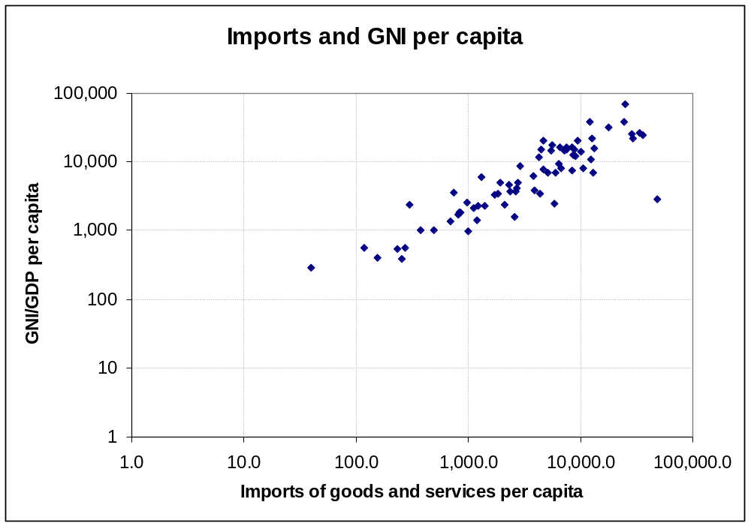
Imports are fundamental to onshore living standards but have to be paid for:
80 small islands worldwide
US
Virgin
Islands
Asserted direction of causality

Slide 12
Back in 1984 Ray Watters and I discovered the “jaws effect” in some small Pacific islands
Imports had become disconnected from merchandise exports as the colonial era came to an end

Slide 13
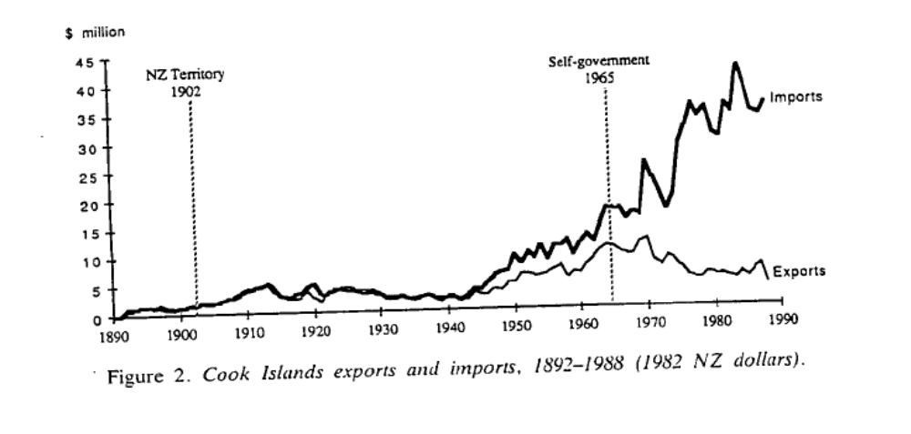
Cook Islands trade balance
Source: Geoff Bertram, ‘Sustainability, Aid, and Material Welfare in Small Pacific Island Economies, 1900-1990’, World Development, 21,2 (February 1993), p.250..

Slide 14
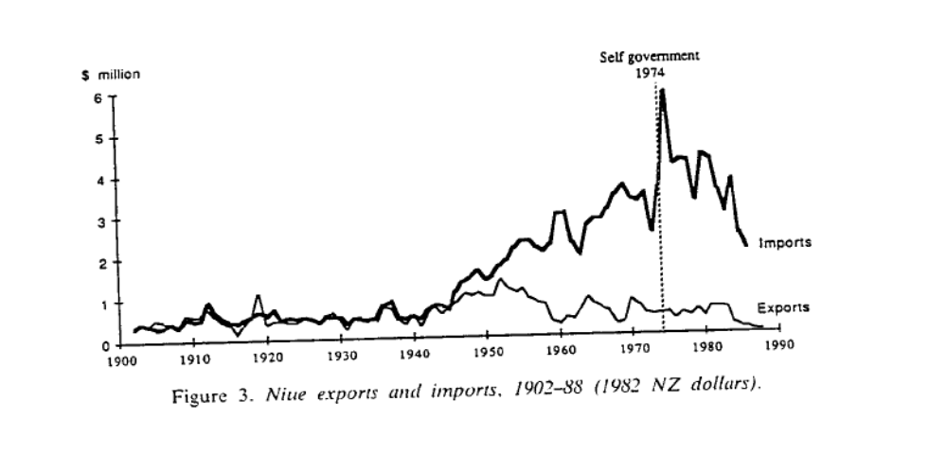
Niue trade balance
Source: Geoff Bertram, ‘Sustainability, Aid, and Material Welfare in Small Pacific Island Economies, 1900-1990’, World Development, 21,2 (February 1993), p.250..

Slide 15
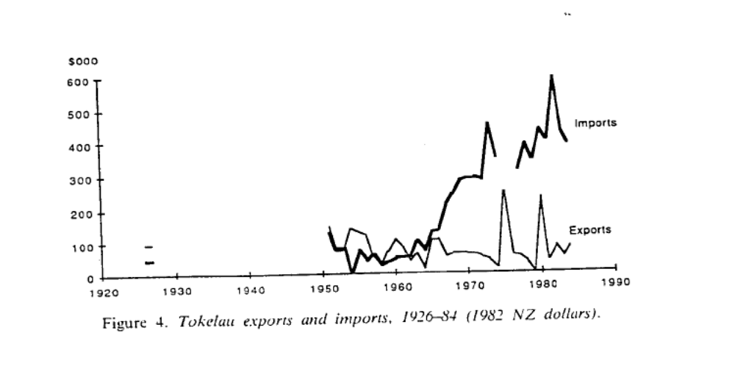
Tokelau trade balance
Source: Geoff Bertram, ‘Sustainability, Aid, and Material Welfare in Small Pacific Island Economies, 1900-1990’, World Development, 21,2 (February 1993), p.250..

Slide 16
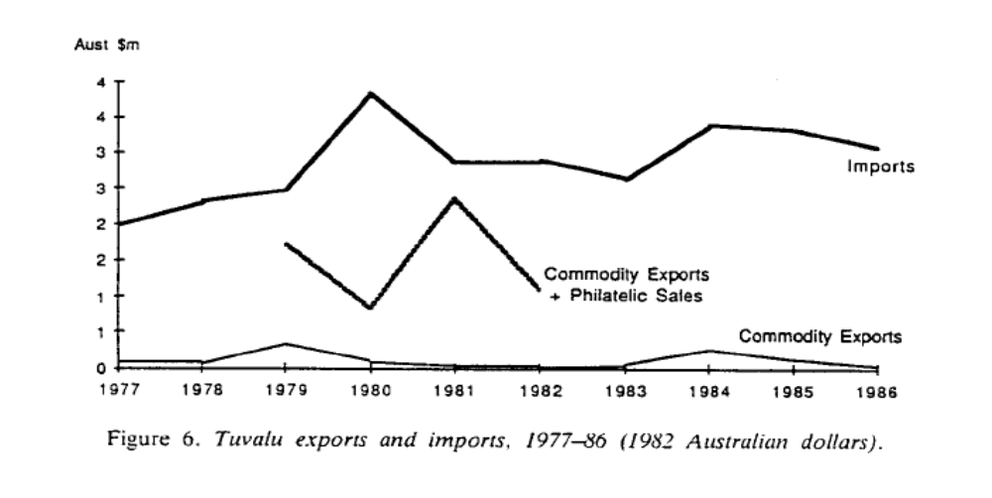
Tuvalu trade balance
Source: Geoff Bertram, ‘Sustainability, Aid, and Material Welfare in Small Pacific Island Economies, 1900-1990’, World Development, 21,2 (February 1993), p.250..

Slide 17
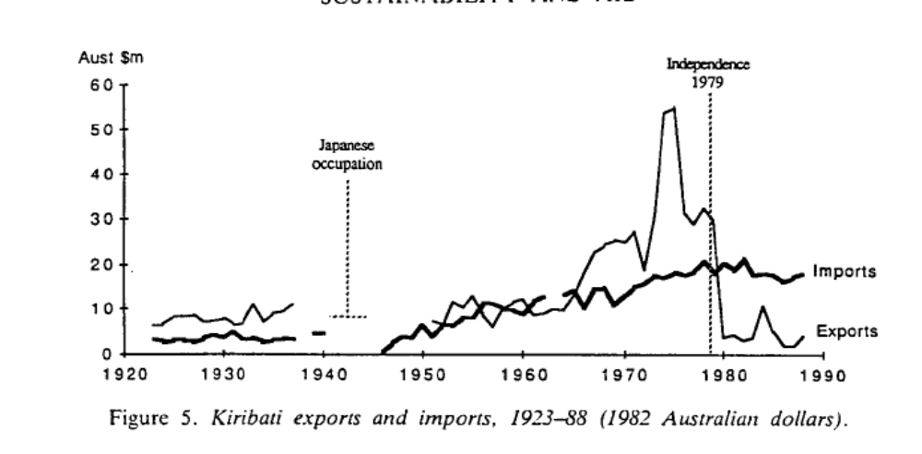
Kiribati trade balance
Source: Geoff Bertram, ‘Sustainability, Aid, and Material Welfare in Small Pacific Island Economies, 1900-1990’, World Development, 21,2 (February 1993), p.250..

Slide 18
For us the question this raised was: how was the observed gap being funded
Not by overseas borrowing – the Pacific has not been a debt-crisis-prone region (the Cook Islands 1988-1996 was the exception to prove the rule)
Only in a few cases did services exports pick up the funding burden
In the Pacific, a strong “commercial balance” signals either extreme poverty (PNG, Vanuatu) or special cases (Fiji, American Samoa)

Slide 19
How could the trade “jaws” be sustainable without borrowing to fill the gaps?
Our answer in 1984 was MIRAB
Two stock-flow relationships were the locomotives of these economies:
  MIR: Stock of overseas migrants => flow of remittances
  AB: Flow of aid => stock of public sector employees (“bureaucrats”)

Slide 20
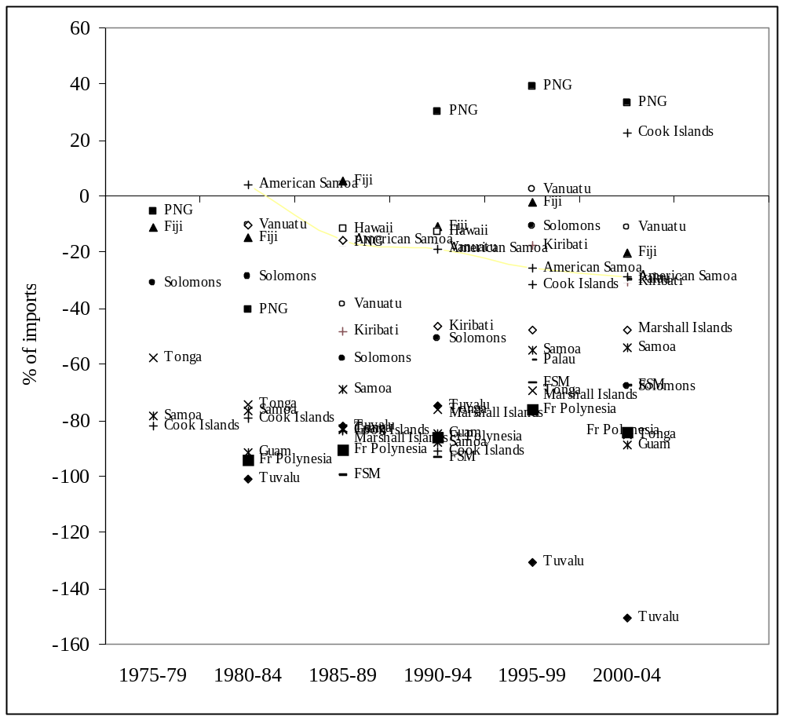
Goods and Services Balances of Seventeen Pacific Island Economies
1975-2004
Source: Geoff Bertram, “Economy”, in Rapaport, M. (ed) The Pacific Islands: Environment and Society, 2nd ed 2011.

Slide 21
Rule 1: don’t get hypnotised by the trade balance (this is the mistake most outside analysts instantly fall into).
Commercial trade deficits are common and sustained, therefore (to date at least) sustainable.
None of the countries in that diagram has run up unsustainable international debt – instead, they have sustained their import capacity by means other than conventional exports.
But it’s true there is a funding constraint driving the market solutions we observe

Slide 22
There’s a solid number of MIRAB cases identified in the literature now
Cook and Kirkpatrick (1998): FSM
Poirine (1998): French Polynesia, US Virgin Is, Guadeloupe, Martinique, St Perre et Miquelon, Mayotte
Bertram (1999): Samoa, Tonga, Easter Island, Palau, Marianas
Royle (2001): St Helena, St Kitts, and the Marshall Islands
McElroy & Morris (2002): Cape Verde, Comoros, Sao Tome & Principe

Slide 23
But MIRAB is on;y one of a rich menu of strategic options: sustainable, but optimal in only a few cases
Two dramatic success stories of transition out of MIRAB status are the Cayman Islands and the Cook Islands
Consider the Cook Islands case by extending my earlier jaws chart:

Slide 28
Looking around the world there are numerous case studies of island economies which do not exhibit MIRAB characteristics.
Baldacchino (2004) and PROFIT. Five dimensions of local jurisdictional autonomy:
  P (people considerations): powers over movement of persons (including issues of citizenship, residence and employment rights);
  R (Resource management): powers over environmental policy, especially regarding natural resources;
  O (overseas engagement and ultra-national recognition):the exercise of “para-diplomacy” by sub-national governments acting as though they are sovereign states
  FI : finance, insurance and taxation;
  T (transportation): powers over access by air and sea.
McElroy (2004) and SITEs: “small, tourist-dependent islands represent [an analytically] useful cluster or special case of island development.”

Slide 29
By 2009 Godfrey Baldacchino and I had the following map of the world’s islands in terms of how they paid their way*:
* From G. Baldacchino and G. Bertram, ‘The beak of the finch: insights into the economic development of small economies’, The Round Table, 98, 401 (April 2009), pp.141–160.

Slide 30
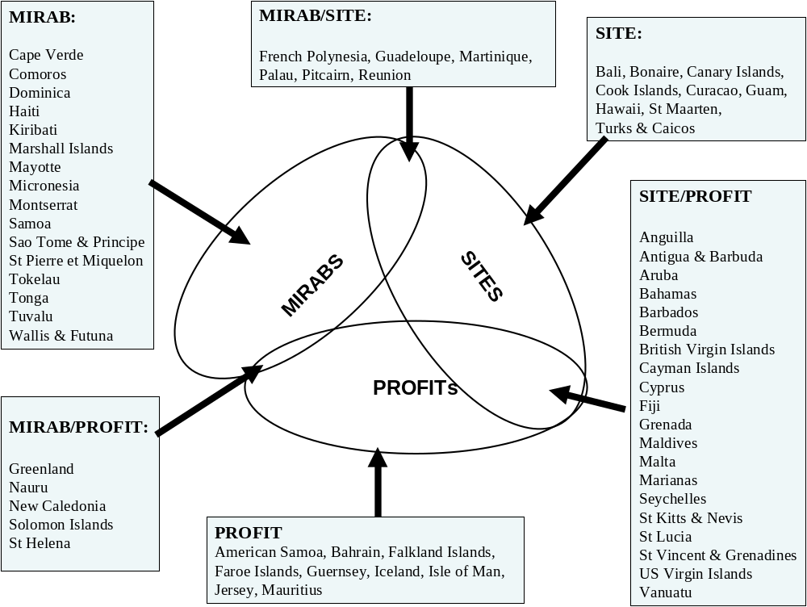

Slide 31
What’s special about small-island speciation is that islands make evolutionary switches around the diagram
Niches are partly exogenous and partly endogenous (created by strategic behaviour)
Selection is partly by chance, but largely by collective response to incentives

Slide 32
Sustaining imports requires some source of funding, but not necessarily “trade balance” with exports ramped up to equal imports.
Balance-of-payments current account equilibrium and reasonable living standards can be sustained with very low commodity exports, as Tuvalu dramatically illustrates.
Diagnosis requires that the funding flows be identified, quantified, and viewed from a dynamic long-run perspective. A recent attempt at doing this is Bertram and Poirine (2007)

Slide 33
Bernard Poirine and I did a number-crunching exercise for 71 island economies to produce a more detailed story*
Conclusion: there are many ways to play the game depending what hand has been dealt….
(arrows in each diagram identify Pacific economies)
‘Island Political Economy’, Chapter 10 in Baldacchino, G. (ed.) A World of Islands, Institute of Island Studies, University of Prince Edward Island, 2007, pp.325-377.

Slide 34
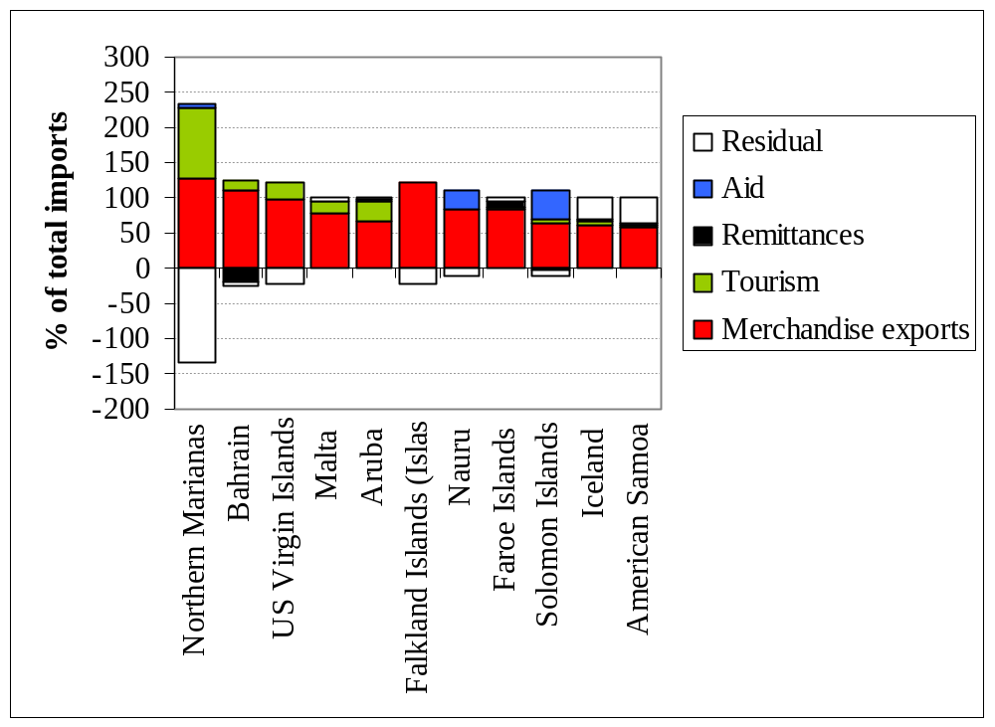
Small Island Export Economies at 2000

Slide 35
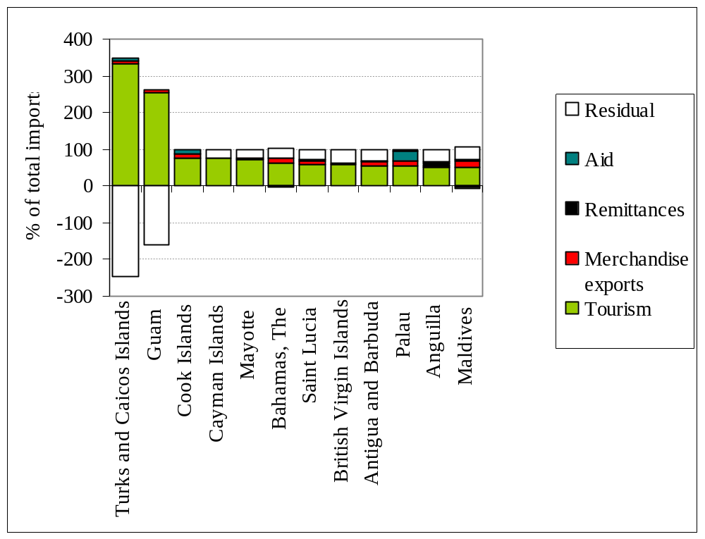
Small-island SITEs at 2000

Slide 36
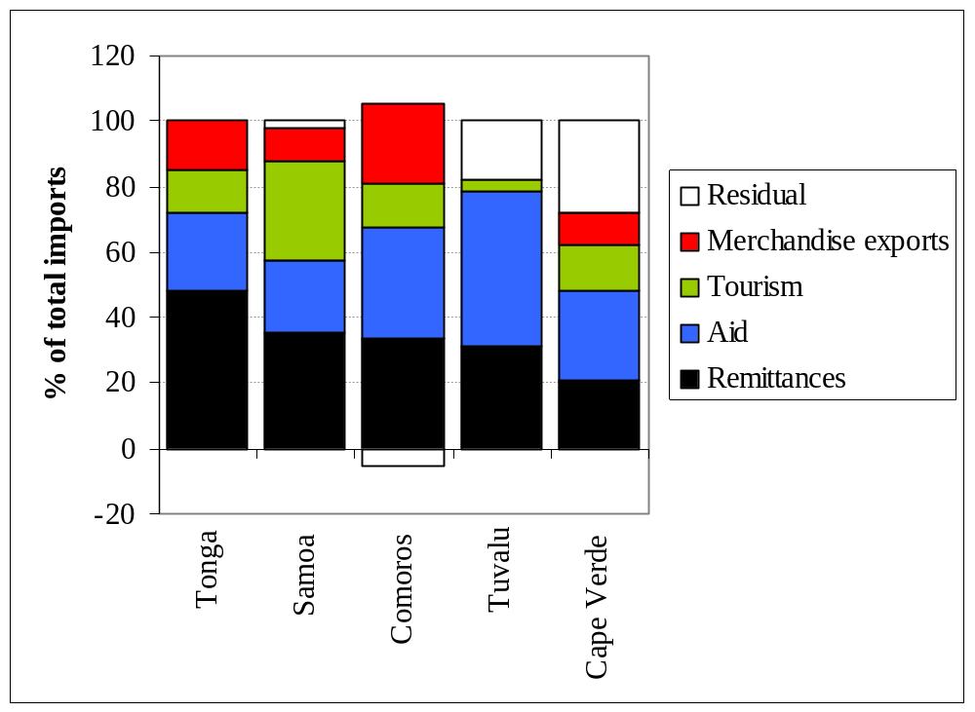
Fully evolved MIRABs at 2000

Slide 37
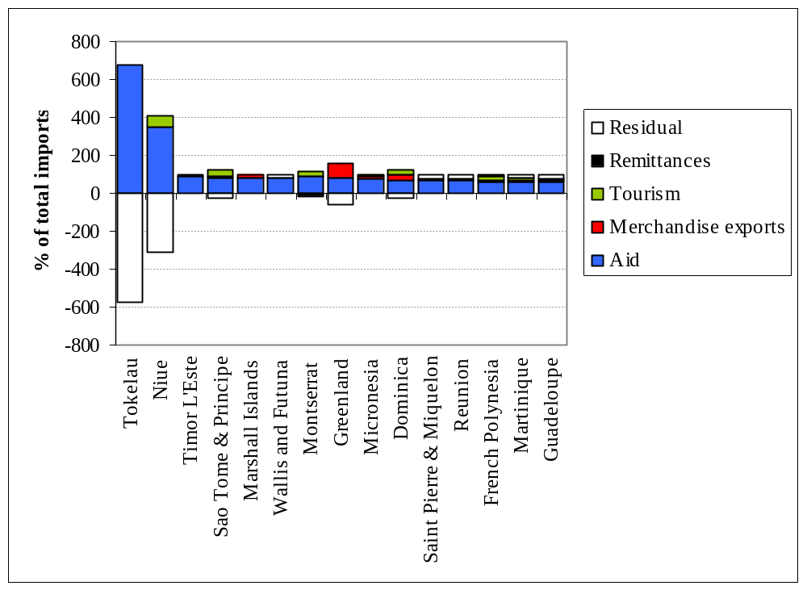
Small Aid-led island economies at 2000

Slide 38
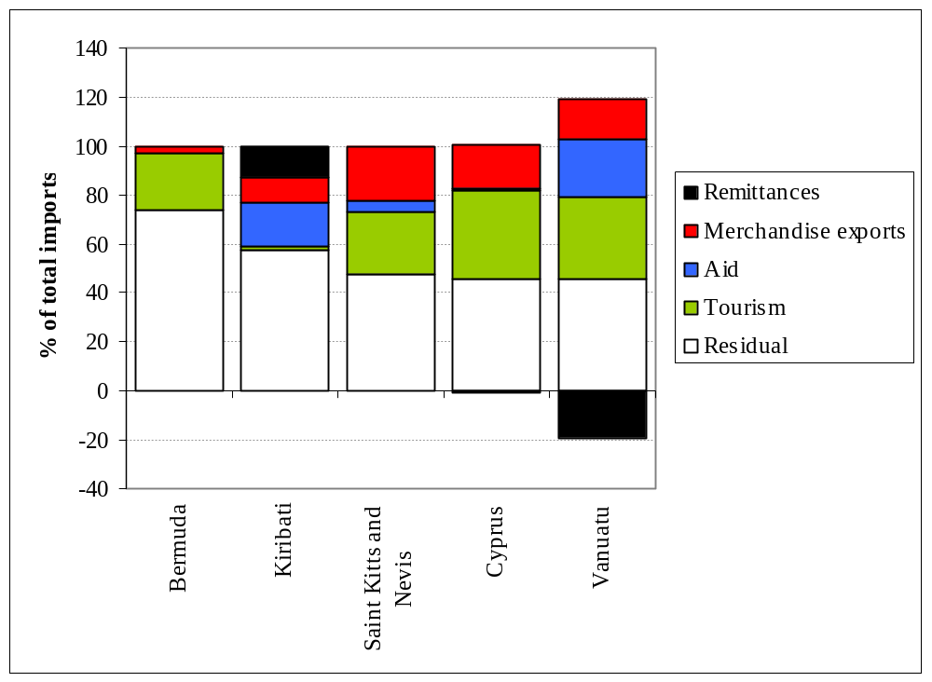
‘Residual-led” (= offshore finance) cases at 2000

Slide 39
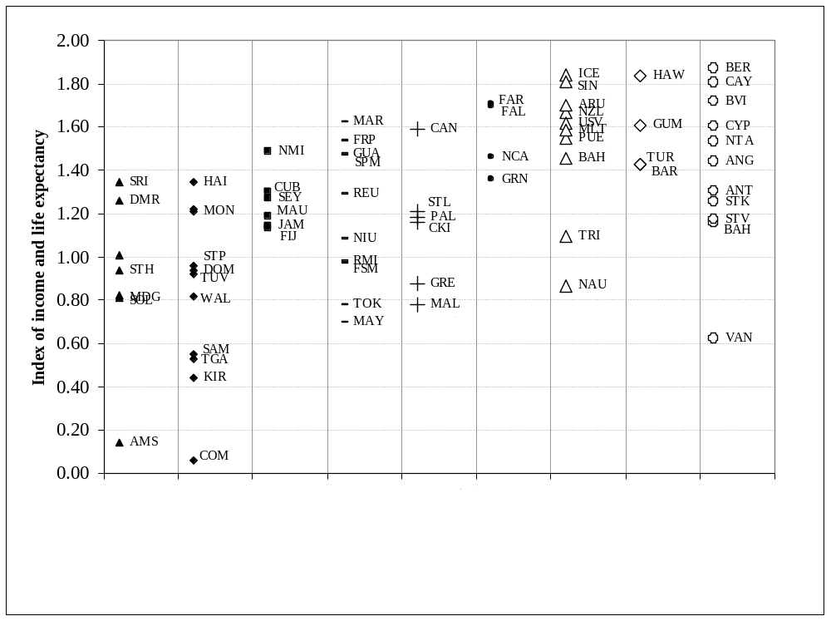
Nine strategic orientations: welfare outcomes
Bertram and Poirine 2007: 361

Slide 40
Remittances are not everything, but they’re fundamental to some Pacific economies
Samoa:
  the flow of remittances captured by the official statistical agencies is currently around US$50 million (NZ$80 million) a year.
  Allowing for informal remittances not appearing in the statistics, the true total flow from New Zealand to Samoa probably lies between $100 million and $150 million a year
  Compare this with New Zealand imports from Samoa of $3-4 million and bilateral aid of $8-9 million a year. Trade and aid, in other words, play only a trivial role in economic relationships between New Zealand and Samoa, while Samoans themselves operate the really important linkage.
Tonga:
  Estimated formal remittances from Tongans in New Zealand are over US$30 million (NZ$50 million), suggesting that the total (including unrecorded transfers) is likely to be in the range $80-100 million a year,
  Compare this with New Zealand’s imports from Tonga of around $2 million and aid of $17 million in 2008. Like Samoa, Tonga’s main economic link with New Zealand currently is via remittances.
New Zealand’s balance of payments statistics provide no estimates of remittance flows! (The Asian Development Bank has called attention to the gap.)

Slide 41
How population (including labour, human capital, and entrepreneurship) is allocated across geographic space
Island peoples form unified entities spanning transnational space
Diasporas are integral parts of many island economies - hence “modern sectors”, “private sectors”, “skilled employment”, etc, occur within the community-defined economy but outside the territorially-delimited “nation”.
The geographic allocation of resources represents a dynamic equilibrium
In the labour market, a fundamental piece of information is the income level of the diaspora relative to the income level of the home population. Once corrections have been made for frictional variables, age, level of education and so on, the income relativity between the diaspora and the home labour force should exhibit a threshold differential at which migration accelerates/decelerates.
In a migratory equilibrium, the income relativity sits exactly on this threshold. So we should be in a position to estimate income levels of people from a uniform ethnic group across transnational space, and hence to characterise the equilibrium. [For methodological pointers see the work of George Borjas – e.g. Imperfect Substitution between Immigrants and Natives: A Reappraisal George J. Borjas, Jeffrey Grogger, and Gordon H. Hanson NBER Working Paper No. 13887, March 2008]

Slide 42
In the labour market, a fundamental piece of information is the income level of the diaspora relative to the income level of the home population.
Once corrections have been made for frictional variables, age, level of education and so on, the income relativity between the diaspora and the home labour force should exhibit a threshold differential at which migration accelerates/decelerates.
In a migratory equilibrium, the income relativity sits exactly on this threshold. We should now be in a position to estimate income levels of people from a uniform ethnic group across transnational space, and hence to characterise the equilibrium.
For some methodological pointers see the work of Borjas - e.g. Imperfect Substitution between Immigrants and Natives: A Reappraisal George J. Borjas, Jeffrey Grogger, and Gordon H. Hanson NBER Working Paper No. 13887, March 2008

Slide 43
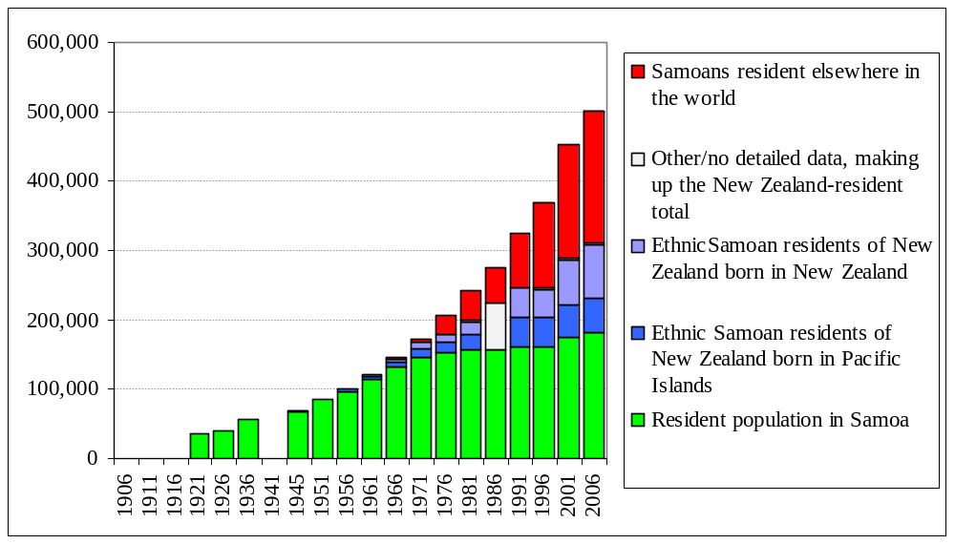
Figure 1 Samoan Community by Place of Residence

Slide 44
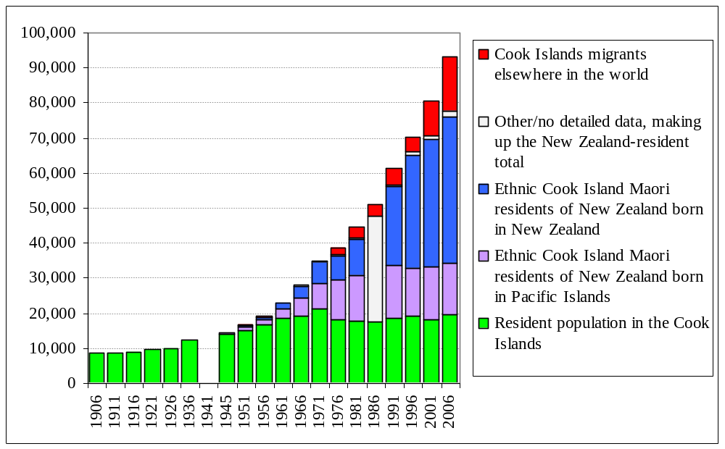
Figure 2 Cook Islands Maori Community by Place of Residence

Slide 45
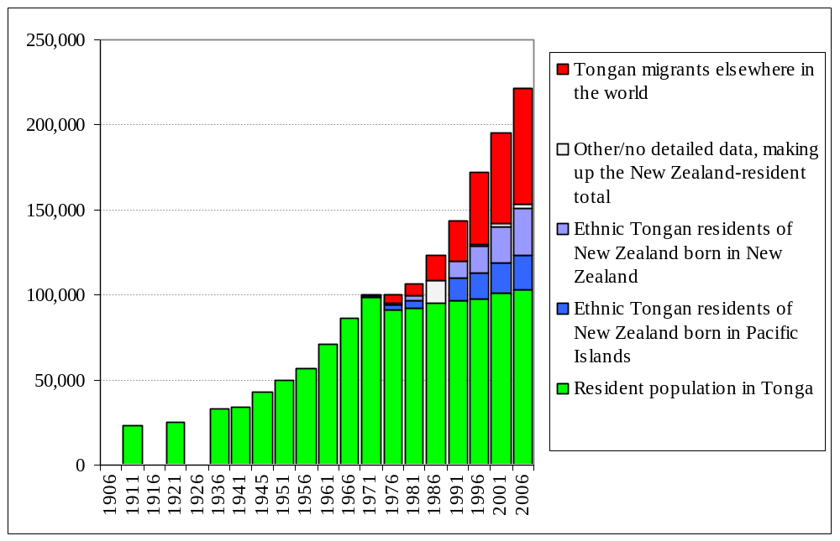
Figure 3: Tongan Community by Place of Residence
Hypothesised “missing migrants”

Slide 46
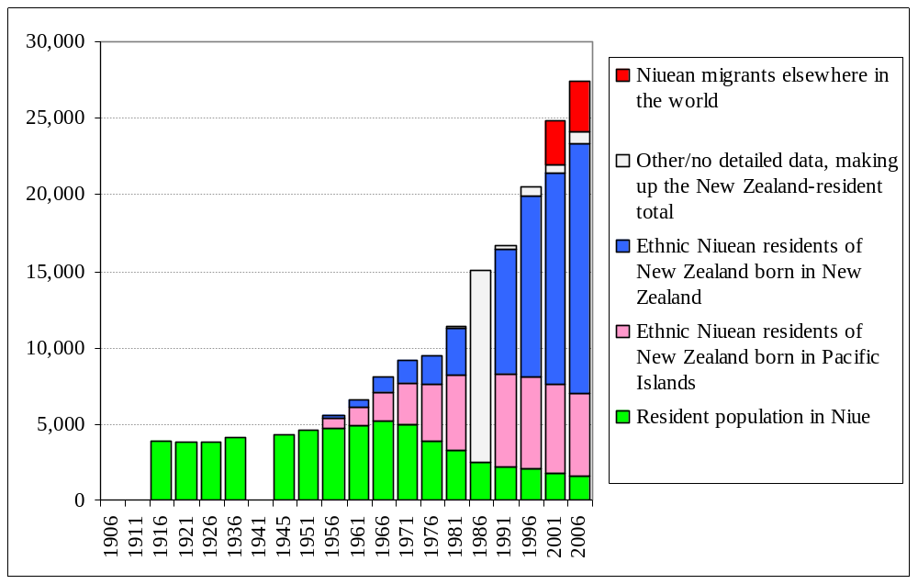
Figure 4: Niuean Community by Place of Residence

Slide 47
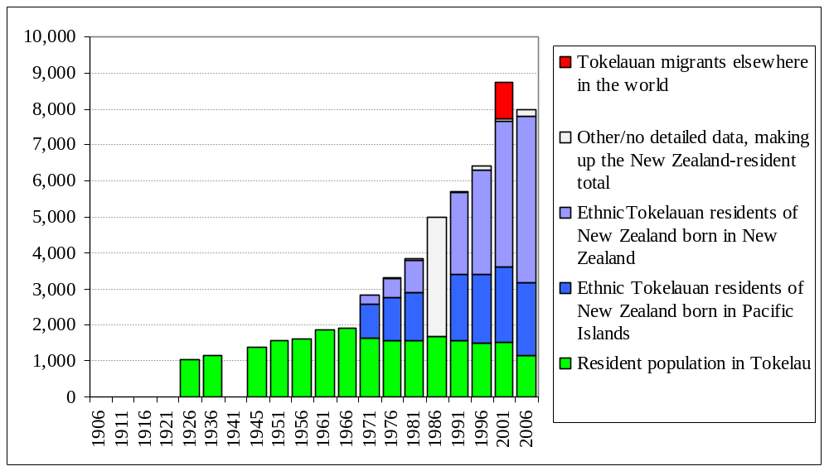
Figure 5: Tokelauan Community by Place of Residence

Slide 48
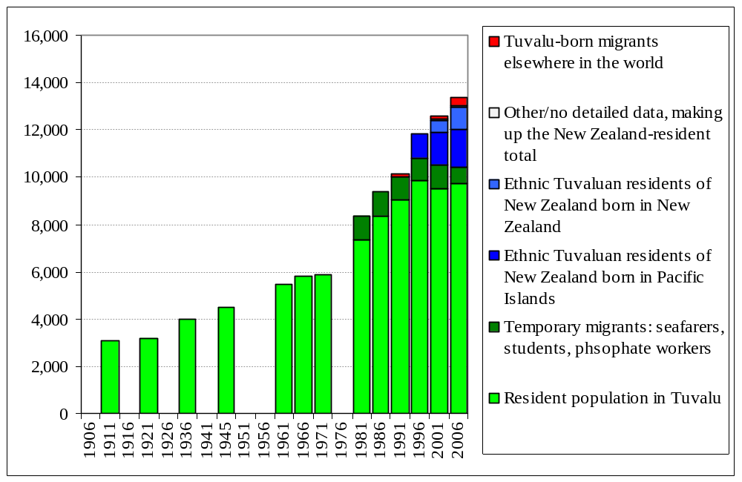
Figure 6: Tuvaluan Community by Place of Residence

Slide 49
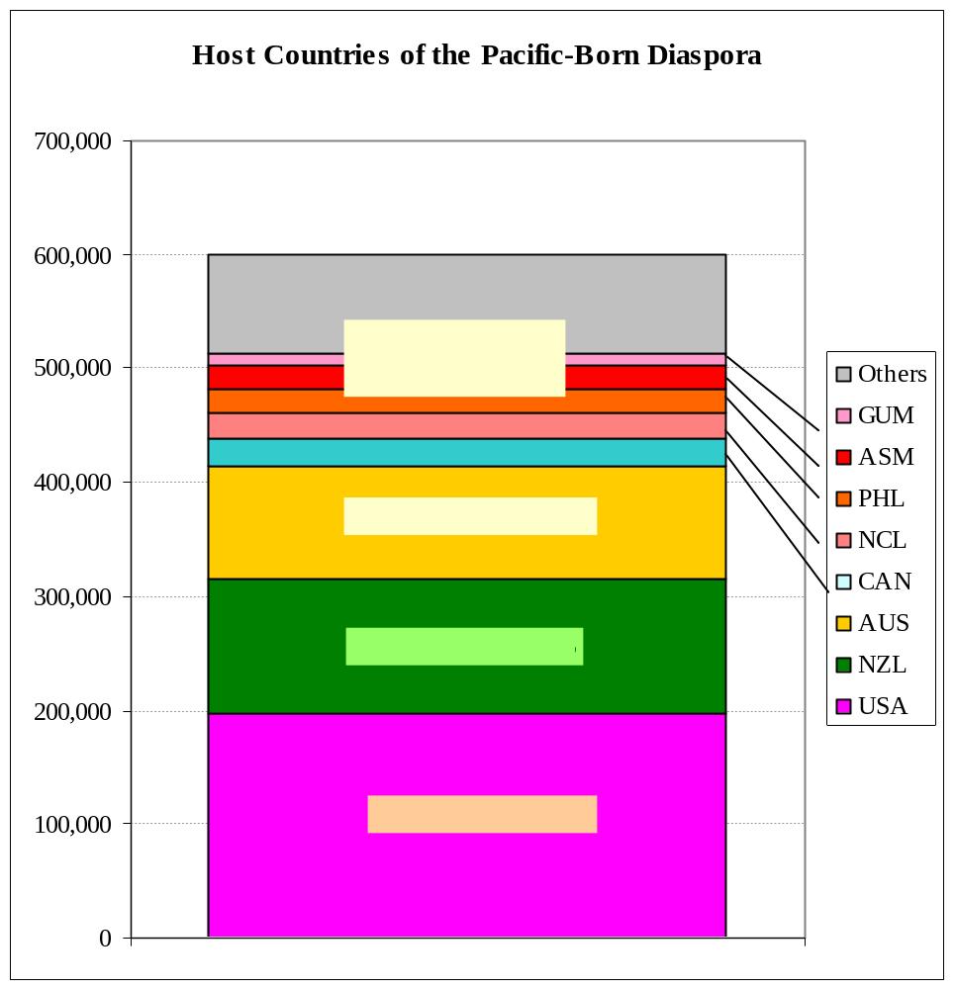

Slide 50
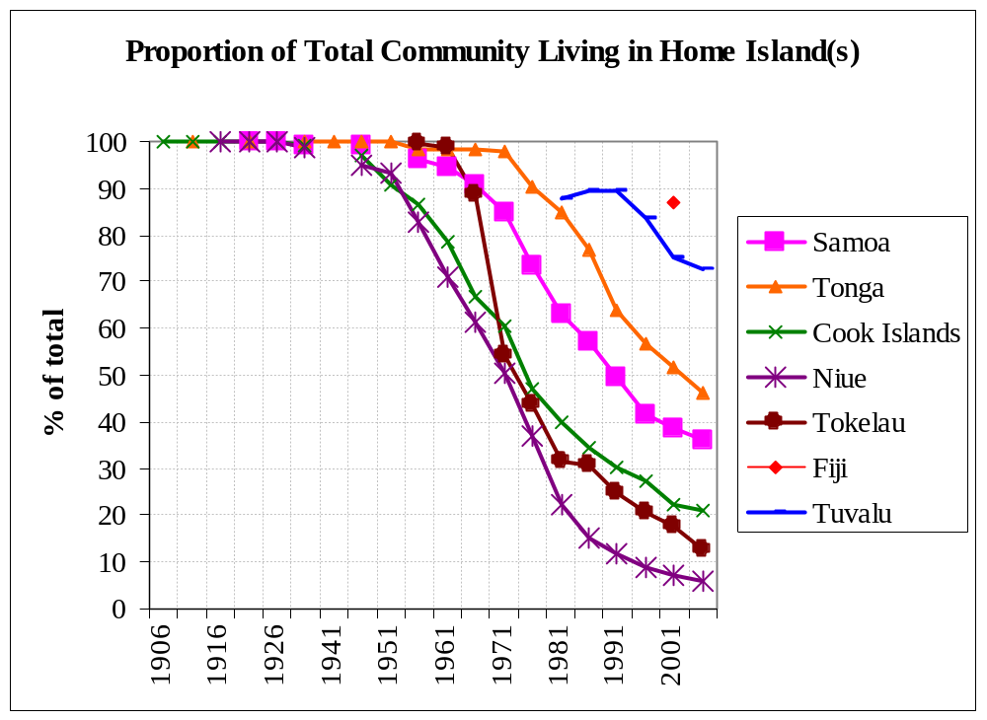
Figure 17: The Migration Transition in Seven Island Communities

Slide 51
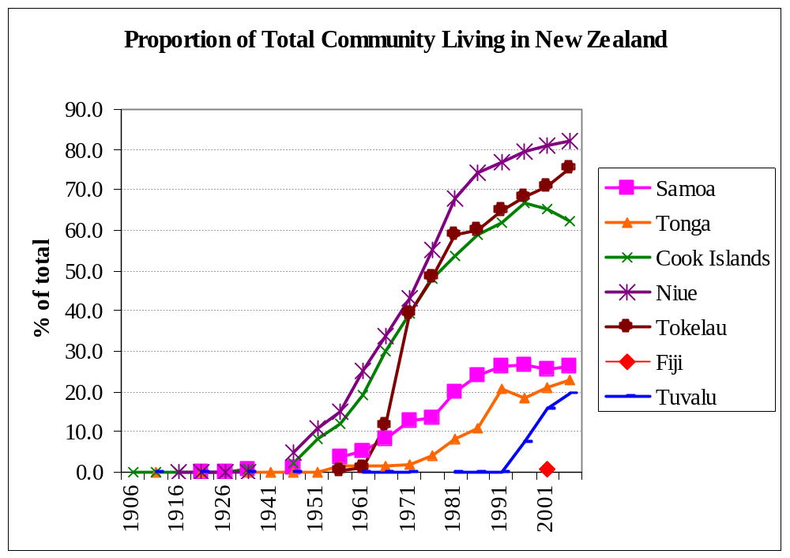

Slide 52
“Carrying capacity” limits are psychological rather than physical but appear genuine.
So long as there is a migration outlet available, Pacific islands’ home population has levelled off at roughly the pre-contact level (mid-eighteenth century) and population growth has been exported.
Niue and Tokelau have depopulated in response mainly to ill-advised New Zealand policies and attitudes regarding security of citizenship and unwillingness to work on political/constitutional integration. [The ‘Realm of NZ’ is at last getting a better press…]
The urgency of out-migration grew rapidly in Tuvalu from the 1980s as pre-contact population was re-established.
Kiribati now faces an even worse Malthusian cul-de-sac, but the barriers may be beginning to break. [Here is perhaps a case for the UK to extend the boundaries of ‘citizenship’?]
Smaller countries are better able to do “bottom-up globalisation” (John Connell’s phrase) – see Figures 8 and 9:

Slide 53
Size matters

Slide 54
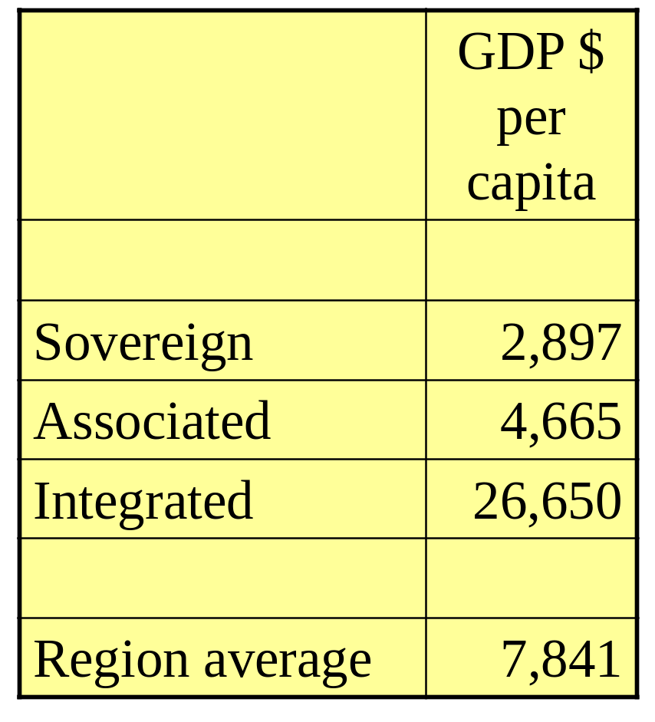
Sovereignty is a tax on material living standards
Small island countries that are sovereign, independent nation states tend to be less well-off than sub-national island jurisdictions (SNIJs)
GDP per Capita in the Pacific by Political Status, US dollars, PPP adjusted, c2000

Slide 55
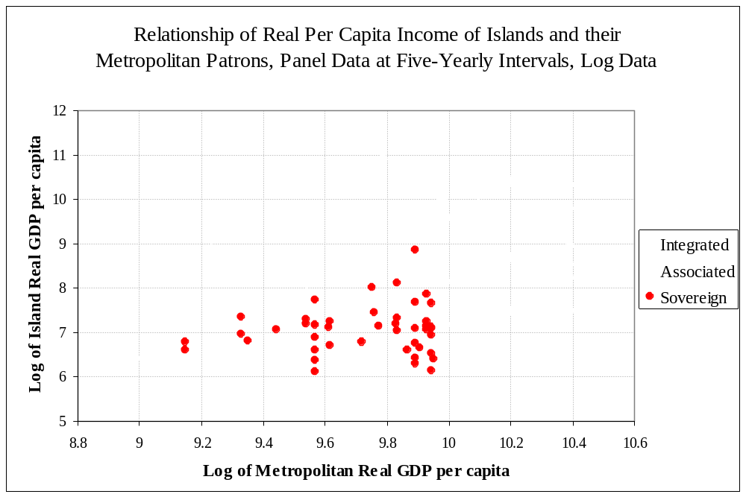
Source: Geoff Bertram, “On the Convergence of Small Island Economies with their Metropolitan Patrons”, World Development 32, 2 (February 2004) pp.343-364.

Slide 56
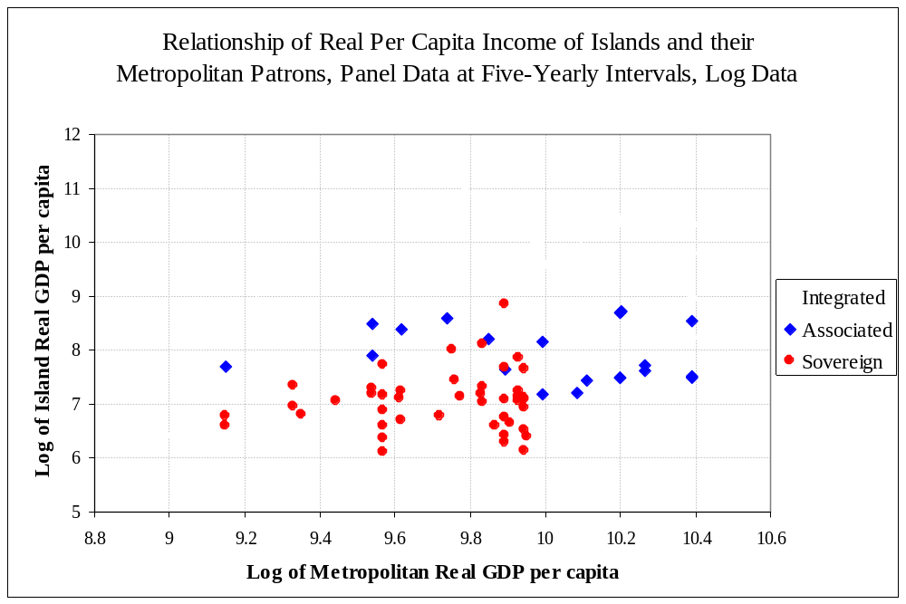
Source: Geoff Bertram, “On the Convergence of Small Island Economies with their Metropolitan Patrons”, World Development 32, 2 (February 2004) pp.343-364.

Slide 57
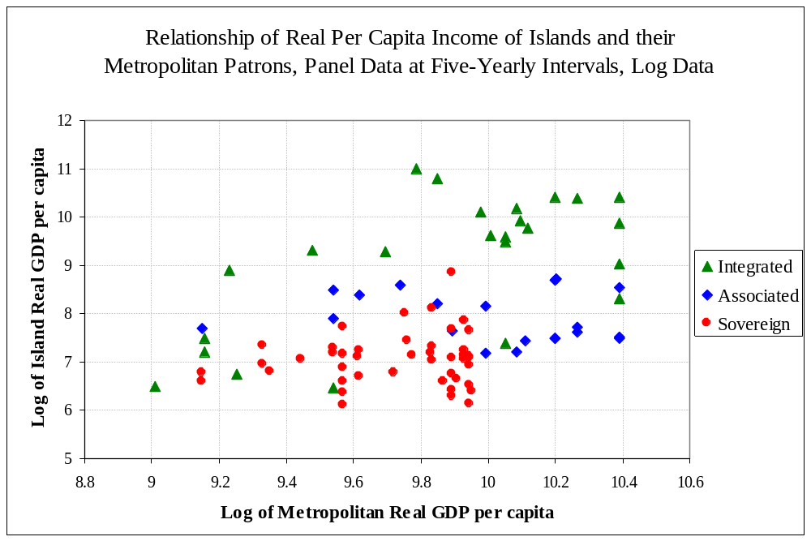
Source: Geoff Bertram, “On the Convergence of Small Island Economies with their Metropolitan Patrons”, World Development 32, 2 (February 2004) pp.343-364.

Slide 58
Some recent academic work on sovereignty and development
Geoff Bertram, “On the Convergence of Small Island Economies with their Metropolitan Patrons”, World Development 32, 2 (February 2004) pp.343-364.
J.L. McElroy and K.B. Pearce, “The Advantages of Political Afiliation: Dependent and Independent Small-Island Profiles”, The Round Table 95(386): 529-539, September 2006.
G. Baldacchino, Island Enclaves 2010; and G. Baldacchino & D. Milne, The Case for Non-sovereignty, Routledge 2009)
Feyrer, J. & Sacerdote, B. (2009) ‘Colonialism and Modern Income: Islands as Natural Experiments’, Review of Economics and Statistics 91(2): 245-262, May.

Slide 59
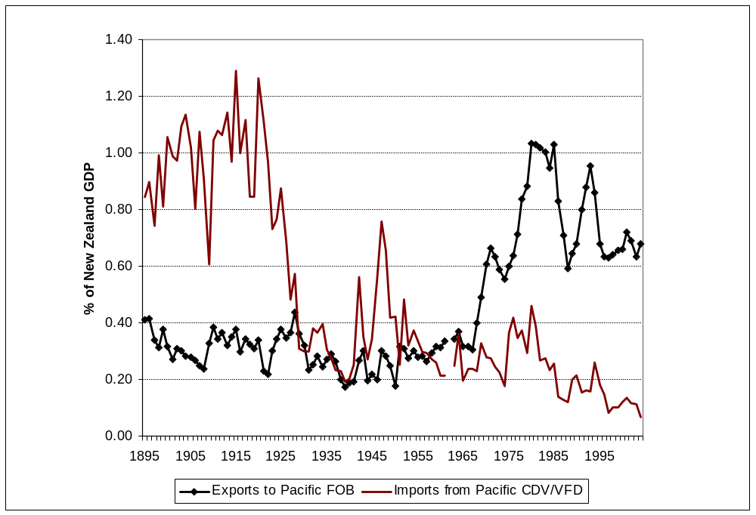
Exports and Imports, New Zealand and the Pacific Islands, 1895-2005

Slide 60
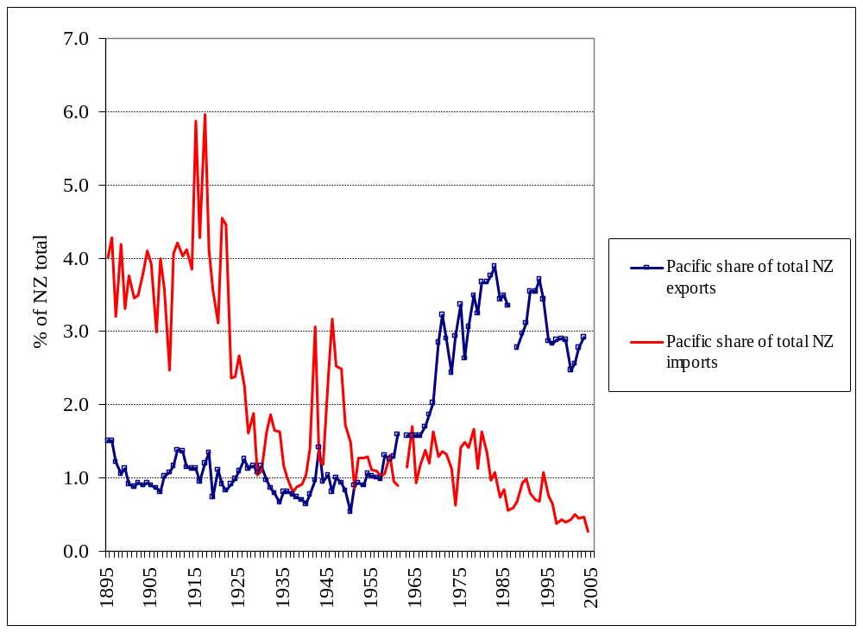
Proportions of New Zealand’s Export and Import Trade Accounted for by Pacific Islands as Trading Partners

Slide 61
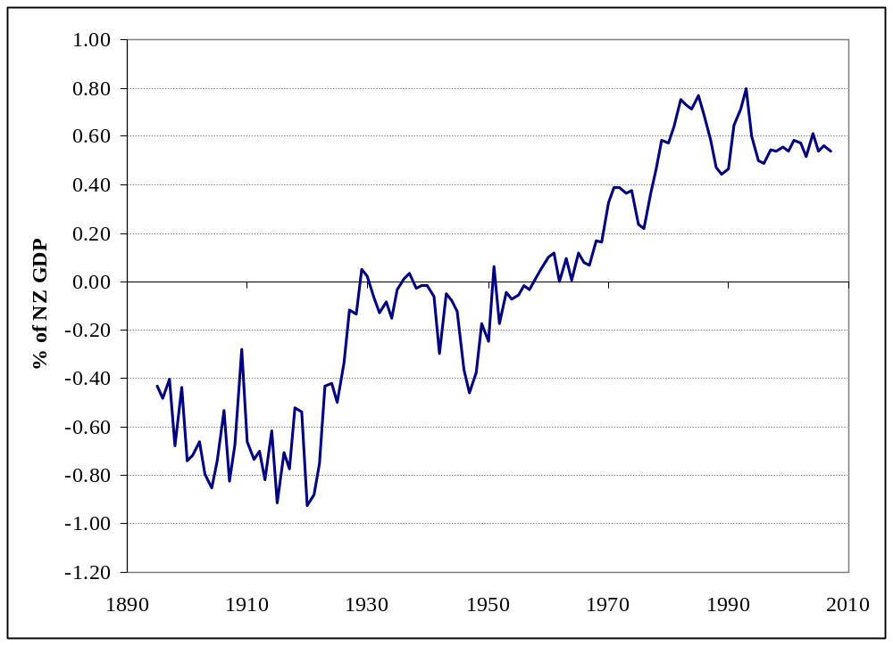
New Zealand’s Trade Balance with the Pacific Islands, 1895-2007

Slide 62
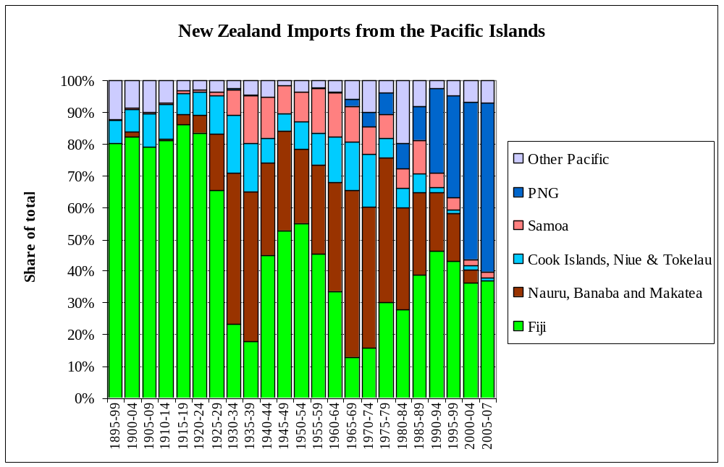

Slide 63
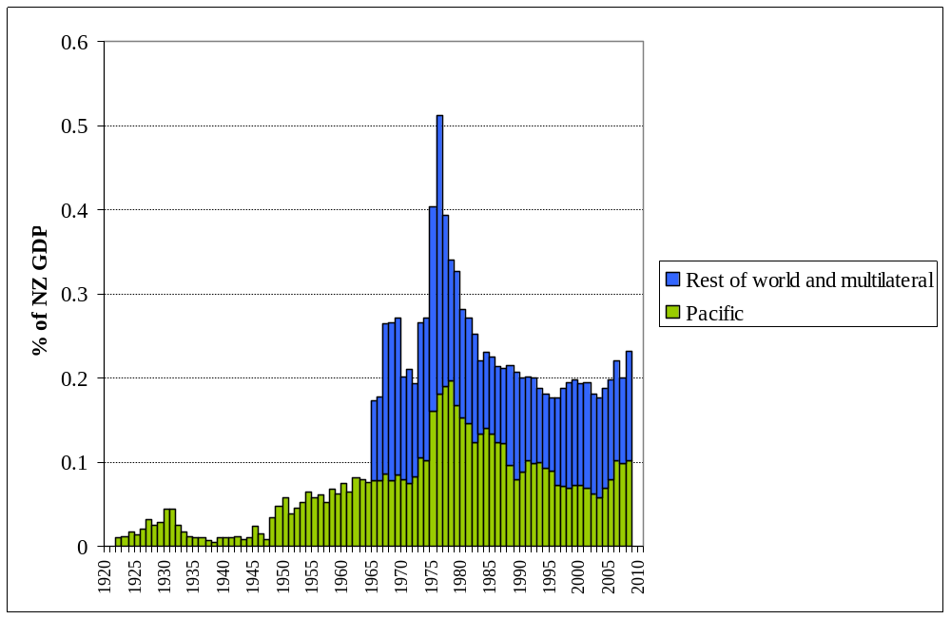
New Zealand Aid to Pacific and Elsewhere, 1920-2008

Slide 64
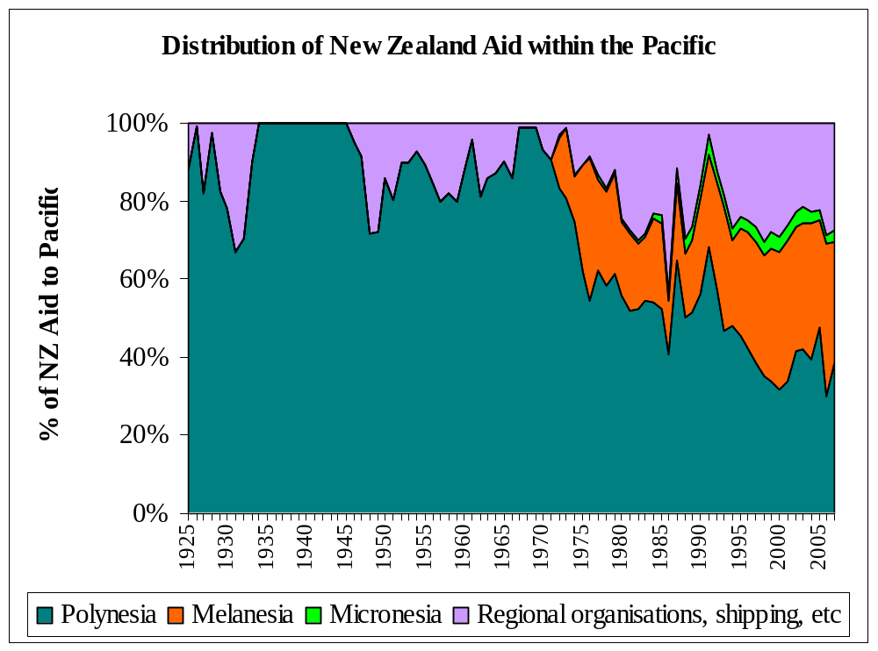

Slide 65
Overall, from an islander perspective their historical relationships with New Zealand have been economically beneficial though marred by occasional tensions over palagi conceptions of political and economic development.
Infrastructure and services were developed to a reasonably good standard under New Zealand rule, and have been sort-of sustained since by ongoing aid commitments.
By opening its doors to island migrants from its territories in the 1950s and 1960s New Zealand gained a source of cheap labour while enabling islanders to access cash incomes at levels that could not have been secured at home, a genuine win-win outcome.
By extending migration access over subsequent decades to a widening range of Pacific islanders – Tongans, Tuvaluans, and most recently Melanesians, New Zealand has cemented its role both as a good neighbour and as a development hub for the peoples of the region.

Slide 66
The interpenetration of small-island economies with metropolitan national economies such as New Zealand means that conventional national-accounts statistics conceal rather than reveal the true developmental performance of the islander communities, dispersed as they are across several different national economies.
Pacific islanders resident in New Zealand produce output which is simultaneously part of both New Zealand’s GDP and a key component of the collective income of their transnational ethnic groups. Pacific migrants pay income taxes and GST in New Zealand, and probably comprise 3 - 5% of the New Zealand tax base, an amount well in excess of the total value of aid and other grants from New Zealand to the islands.
The modern sector of any Pacific island people with migration outlets will lie offshore, inhabited by the diaspora of entrepreneurs and wage-workers which controls a large share of the financial and human capital of the ethnic community as a whole.

Slide 67
Remittances form a direct cashflow link between the diaspora and the home population, but other links are equally important for long-run growth – especially patterns of return migration, back-and-forth visiting, communication via media channels, and accumulation of financial assets in metropolitan banks and share registers.
Migration-adjusted national income accounting is in its infancy and is a rich area for empirical macroeconomic research. National-accounts aggregates prepared for the home population in isolation not only ignore much of the actual (but offshore) modern sector; they also miss the degree of success in preserving non-material wealth in the form of culture and human capital while raising material welfare.
Thus the time is ripe for a re-thinking of New Zealand’s policy stance towards the small islands of the region, based on acknowledgement that “sustainable development” need not mean either strong trading performance or large-scale industrial development in the islands, but can be secured by other forms of economic activity, many of which point towards an informal process of regional economic and social integration that transcends the narrow categories of national sovereignty and domestic product.

