Slide 1
Is there a ‘regulatory compact’ regarding gentailer asset values and revenues? If so, what does it say?
Geoff Bertram
Paper for IGPS Symposium on Proposals to Restructure the New Zealand Electricity Market
4 July 2013

Slide 2
My recent arguments summarised
Gentailers have been gouging the most dispersed and powerless consumer group – residentials – to secure excess profits
Those excess profits have been capitalised into revaluations of fixed assets on the companies’ books
The size of the revaluations (around $11.4 billion) indicates excess profits (rents) well in excess of $1 billion per year, relative to what residential consumers could have been paying under old-fashioned rate-of-return regulation
These rents are far in excess of what has been needed to fund new and replacement investment, even in an energy-only market

Slide 3
My recent arguments summarised (2)
Residential and small-business consumers lack countervailing power against what is effectively a gentailer cartel, and government has been missing in action
Rolling back the revaluations to historic cost would reveal the full extent of excess profits and hence the scope for price regulation to yield benefits to consumers
The $11.4 billion of revaluations is basically a bare wealth transfer from consumers, serving no economic purpose other than to enrich the owners of the generation assets.
In principle, a lump-sum reversal of that wealth transfer would be possible now without disturbing the operation of the electricity market.

Slide 4
Book value of gentailer fixed assets decomposed between historic cost and revaluations
 | Historic Cost | + | Revaluations | = | Total book value | Revals as %
 | $million |  | $million |  | $million | of book value
Mighty River | 2.2 |  | 2.8 |  | 5.1 | 56
Genesis | 1.7 |  | 0.9 |  | 2.6 | 34
Meridian | 3.6 |  | 4.4 |  | 8.0 | 55
Contact | 3.2 |  | 2.0 |  | 5.2 | 39
Trustpower (2013) | 1.4 |  | 1.3 |  | 2.7 | 48
Total | 12.1 |  | 11.4 |  | 23.5 | 49

Slide 5
My recent arguments summarised (3)
Until April 2013, two-thirds of the revalued assets and 71% of the revaluations were in Government ownership, so the New Zealand community have gained, as taxpayers, much of what they have lost as consumers.
Reversing 71% of the wealth transfers would have been easy prior to the part-privatisation programme: the Government balance sheet would have been weakened for the benefit of 1.7 million private households.
Reversing the other 29% of revaluations would have impacted on the private owners of Contact Energy and Trustpower, raising interesting issues (that I want to deal with in this paper).
Part-privatisation of the SOEs will leave only one-third of total assets and revaluations in state hands, with the rest held by private investors. Reversing the past decade’s wealth transfers from consumers will then impact primarily upon private parties, sharply raising the political stakes and bringing on a debate about regulatory “takings”.

Slide 6
The Electricity Authority response
Brent Layton, The Economics of Electricity, 4 June 2013, makes three points criticising my position:
  He does not like the way I present the price-trend data (though he agrees about the trend)
  He says my claim of inflated asset values is a “myth” (but does not deny the scale of the revaluations – just the view that they are inflated)
  He argues that an implicit regulatory bargain, entered into about 1999, rules out any clawback of the past decade’s “windfall” revaluations

Slide 7
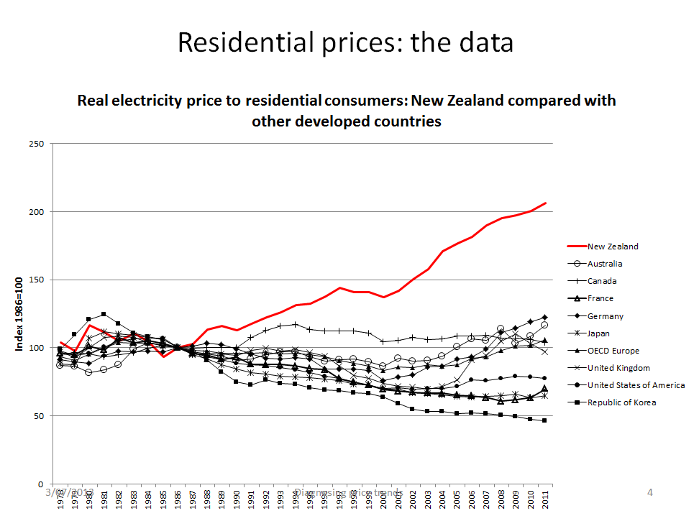
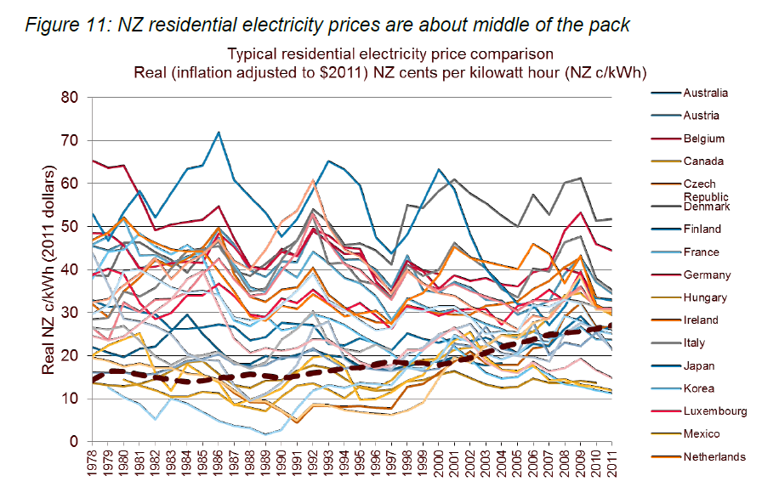
Presentation of the IEA price data

Slide 8
Inflated asset values, Dr Layton says, are “a myth” because
“53…..[Gentailers] are not regulated entities with market power setting their prices off their own asset valuations. There are five major generators and a whole lot of others as well, and the barriers to entry into being a generator are low. …
54. The generation market is workably competitive and, in such a market, prices are set by the interplay of supply and demand. Prices determine the returns parties receive for output and returns determine asset values and not vice versa.
55. The claims that generators are using asset revaluations to ratchet up prices are based on confusion over what determines asset values in a regulated market with what determines them in a workably competitive one.”
Layton 2013 p.15
I disagree, but save this for another occasion
(but see my IGPS seminar presentation of 24 May 2013, “Asset revaluations, price gouging, and barriers to entry: the state of play in electricity sector non-regulation”)

Slide 9
The “regulatory bargain”
“45. In order to remove past windfall gains from existing generators it would be necessary to make decisions to transfer wealth from them to consumers and bear the undesirable chilling effects this would have on the willingness of parties to invest in future in electricity and probably other sectors.
…
49. A variant on the previous criticism is that most of New Zealand’s older hydro-generation assets were built a very long time ago by the government (by the NZ Electricity Department, or NZED) and have been fully depreciated and paid off. According to those promoting this criticism, there is no need to include any payment for the cost of capital in the price of electricity produced from these plants.
50. The problems with this reasoning are that NZED’s generation assets were transferred to SOE’s and/or privatised on the basis of their earning capacity at the time of the transfer. Moreover, they were transferred on the basis that the new owners would receive the benefits of any unexpected increases and bear the costs of any unexpected decreases in electricity prices subsequent to the transfer.
51. To now determine that the return on capital will be set by regulators, and windfall gains and losses will not be permitted, breaches the implicit regulatory bargain entered into by the Crown when it transferred the assets. It can be open to a regulator to do such a thing, but the consequence would be to have a chilling effect on investment in the electricity sector, and probably elsewhere. This would not bring long-term benefits to consumers.
Layton 2013 pp.13-14, emphasis added

Slide 10
First key plank of the supposed bargain: The asset valuations of the new generation companies were set to capitalise their earning capacity at the time of the transfer.
Absolutely correct.
Mighty River, Genesis, and Meridian Energy all undertook “fair value” exercises to re-set their fixed asset values as at April 1999 when they took over the assets from ECNZ
(The actual sale-and-purchase transactions were at ECNZ’s historic-cost book values, and all three SOEs were required to re-set their asset valuations to “fair value” afterwards).
Contact Energy actually conducted a write-down upon assuming control of its assets in 1996 but thereafter undertook regular “fair-value” revaluations starting in 1999
Trustpower moved to “market-value” valuation in 2001, after initially carrying its fixed assets at acquisition cost.
These early valuations suggest no expectation that prices and revenues would rise dramatically in the foreseeable future

Slide 11
Second key plank in Layton’s supposed “bargain”: subsequent increases in prices and asset values were “unexpected” and hence can be described as “windfalls”, which the new owners were fully entitled to enjoy without any fear of subsequent clawback
Were the revaluations “unexpected windfalls”, or the result of the new owners deliberately shaking the tree once they had got their hands on it (that is, “post-contractual opportunism”)?
This is central to the issue of whether the revaluations were consistent with any “implicit regulatory bargain” to which the Government, as original owner, must presumably have been a willing party.

Slide 12
What did the Government party reasonably expect price and asset-value outcomes to be under the regulatory bargain?
There is an extensive, and very explicit, record of what the Government of the day expected to happen, back in 1997-1999 when the ECNZ assets were transferred
The two key outcomes intended from the Bradford reforms were
  Lower prices, especially to residential consumers
  Greater choice of retail supplier for consumers
If there was an implicit bargain, it must have involved the gentailers dropping prices, especially for residential consumers

Slide 13
Hon Max Bradford, 16 September 1997, Hansard Vol.563 p.4289
“… we have kept our options open to ensure that we are able to deliver lower real prices to household consumers. We will do that in whatever way we can.”

Slide 14
Hon Max Bradford, 19 May 1998, Hansard Vol.558 p.9151
“The electricity reforms are about getting a better deal for all consumers. They will deliver choice and lower electricity prices. In this way the Government is also seeking to improve significantly our international competitiveness by lowering the energy costs for business.”

Slide 15
Hon Warren Kyd (National, Hunua) 19 May 1998 Hansard Vol.558 p.9156
“The idea behind this legislation is to lower the cost of electricity for people, for workers, for widows, for children, and for business. They will be able to get cheaper electricity because of this Bill. …. [I]f we have true competition the cost of energy for businesses will be lower and they will become more internationally competitive. That is the compulsion for this legislation. That is the need for urgency. This legislation will allow domestic consumers and our businesses to get cheaper power so that we can be more competitive internationally.”

Slide 16
Hon Peter Brown (NZ First) 19 May 1998 Hansard Vol.558 pp.9159-9160
“… the coalition Government is committed to delivering a better deal for ordinary New Zealanders. The driving force behind this reform is the delivering of lower prices for electricity consumers”
“We are proposing to split ECNZ into three competing State-owned enterprises. This will lead to greater competition in wholesale electricity and a fall in wholesale prices. The result will be lower prices for consumers….”
“We believe that the three-way split will pave the way for greater choice and lower power bills for consumers. New Zealand First acknowledges that some in the electricity industry have a number of concerns in relation to this bill, but we have decided that those concerns must be balanced against the long-term benefits to consumers and the economy as a whole. The reforms contained in this Bill will deliver these benefits to those domestic consumers who have so far not benefited from the gains made by earlier reforms.

Slide 17
Hon Bob Simcock (National) 19 May 1998 Hansard Vol.558 p.9162
“I want to state some simple facts. These reforms are occurring because we want to reduce the price of electricity to consumers.”

Slide 18
Hon Gerry Brownlee (National) 30 June 1998 Hansard Vol.558 p.10368
“I am pleased that this Government is about the business of lowering electricity prices for New Zealand consumers.”

Slide 19
Electricity Industry Reform Act 1998
“2.The purpose of this Act is to reform the electricity industry in order to better ensure that
costs and prices in the electricity industry are subject to sustained downward pressure; and
the benefits of efficient electricity pricing flow through to all classes of consumers.”

Slide 20
Hon Bill Birch (National) 30 June 1998 Hansard Vol.558 p.10555
“Five years ago the then board and management of ECNZ advised Government Ministers they could expect that the real price of electricity would continue to increase at 2 percent a year. The Government at that time decided to embark on a series of reforms of the electricity sector because we were convinced that it was unnecessary for the consumers of electricity in this country to face those sorts of real price increases. It was our firm belief that by introducing more competition into the electricity sector, both in relation to generation and in relation to distribution and retail, we could not only reduce prices to the consumer, but drive down the cost of supplying electricity”.

Slide 21
Hon John Luxton (National) 30 June 1998 Hansard Vol.558 pp.10569-10570
“People in the market place have worked out that power prices will be lower….. I have to say that unfortunately the same thing will happen to the Government’s balance sheet. As ECNZ is split up and as competition comes into the market place, it will take some money off the Government’s balance sheet….. [T]he return on power assets will be lower, because power prices will be lower for ordinary New Zealanders. That is why the Government is making these changes”

Slide 22
Marta Steeman, “Power reform hits credibility snag”, Dominion 10 April 1999
CONSUMERS will be rightly considering whether the much-trumpeted benefits from the huge changes to the electricity industry are a figment of Commerce Minister Max Bradford's imagination after TransAlta announced big power price rises for more than half a million customers.
The Government has only itself to blame for building up consumer expectations of price reductions. At important steps along the way of the reform process, the Government has taken the opportunity to sell the changes as bringing wholesale electricity price falls of 10 per cent and, by implication, falls in prices to consumers.
Now the electricity reforms have struck a credibility problem only days after the official split of the Electricity Corporation into three smaller businesses.
Consumers can probably be persuaded that the reforms will take time to deliver benefits and to expect price falls over time, but price rises are not part of the bargain. [emphasis added]

Slide 23
So outcomes 2000-2012 do not match the stated expectations on the Government side of the bargain
What, exactly, was “unexpected” about the “windfall” gains of 2000-2012?
They were not unforeseeable, if the gentailers were left free to act opportunistically and then did so
The expectation seems to have been that foreseeable increases would be forestalled by gentailer restraint under light-handed regulation
The disappointment of that expectation looks very like a breach of the implicit regulatory bargain – by the industry

Slide 24
True “windfalls” are gifts of nature that fall unexpectedly from the sky, to be appropriated by whoever finds themselves by chance to be underneath the tree at the time.
The term does not apply well to the outcome of a deliberate process of price-gouging of vulnerable captive consumers, with the resulting transfers of wealth from the poor crystallised as book-value revaluations - even when those revaluations enjoy formal legitimacy under generally accepted accounting practice.

Slide 25
Recapturing from the gentailers the chunk of wealth they have extracted from consumers is inevitably going to be characterised as “expropriation” or “a taking”
But the credible threat of retrospective clawback is central to effective light-handed regulation
Recall that the Electricity Authority itself was been obliged to embark on such retrospective, ex-post reversal of undesirable wealth transfers in the case of the Undesirable Market Transaction (UTS) of 26 March 2011.
Is there a statute of limitations in the implicit regulatory bargain covering gentailer prices and asset values?

Slide 26
Rolling book values back to historic cost will involve wealth transfers
Defenders of the status quo argue that such transfers – which they will no doubt label “a taking” - will have a “chilling” effect on large-corporate investment
This may well be true: wealth transfers usually chill the losers while they warm the winners – which is why I have never agreed with that old Treasury notion that wealth transfers are welfare-neutral
The transfer since 1999 of $11.4 billion of household wealth to the gentailers’ balance sheets has certainly had a chilling effect – literally, as houses go unheated, kids suffer respiratory illnesses, and rising power bills squeeze households’ ability to pay for other basic needs
Reversing that transfer will be controversial – properly a matter for the Parliament and thus the electorate
So the Labour-Greens policy initiative in advance of the next election campaign is to be applauded and welcomed

